Slide 1
PAKISTAN'S PREMIUM OUTDOOR MEDIA NETWORK
DIGITAL NETWORK PORTFOLIO · 2026
TCF
TAGLINE
Define
the View.
Digital streamers & pylons. Owned end-to-end.
M E D I A G R O U P
TCF MEDIA GROUP
tcfmediagroup.com
MEDIA OWNER · AGENCY · POWERHOUSE
LAHORE · ISLAMABAD · KARACHI
Notes:
1

Slide 2

WHO WE ARE · 01
Media Owner.
Agency.
Powerhouse.
26+
#1
YEARS OF
BILLBOARD
Dominance in OOH
Network in Pakistan
360°
300ft
TCF Media Solutions is Pakistan's only company that combines media ownership with full-service 360° marketing. We own the assets, design the strategy and execute every campaign from idea to impact.
With exclusive rights on M2 Motorway and Pakistan's largest billboard at 300 ft × 30 ft — we don't just advertise. We dominate.
MARKETING
LARGEST
Full-Service Powerhouse
Billboard in Pakistan
TCF MEDIA GROUP
MEDIA OWNER · AGENCY · POWERHOUSE
2 / 28
Notes:
2

Slide 3






WHY TCF WINS · 02
The Unfair Advantages
That Set Us Apart
01
02
03
MEDIA OWNER + AGENCY
EXCLUSIVE RIGHTS
MASSIVE INVENTORY
Unmatched control & agility. No middlemen — we own every asset we advertise on.
M2 Motorway. DHA Lahore and Prime locations — locked.
Pakistan's biggest billboard network including the 300×0 ft largest in the country.
04
05
06
OFFICIAL PARTNER
REAL-TIME EXECUTION
TRUSTED BY GIANTS
Formally partnered with DHA and FWO — Pakistan's most prestigious authorities.
Live campaign monitoring, in-house creative teams, rapid turnaround.
KFC, Coca-Cola, Bahria Town, Gul Ahmed, Shaukat Khanum — and many more.
TCF MEDIA GROUP
THE UNFAIR ADVANTAGES THAT SET US APART
3 / 28
Notes:
3

Slide 4
OUR NETWORK · 03
Pakistan's motorways,
owned end-to-end.
M2
FWO / NHA
FULL M2
AUTHORITY
Lahore → Islamabad
Every Toll Plaza
Contract Partner
Official Rights
TCF Media Group operates Pakistan's most extensive motorway OOH network. Our inventory spans the full Lahore–Islamabad M2 corridor, the LHR–Sialkot M12, and the Swat Motorway into KPK — built in partnership with FWO, the National Highway Authority, and direct rights-holders.
TCF MEDIA GROUP
M2 · M12 · SWAT MOTORWAY
4 / 71
Notes:
4

Slide 5
WHY MOTORWAY · 04
A captive audience,
for four hours straight.
The Lahore–Islamabad M2 is Pakistan's single busiest long-haul corridor. Between 80,000 and 100,000 vehicles travel it every day — and each passenger spends roughly four uninterrupted hours on the road. For a brand, that's the kind of dwell time no urban billboard, radio spot, or streaming ad can match.
80K–100K
~4 HRS
2.4M+
VEHICLES DAILY
EXPOSURE PER TRIP
MONTHLY IMPRESSIONS
on the M2 corridor alone
uninterrupted, captive audience
per premium placement
TCF MEDIA GROUP
WHY MOTORWAY ADVERTISING WINS
5 / 71
Notes:
5

Slide 6
TCF MEDIA GROUP · DIGITAL NETWORK PORTFOLIO
DHA STREAMERS
— SECTION OVERVIEW
01
DHA
Streamers.
Digital LED streamers running across DHA Lahore's Phase 6 and Phase 8 corridors — premium roadside placements with continuous brand exposure.
DEFINE THE VIEW
tcfmediagroup.com
Notes:
4

Slide 7
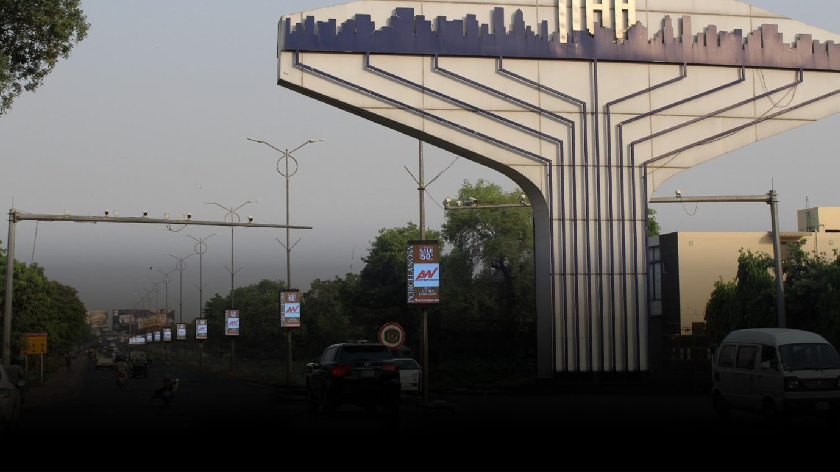

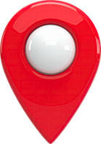
DHA MAIN ENTRANCE To Masjid Chowk
Quantity
POLES: 22
STREAMERS: 44
3 × 6 ft
SIZE
IDX 798201
MOV
Impressions
2,196,041
Streamers

Slide 8
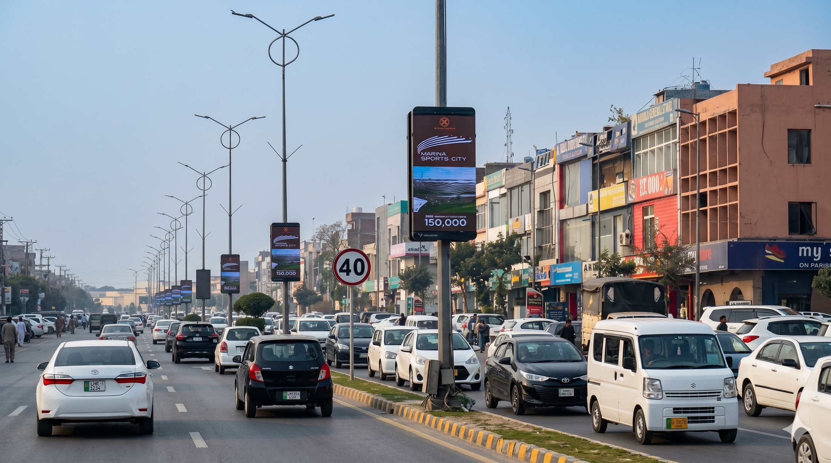
MASJID CHOWK TO LALIK JAN UNDERPASS, H BLOCK
Quantity
POLES: 19
STREAMERS: 38
3 × 6 ft
SIZE
IDX 798203
MOV
Impressions
2,119,987
Streamers

Slide 9
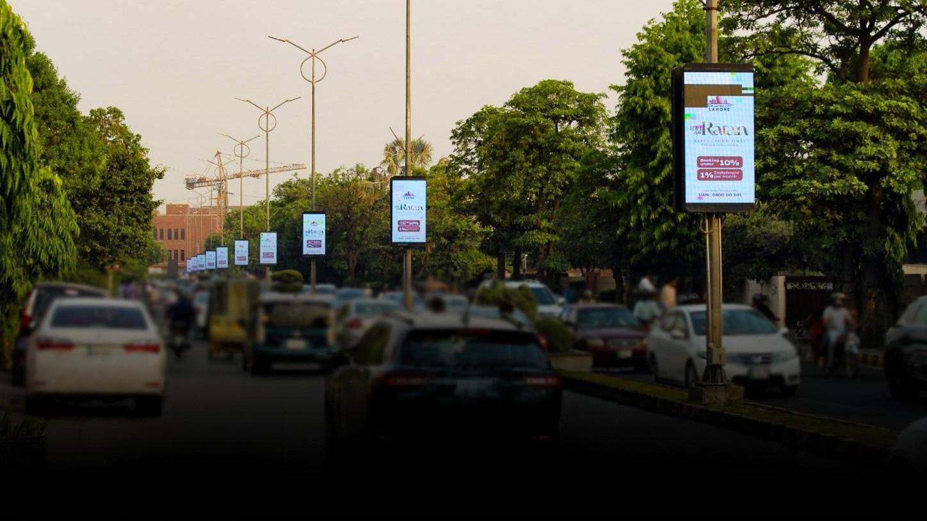
LALIK JAN UNDERPASS To
LUMS Chowk, DHA Lahore
Quantity
POLES: 26
STREAMERS: 52
3 × 6 ft
SIZE
IDX 792168
MOV
Impressions
1,972,262
Streamers

Slide 10
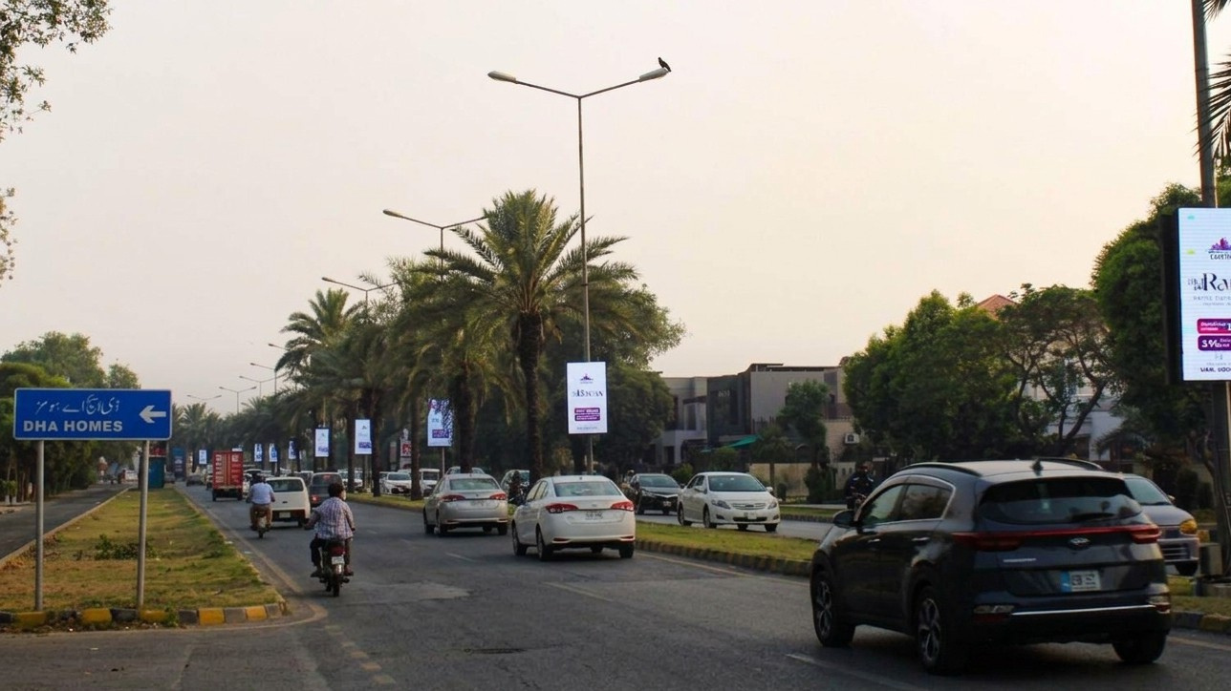
LUMS TO WATEEN CHOWK, DHA PHASE 5 LAHORE
Quantity
POLES: 21
STREAMERS: 42
3 × 6 ft
SIZE
IDX 800771
MOV
Impressions
1,975,019
Streamers

Slide 11
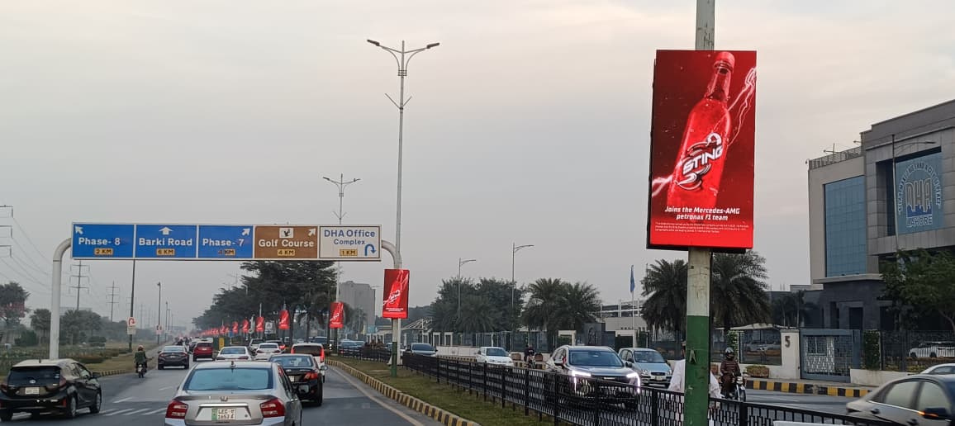
PHASE 6 A Main DHA office to Underpass
Quantity
POLES: 26
STREAMERS: 52
3 × 6 ft
SIZE
IDX 800716
MOV
Impressions
1,011,871
Streamers

Slide 12
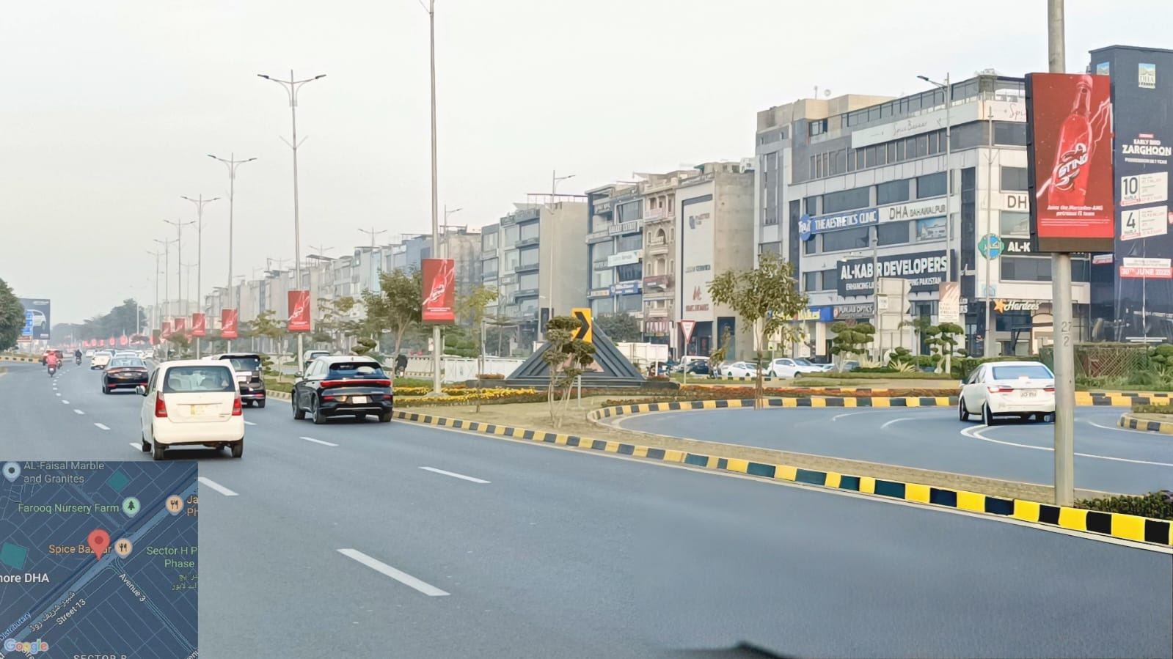
PHASE 6 B
Underpass to Meezan Bank
Quantity
POLES: 26
STREAMERS: 26
3 × 6 ft
SIZE
IDX 801609
MOV
Impressions
1,004,826
Streamers

Slide 13
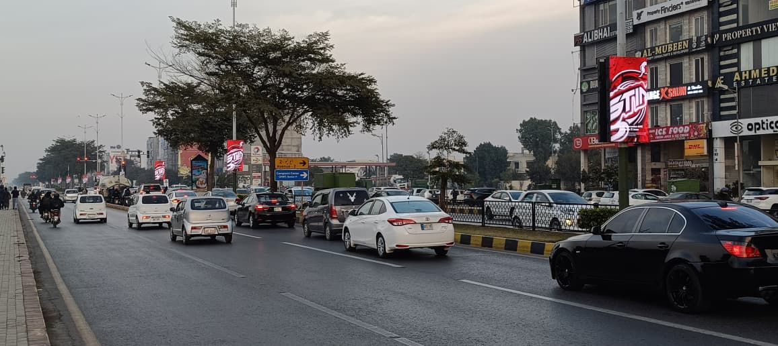
PHASE 6 C
Meezan Bank to Braodway Chowk
Quantity
POLES: 21
STREAMERS: 42
3 × 6 ft
SIZE
IDX 801609
MOV
Impressions
1,004,826
Streamers

Slide 14
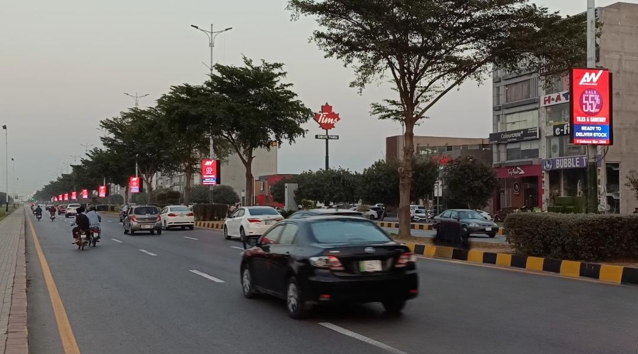
PHASE 6 D
BROADWAY CHOWK TO TIM HORTONS
Quantity
POLES: 20
STREAMERS: 40
3 × 6 ft
SIZE
IDX 801609
MOV
Impressions
1,004,826
Streamers

Slide 15
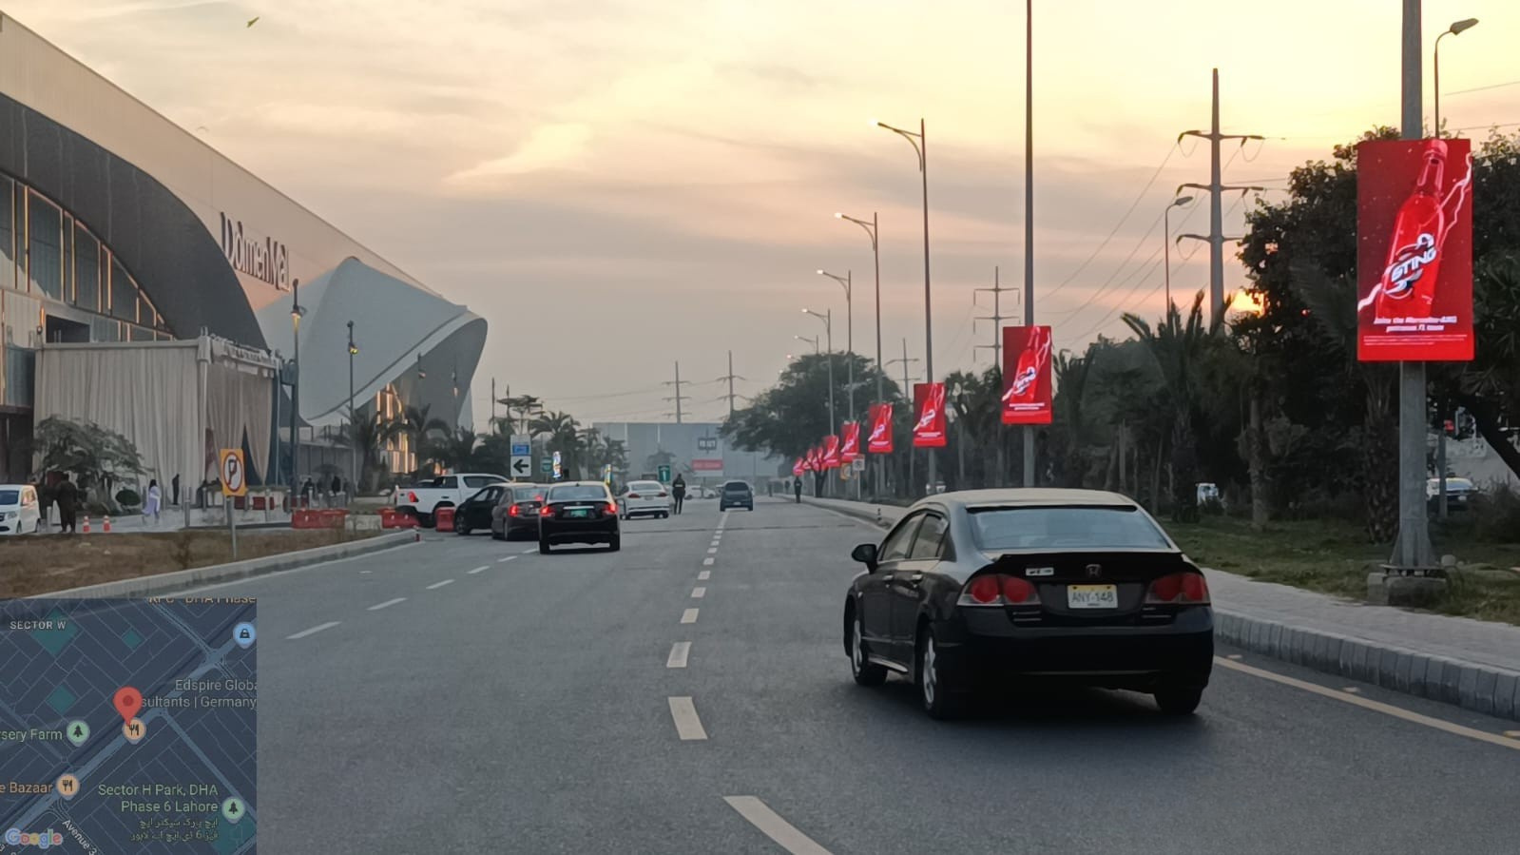
INFRONT OF DOLMEN MALL DHA PHASE 6 LAHORE
Quantity
POLES: 15
STREAMERS: 30
3 × 6 ft
SIZE
IDX 802009
MOV
Impressions
794,050
Streamers

Slide 16
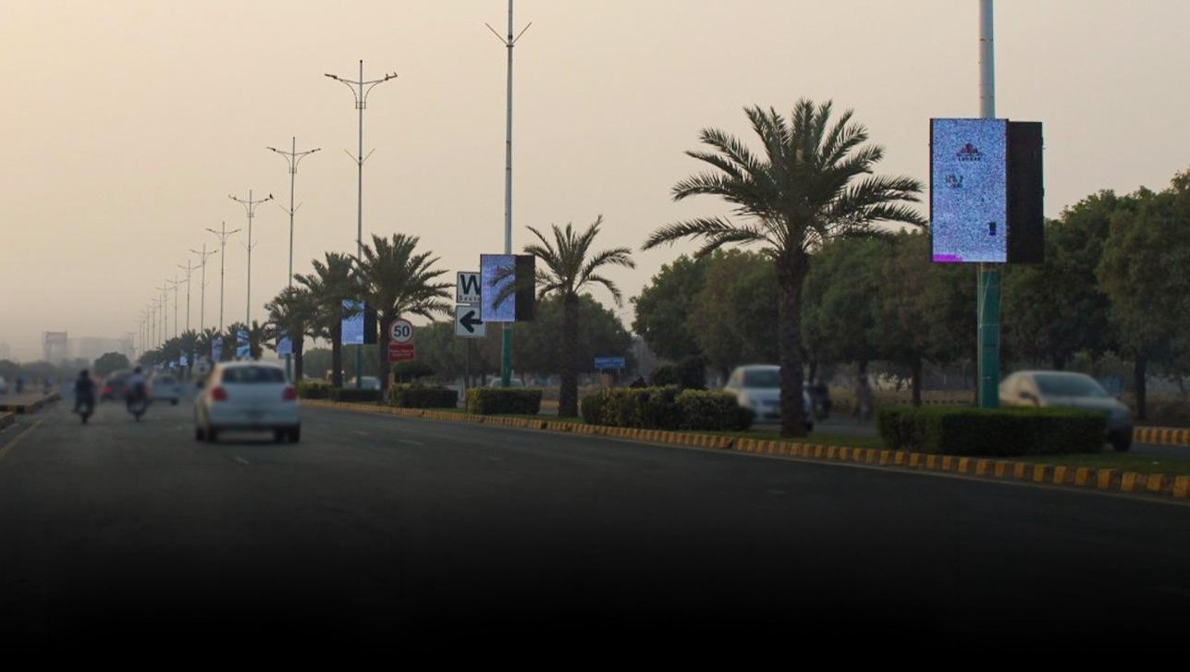
PHASE 8 A
Broadway Road
Quantity
POLES: 25
STREAMERS: 50
3 × 6 ft
SIZE
IDX 800723
MOV
Impressions
1,005,796
Streamers

Slide 17
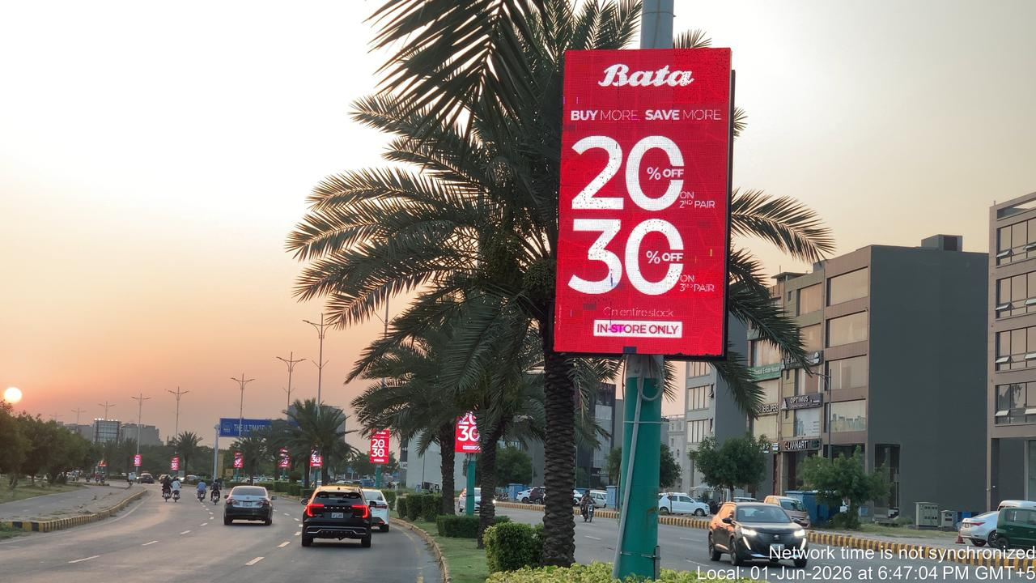
DHA Phase 8 B Commercial Ring Road
Quantity
POLES: 15
STREAMERS: 30
3 × 6 ft
SIZE
IDX 801113
MOV
Impressions
1,005,796
Streamers

Slide 18
TCF MEDIA GROUP · DIGITAL NETWORK PORTFOLIO
DHA STREAMERS
— SECTION OVERVIEW
02
Gulberg
Streamers.
Digital LED streamers across Gulberg's prime commercial corridors — high-traffic retail, dining and lifestyle zones in central Lahore.
DEFINE THE VIEW
tcfmediagroup.com
Notes:
16

Slide 19
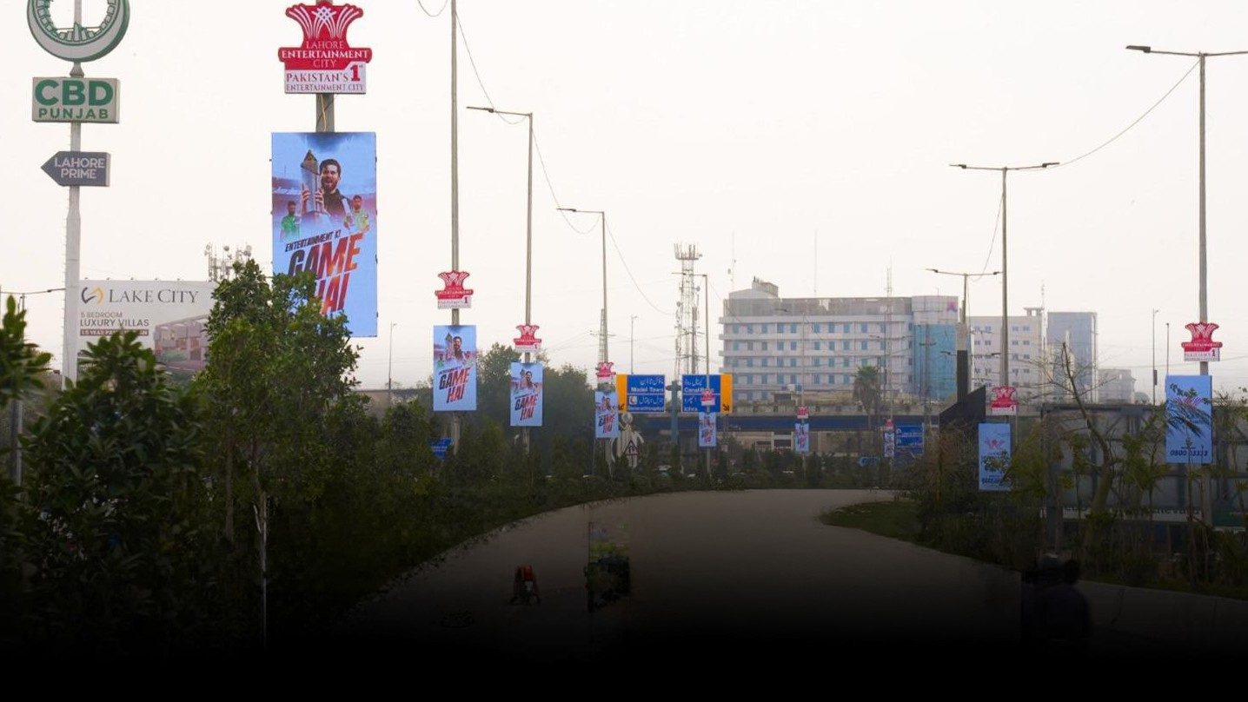
CBD Kalma Chowk
Quantity
POLES: 18
STREAMERS: 25
3 × 6 ft
SIZE
IDX 797912
MOV
Impressions
2,730,919
Streamers

Slide 20
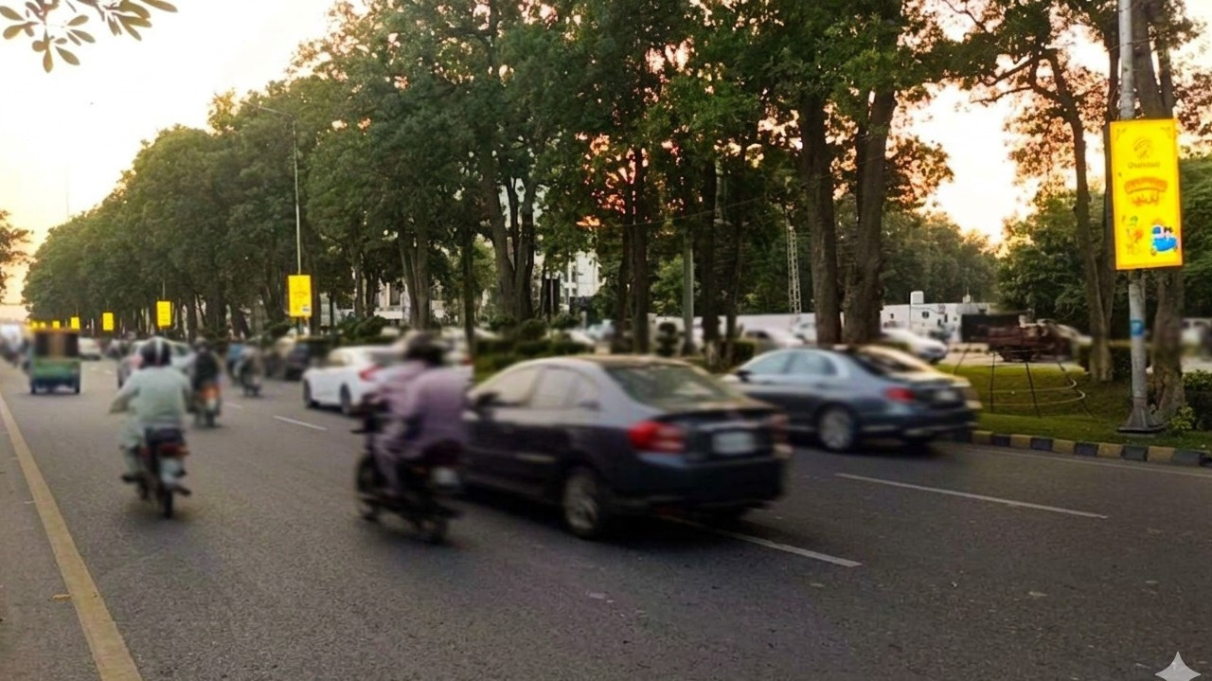
Center Point to UCH
Quantity
POLES: 20
STREAMERS: 20
3 × 6 ft
SIZE
IDX 802714
MOV
Impressions
3,101,908
Streamers

Slide 21
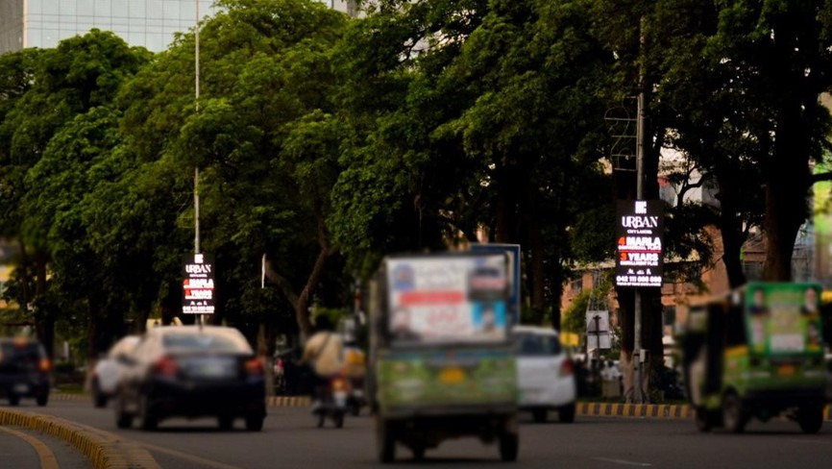
UCH to Askari Tower LIBERTY ROUNDABOUT
Quantity
POLES: 22
STREAMERS: 25
3 × 6 ft
SIZE
IDX 801112
MOV
Impressions
3,077,845
Streamers

Slide 22
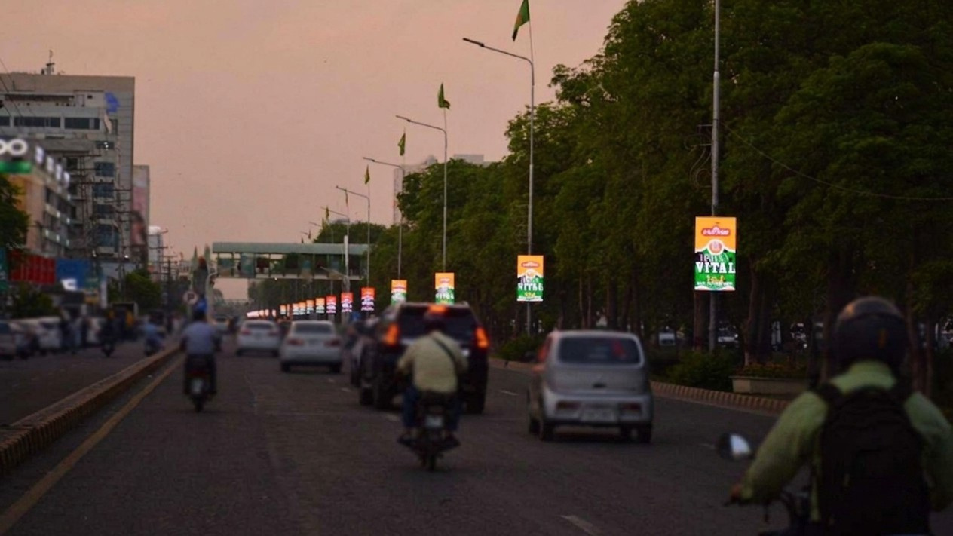
Askari Tower Eden Center Hafeez Centre
Quantity
POLES: 34
STREAMERS: 34
3 × 6 ft
SIZE
IDX 801110
MOV
Impressions
3,077,845
Streamers

Slide 23
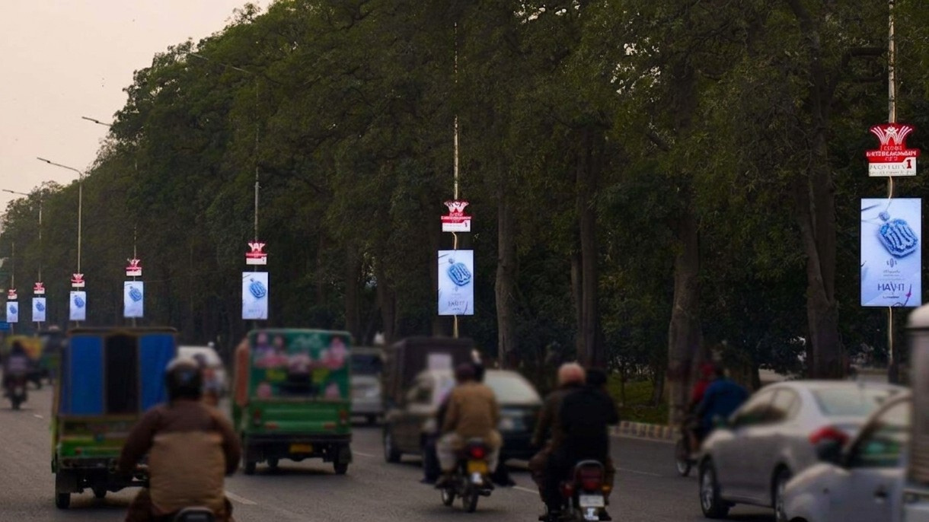
Eden center To Main market Zahoor Ilahi Road
Quantity
POLES: 33
STREAMERS: 33
3 × 6 ft
SIZE
IDX 801108
MOV
Impressions
3,015,445
Streamers

Slide 24
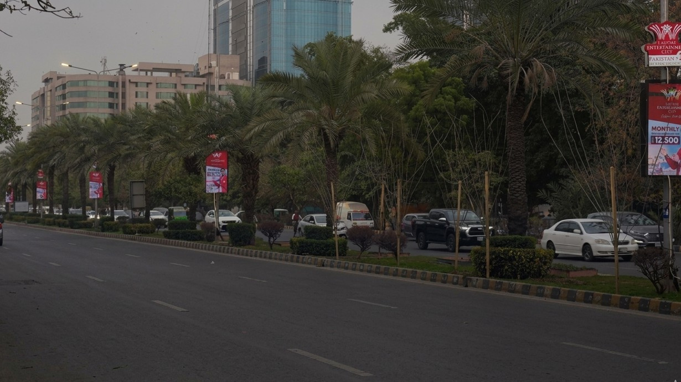
Main Market To Sadiq Trade Center (Gulberg)
Quantity
POLES: 38
STREAMERS: 38
3 × 6 ft
SIZE
IDX 793076
MOV
Impressions
3,015,445
Streamers

Slide 25
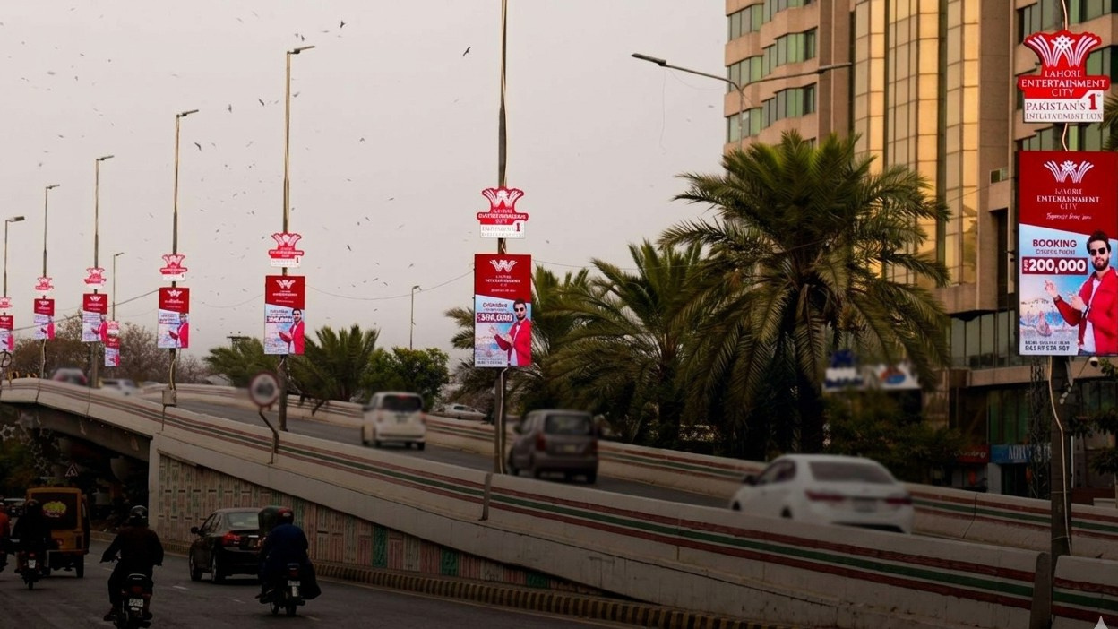
Sadiq Trade Center Flyover
Quantity
POLES: 13
STREAMERS: 13
3 × 6 ft
SIZE
IDX 801113
MOV
Impressions
1,597,217
Streamers

Slide 26
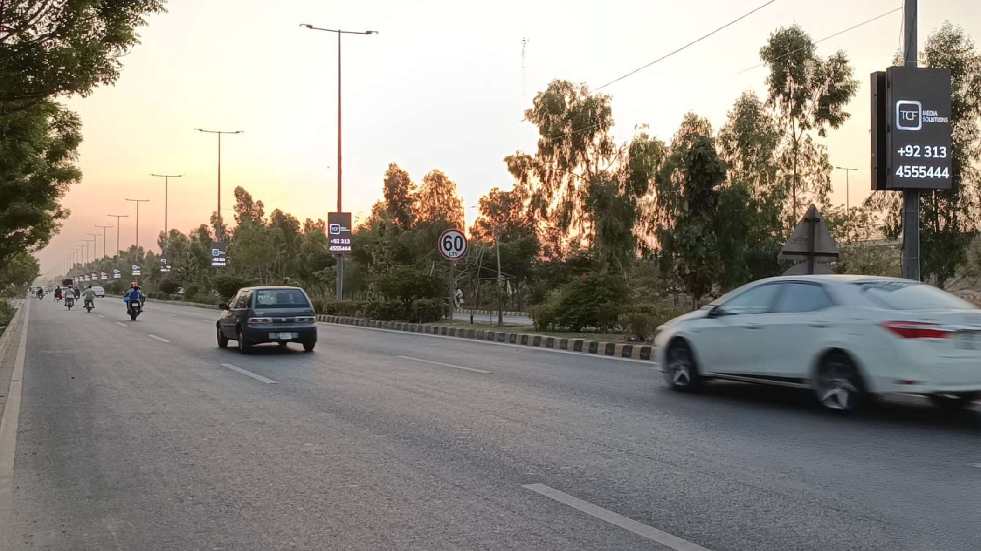
Lake City Roundabout to KFC
Quantity
POLES: 28
STREAMERS: 48
3 × 6 ft
SIZE
IDX 801747
MOV
Impressions
597,909
Streamers

Slide 27
TCF MEDIA GROUP · DIGITAL NETWORK PORTFOLIO
DHA STREAMERS
— SECTION OVERVIEW
03
Digital
Pylons.
Premium digital pylon displays at landmark DHA Lahore locations — high-impact 8 × 12 ft vertical formats at marquee chowks and entry points.
DEFINE THE VIEW
tcfmediagroup.com
Notes:
25

Slide 28
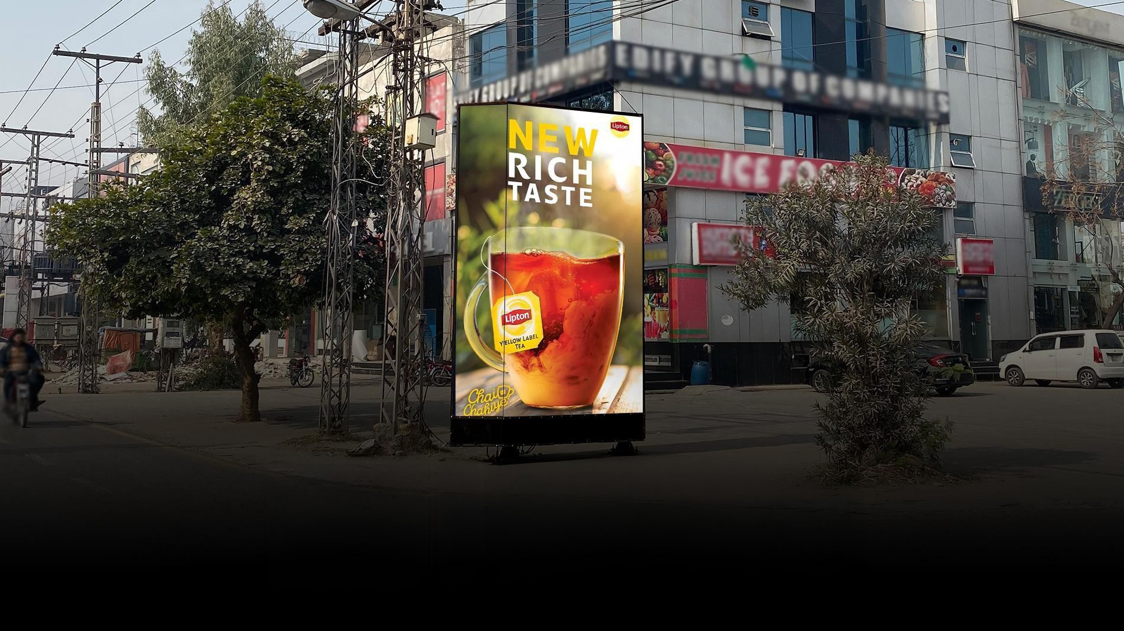
Y-Block Market Dha Lahore
Quantity
1 Digital Pylon
3D Signage Height: 12 ft
Width: 8 ft
SIZE
IDX 801893
MOV
Streamers

Slide 29
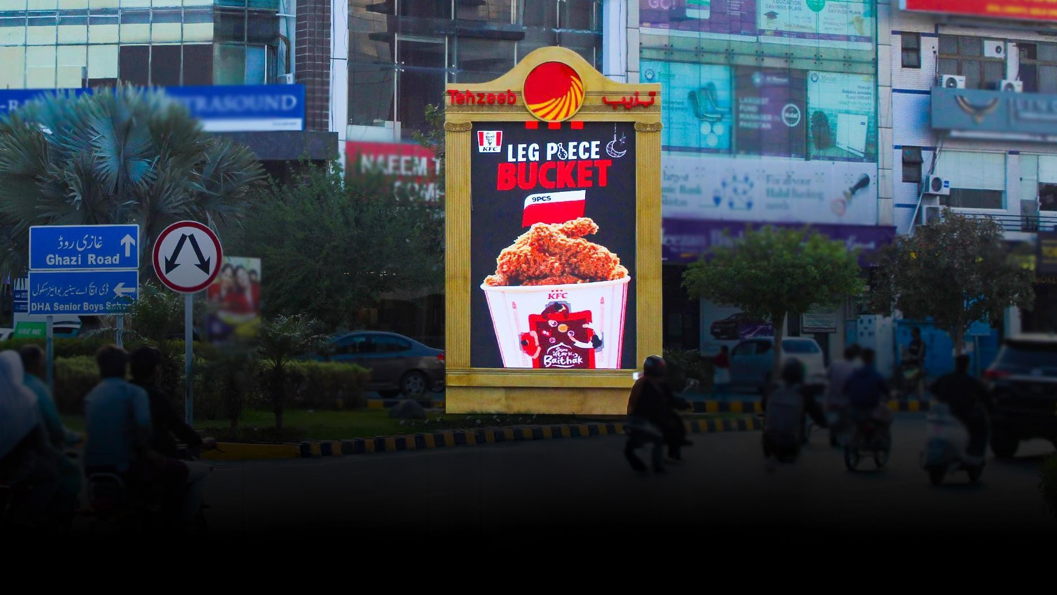
Lalik Jan Chowk
From LUMS, DHA Lahore
Quantity
1 Digital Pylon
Width: 8 ft
Height: 12 ft
SIZE
IDX 801918
MOV
Streamers

Slide 30
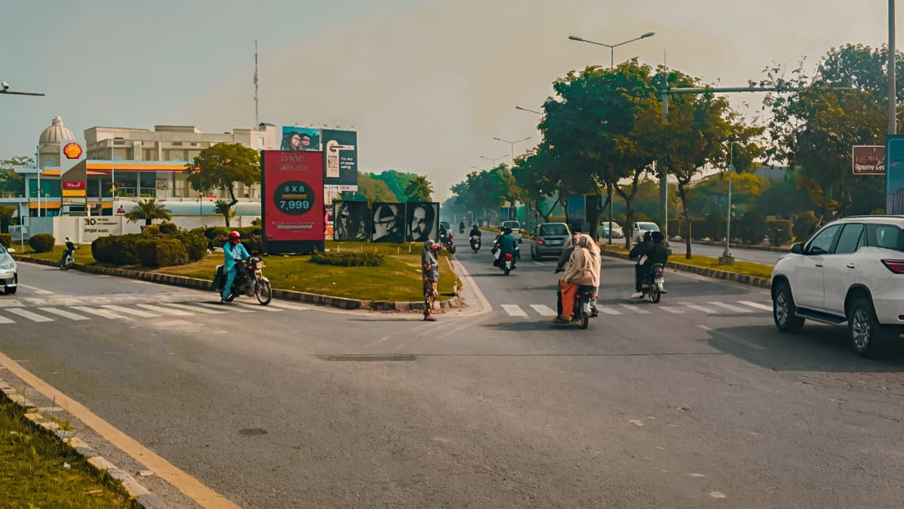
Education City Chowk DHA Phase 5
Quantity
1 Digital Pylon
Width: 8 ft
Height: 12 ft
SIZE
IDX 802006
MOV
Streamers

Slide 31
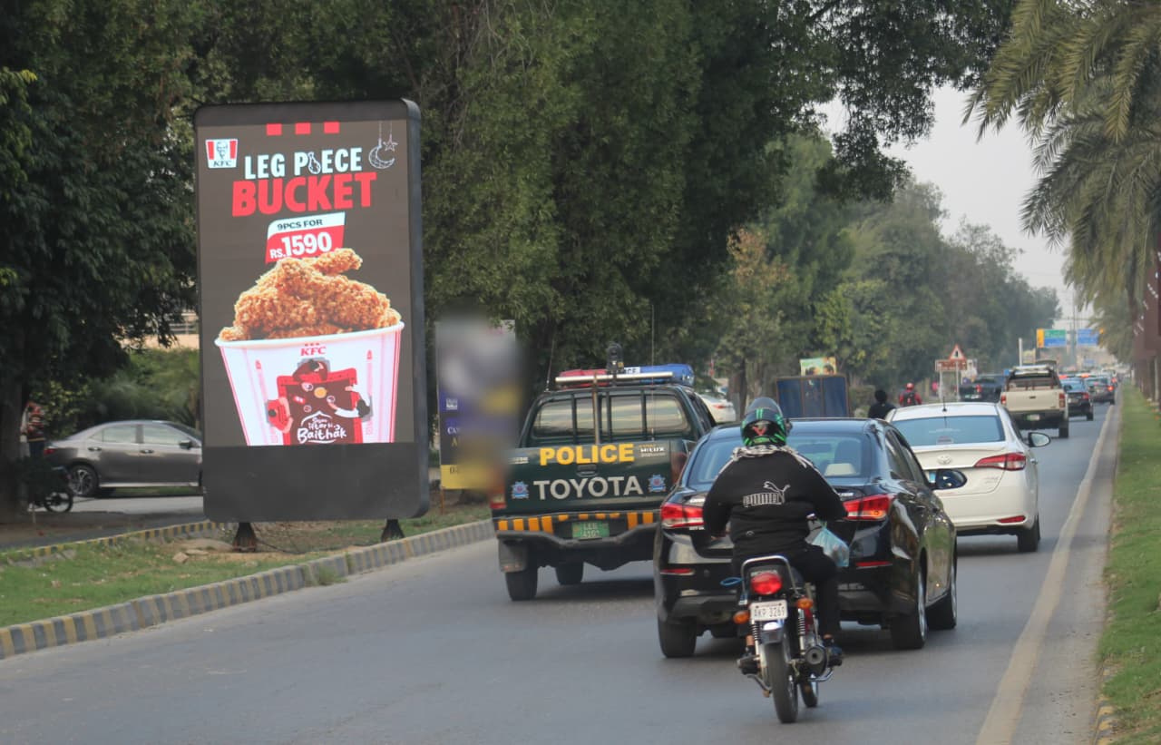
Pakistan Chowk
Phase 5 to Phase 6, DHA Lahore
Quantity
1 Digital Pylon
Width: 8 ft
Height: 12 ft
SIZE
IDX 802145
MOV
Streamers

Slide 32
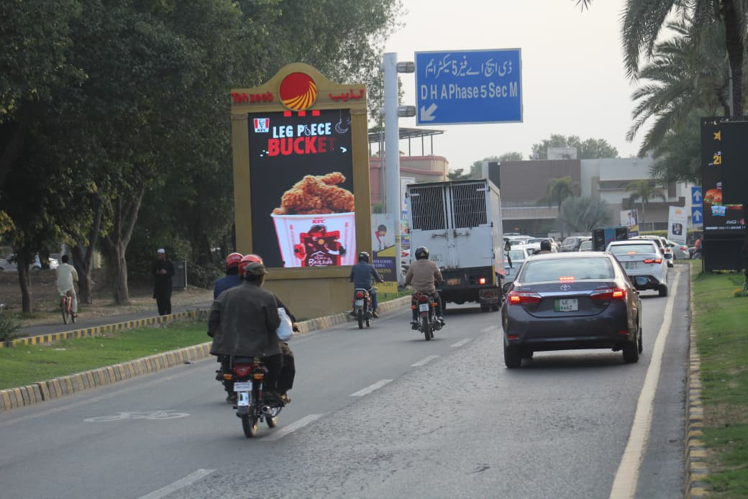
Pakistan Chowk
Phase 6 to Phase 5, DHA Lahore
Quantity
1 Digital Pylon
Width: 8 ft
Height: 12 ft
SIZE
IDX 802028
MOV
Streamers

Slide 33
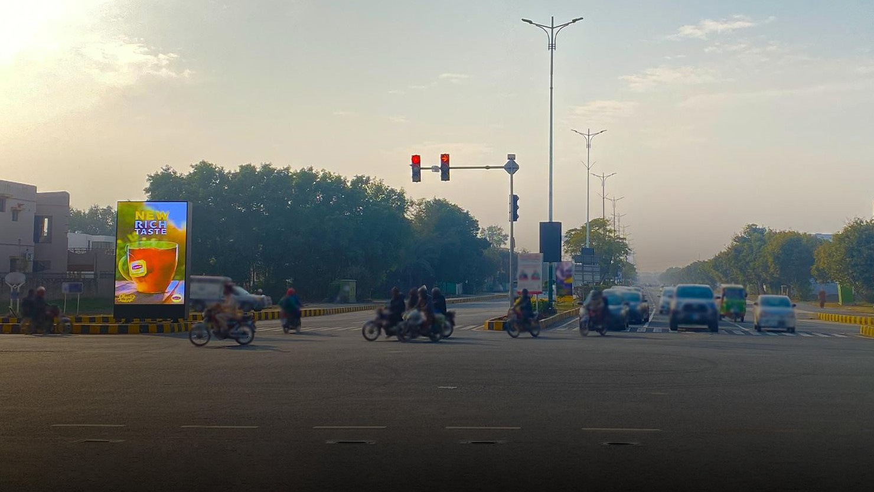
RAYA EXIT FAIRWAYS
Left Triangle DHA 6 Lahore
Quantity
1 Digital Pylon
Width: 8 ft
Height: 12 ft
SIZE
IDX 802007
MOV
Streamers

Slide 34
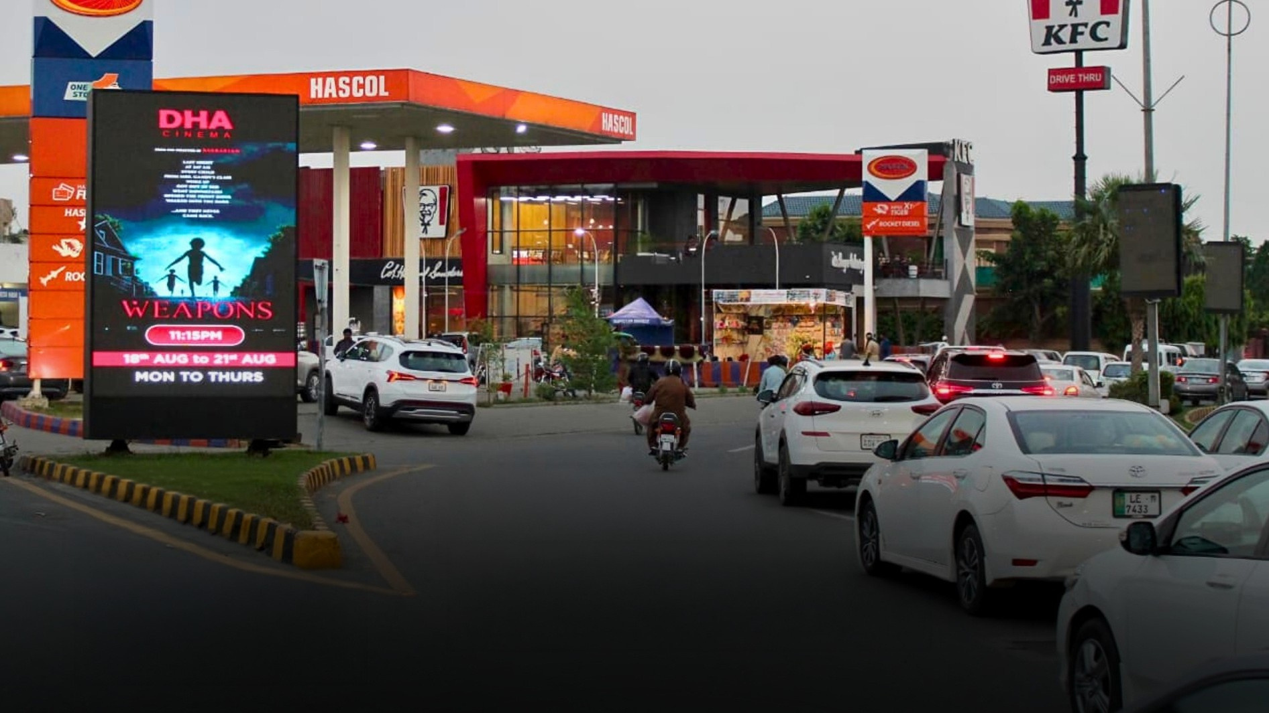
DHA Cinema Chowk Near Hascol Petrol Pump, DHA Lahore
Quantity
1 Digital Pylon
Width: 8 ft
Height: 12 ft
SIZE
IDX 802250
MOV
Streamers

Slide 35
TCF MEDIA GROUP · DIGITAL NETWORK PORTFOLIO · 2026
GET IN TOUCH
CONTACT
Let's work
together.
Get in touch.
PHONE
+92 313 455 5444
+92 310 855 5521
WEB
tcfmediagroup.com
OFFICE
Define the View.
46-A XX-Block, Khayaban-e-Iqbal,
DHA Lahore, Pakistan
Pakistan's premium outdoor media network —Billboards, digital streamers,
pylons and motorway billboards. Owned end-to-end.
Notes:
33

