Slide 1
PAKISTAN'S PREMIUM OUTDOOR MEDIA NETWORK
DIGITAL NETWORK PORTFOLIO · 2026
TCF
TAGLINE
Define
the View.
Digital streamers & pylons. Owned end-to-end.
M E D I A G R O U P
TCF MEDIA GROUP
tcfmediagroup.com
MEDIA OWNER · AGENCY · POWERHOUSE
LAHORE · ISLAMABAD · KARACHI
Notes:
1

Slide 2

WHO WE ARE · 01
Media Owner.
Agency.
Powerhouse.
26+
#1
YEARS OF
BILLBOARD
Dominance in OOH
Network in Pakistan
360°
300ft
TCF Media Solutions is Pakistan's only company that combines media ownership with full-service 360° marketing. We own the assets, design the strategy and execute every campaign from idea to impact.
With exclusive rights on M2 Motorway and Pakistan's largest billboard at 300 ft × 30 ft — we don't just advertise. We dominate.
MARKETING
LARGEST
Full-Service Powerhouse
Billboard in Pakistan
TCF MEDIA GROUP
MEDIA OWNER · AGENCY · POWERHOUSE
2 / 28
Notes:
2

Slide 3






WHY TCF WINS · 02
The Unfair Advantages
That Set Us Apart
01
02
03
MEDIA OWNER + AGENCY
EXCLUSIVE RIGHTS
MASSIVE INVENTORY
Unmatched control & agility. No middlemen — we own every asset we advertise on.
M2 Motorway. DHA Lahore and Prime locations — locked.
Pakistan's biggest billboard network including the 300×0 ft largest in the country.
04
05
06
OFFICIAL PARTNER
REAL-TIME EXECUTION
TRUSTED BY GIANTS
Formally partnered with DHA and FWO — Pakistan's most prestigious authorities.
Live campaign monitoring, in-house creative teams, rapid turnaround.
KFC, Coca-Cola, Bahria Town, Gul Ahmed, Shaukat Khanum — and many more.
TCF MEDIA GROUP
THE UNFAIR ADVANTAGES THAT SET US APART
3 / 28
Notes:
3

Slide 4
OUR NETWORK · 03
Pakistan's motorways,
owned end-to-end.
M2
FWO / NHA
FULL M2
AUTHORITY
Lahore → Islamabad
Every Toll Plaza
Contract Partner
Official Rights
TCF Media Group operates Pakistan's most extensive motorway OOH network. Our inventory spans the full Lahore–Islamabad M2 corridor, the LHR–Sialkot M12, and the Swat Motorway into KPK — built in partnership with FWO, the National Highway Authority, and direct rights-holders.
TCF MEDIA GROUP
M2 · M12 · SWAT MOTORWAY
4 / 71
Notes:
4

Slide 5
WHY MOTORWAY · 04
A captive audience,
for four hours straight.
The Lahore–Islamabad M2 is Pakistan's single busiest long-haul corridor. Between 80,000 and 100,000 vehicles travel it every day — and each passenger spends roughly four uninterrupted hours on the road. For a brand, that's the kind of dwell time no urban billboard, radio spot, or streaming ad can match.
80K–100K
~4 HRS
2.4M+
VEHICLES DAILY
EXPOSURE PER TRIP
MONTHLY IMPRESSIONS
on the M2 corridor alone
uninterrupted, captive audience
per premium placement
TCF MEDIA GROUP
WHY MOTORWAY ADVERTISING WINS
5 / 71
Notes:
5

Slide 6
TCF MEDIA GROUP · DIGITAL NETWORK PORTFOLIO
DHA STREAMERS
— SECTION OVERVIEW
02
BillBoards.
DEFINE THE VIEW
tcfmediagroup.com
Notes:
6

Slide 7
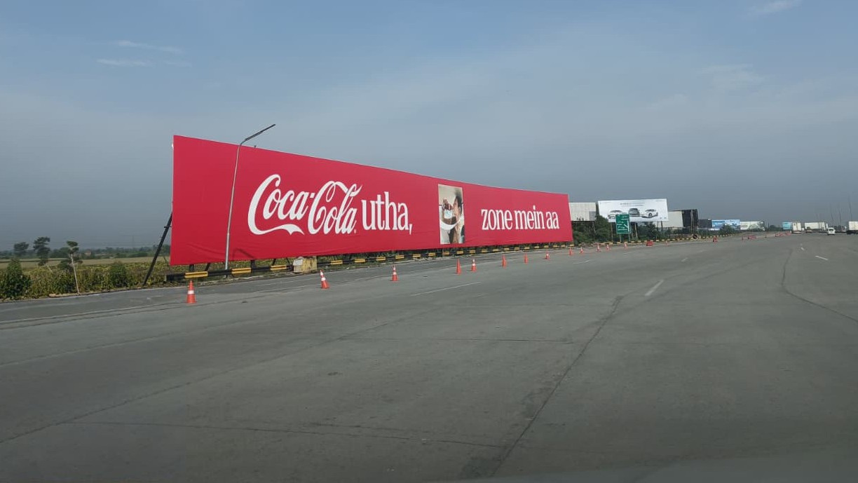

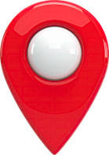
Ravi Toll Plaza Exit North Towards Islamabad
RATE / MONTHLY
3,000,000
300*30
SIZE
M2 MOTORWAY
Availability : 06-13-2026

Slide 8
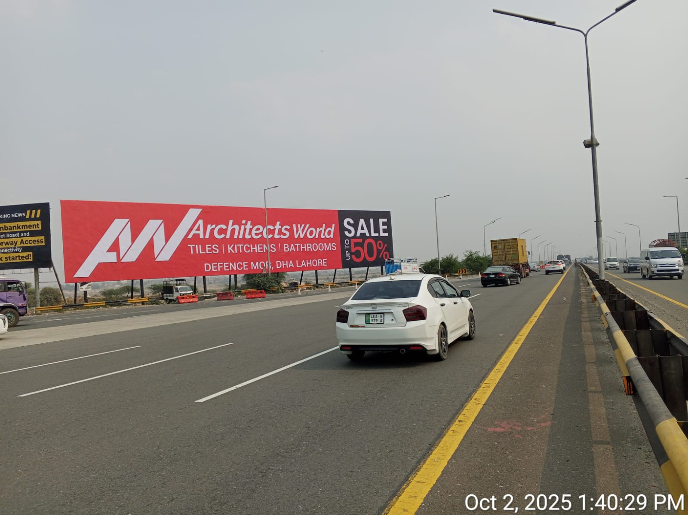
Ravi Toll Plaza Exit South
Towards LAHORE
RATE / MONTHLY
2,000,000
160*30
SIZE
M2 MOTORWAY
Availability : 06-13-2026

Slide 9
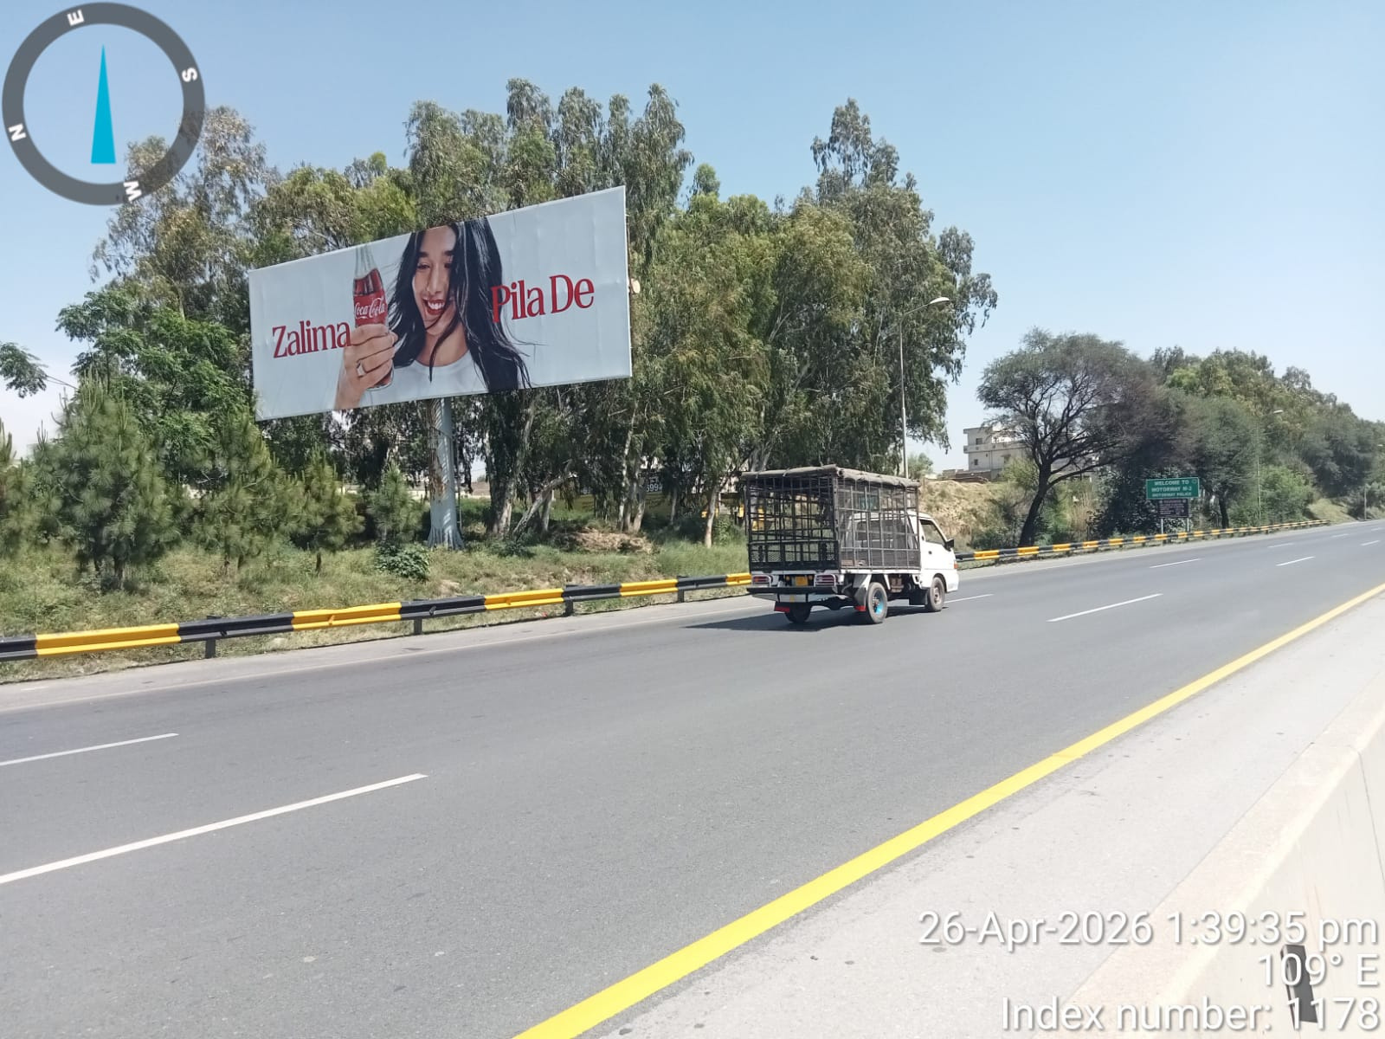
Islamabad Toll Plaza Exit South Towards Lahore
RATE / MONTHLY
1,000,000
60*20
SIZE
M2 MOTORWAY
Availability : 06-13-2026

Slide 10
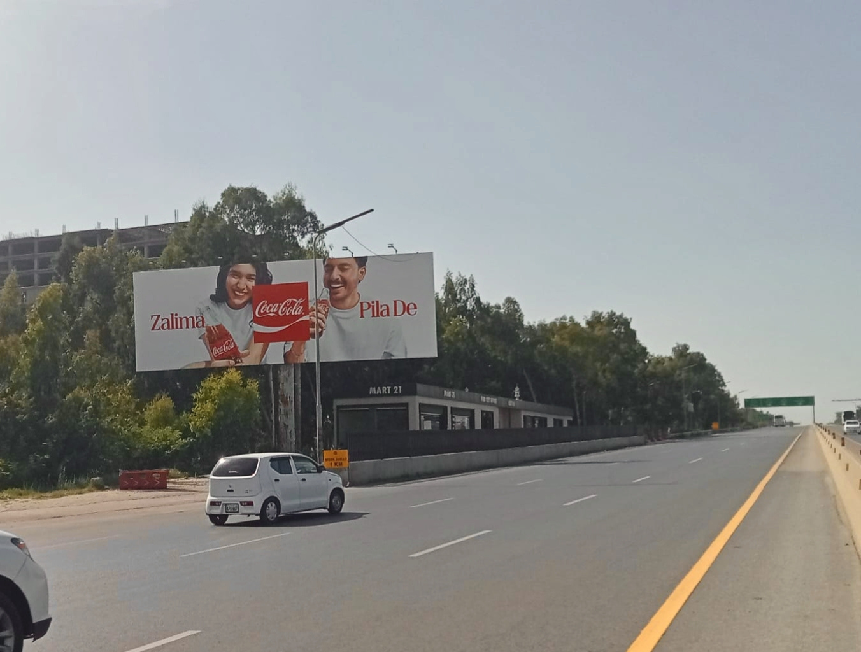
Islamabad Toll Plaza Exit North Towards Islamabad
RATE / MONTHLY
1,000,000
60*20
SIZE
M2 MOTORWAY
Availability : 06-13-2026

Slide 11
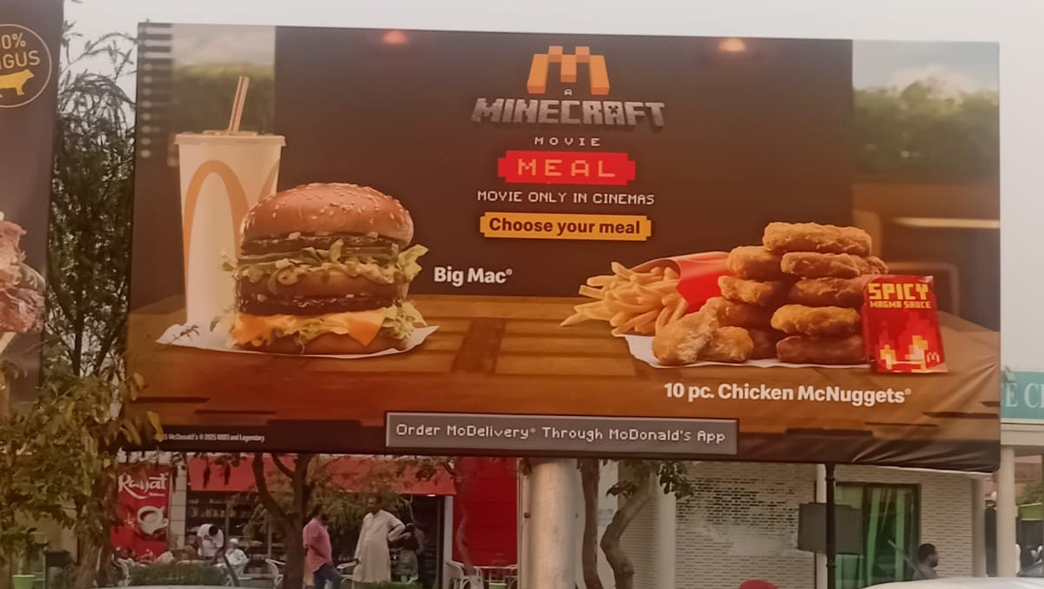
Bhera Rest Area Islamabad To Lahore (South)
RATE / MONTHLY
350,000
20*10
SIZE
M2 MOTORWAY
Availability : 06-13-2026

Slide 12
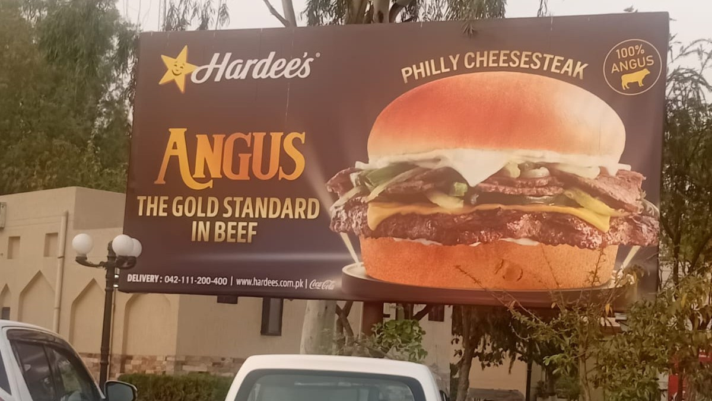
Bhera Rest Area
Islamabad To Lahore (South)
RATE / MONTHLY
350,000
20*10
SIZE
M2 MOTORWAY
Availability : 06-13-2026

Slide 13
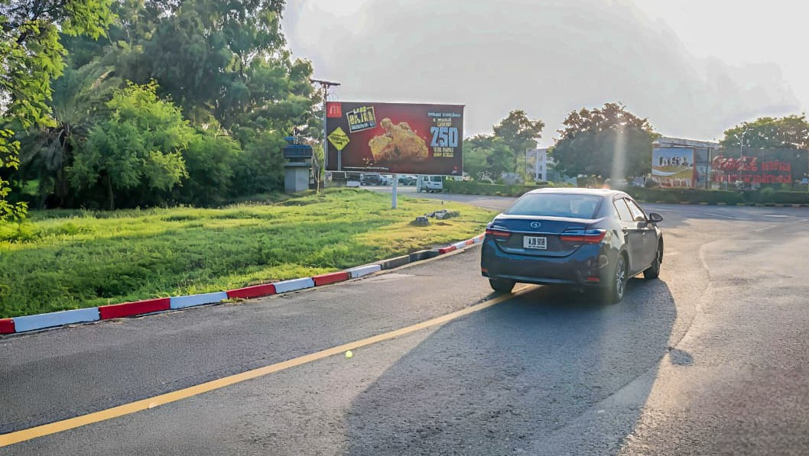
Bhera Rest Area Lahore To Islamabad (North)
RATE / MONTHLY
350,000
20*10
SIZE
M2 MOTORWAY
Availability : 06-13-2026

Slide 14
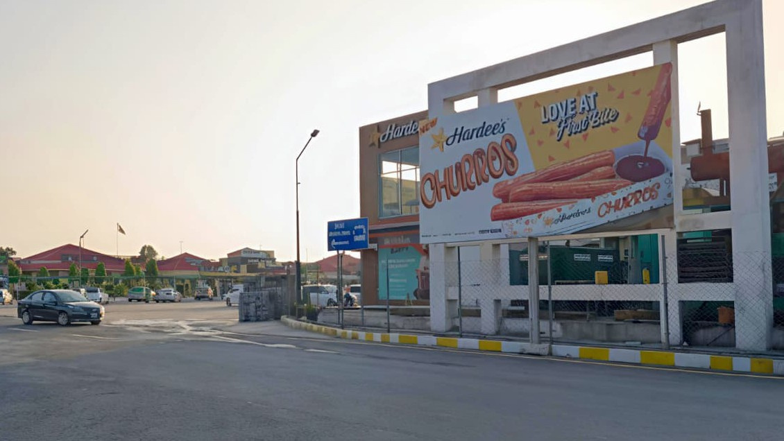
Bhera Rest Area Lahore To Islamabad (North)
RATE / MONTHLY
350,000
20*10
SIZE
M2 MOTORWAY
Availability : 06-13-2026

Slide 15
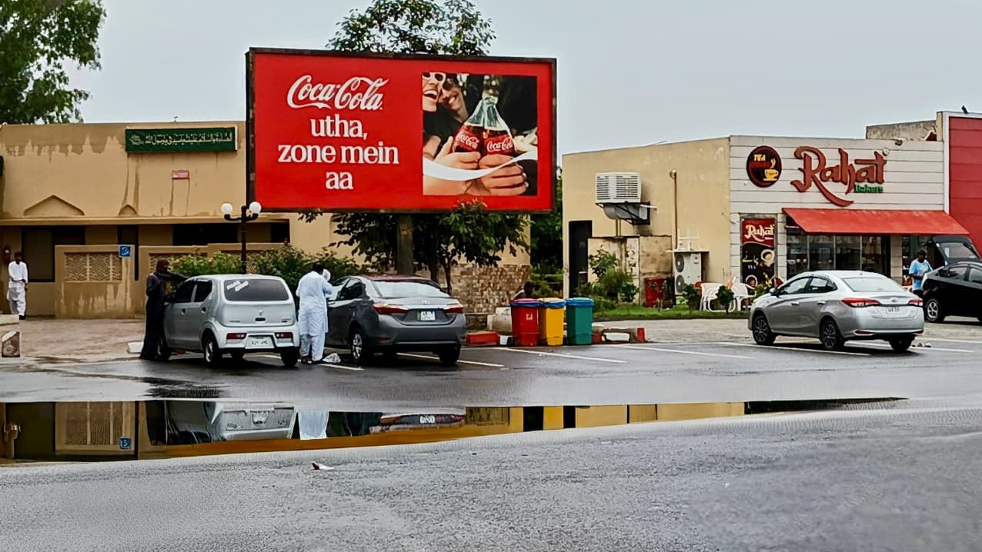
Bhera Rest Area Lahore To Islamabad (North)
RATE / MONTHLY
350,000
20*10
SIZE
M2 MOTORWAY
Availability : 06-13-2026

Slide 16
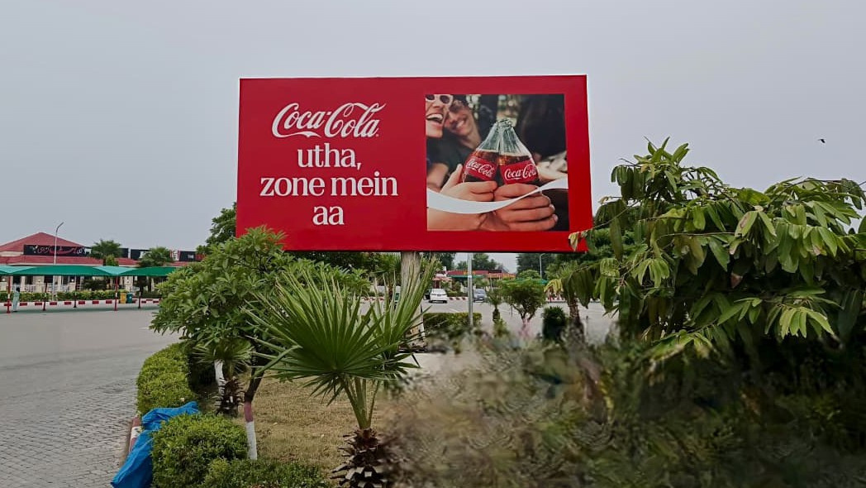
Sukheki Rest Area Lahore To Islamabad (North)
RATE / MONTHLY
350,000
20*10
SIZE
M2 MOTORWAY
Availability : 06-13-2026

Slide 17
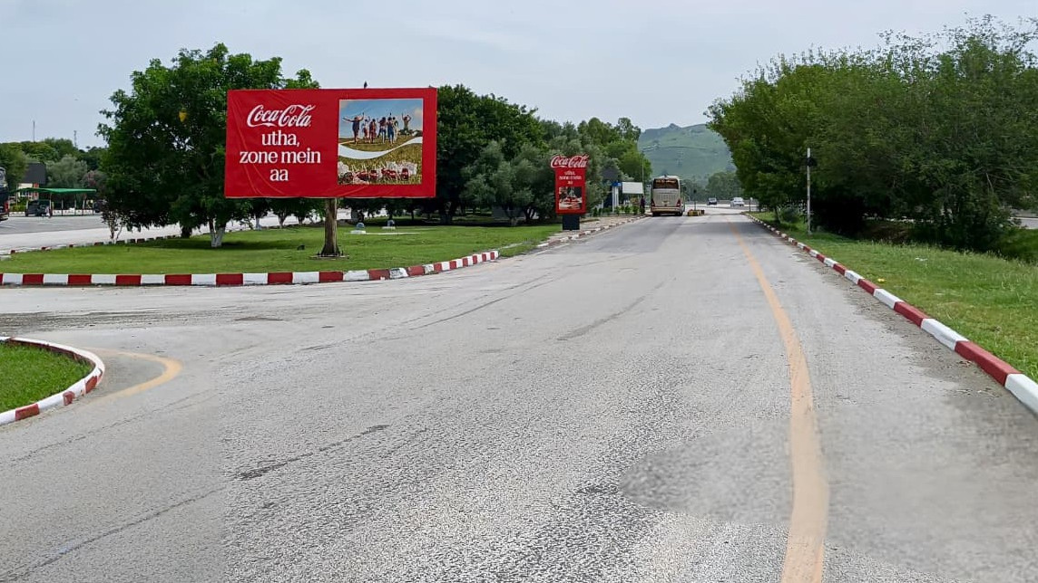
Kallar Kahar Rest Area Islamabad To Lahore (South)
RATE / MONTHLY
350,000
20*10
SIZE
M2 MOTORWAY
Availability : 06-13-2026

Slide 18
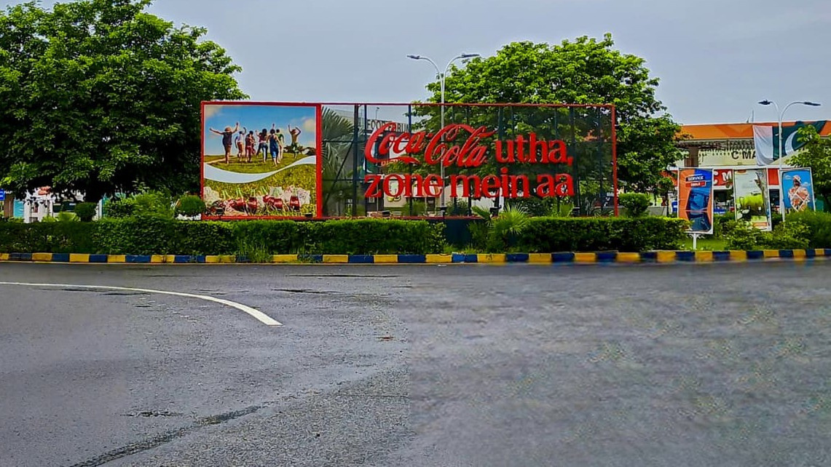
Lahore To Islamabad Bhera Rest Area (North)
RATE / MONTHLY
600,000
36*10
Backlit
SIZE
M2 MOTORWAY
Availability : 06-13-2026

Slide 19
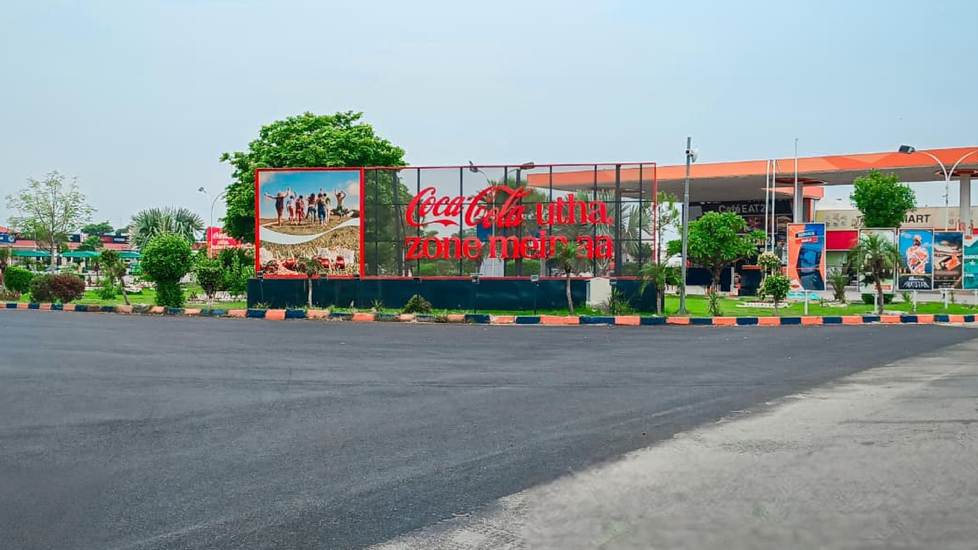
Lahore To Islamabad Sukheki Rest Area (North)
RATE / MONTHLY
600,000
36*10
Backlit
SIZE
M2 MOTORWAY
Availability : 06-13-2026

Slide 20
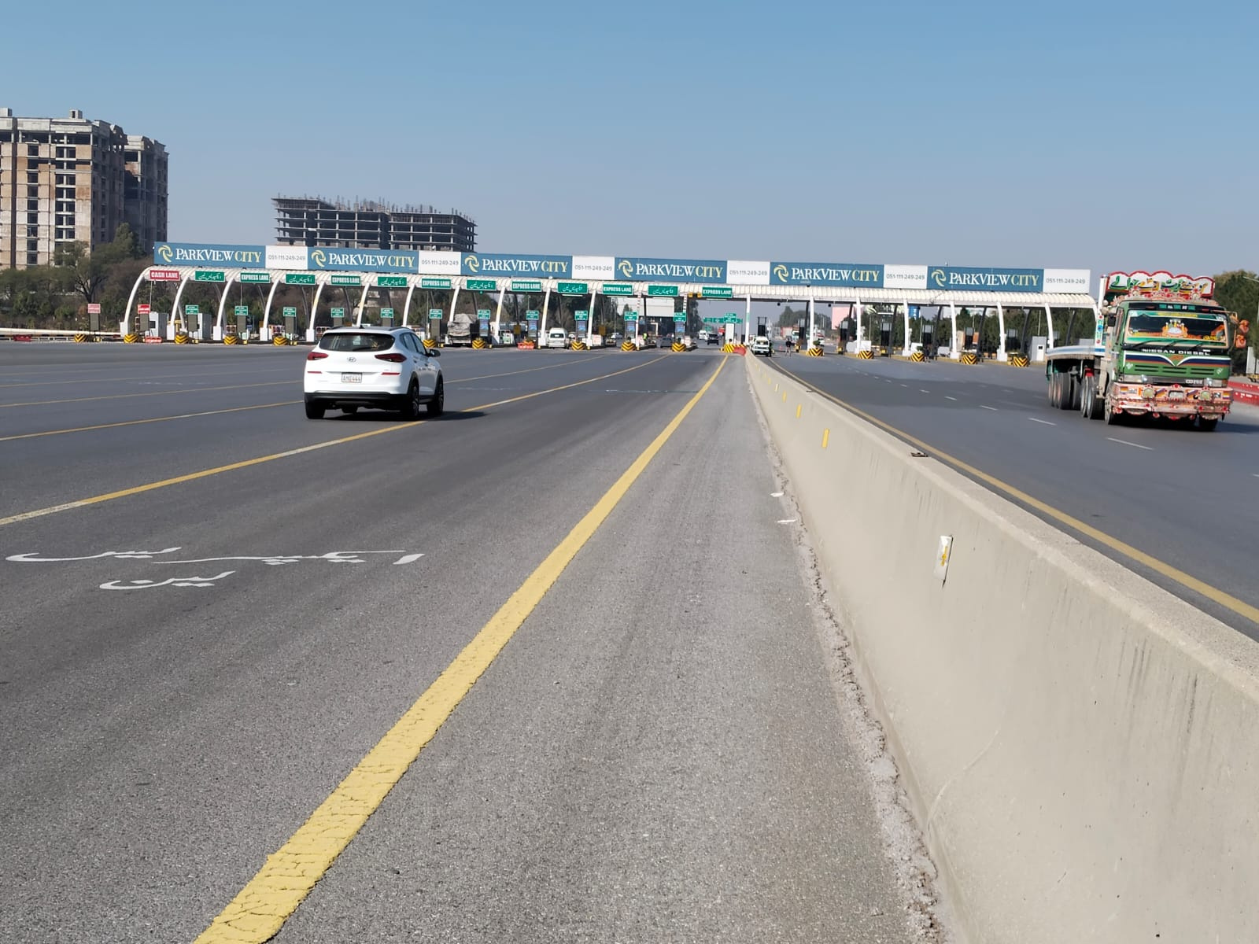
Islamabad Toll Plaza Both Sides Quantity (2)
RATE / MONTHLY
3,000,000
375 x 9
SIZE
M2 MOTORWAY
Availability : 06-13-2026

Slide 21
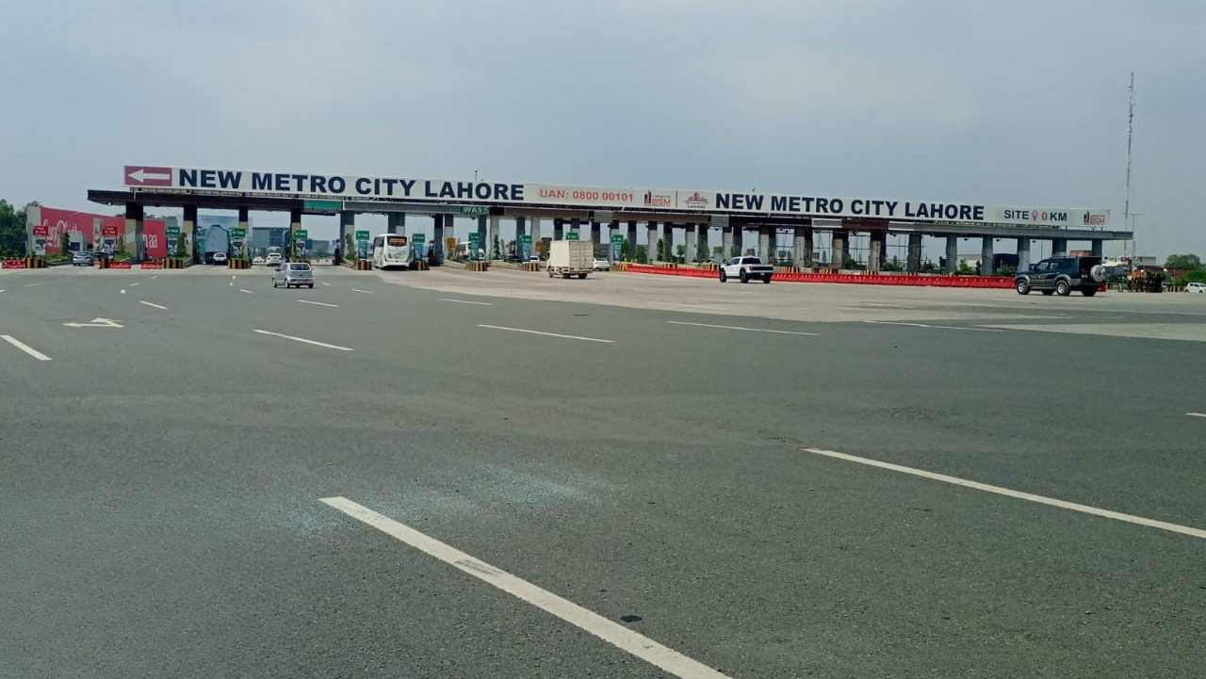
Ravi Toll Plaza (North & South)
Both Sides Quantity (2)
RATE / MONTHLY
4,000,000
435 x 8
SIZE
M2 MOTORWAY
Availability : 06-13-2026

Slide 22
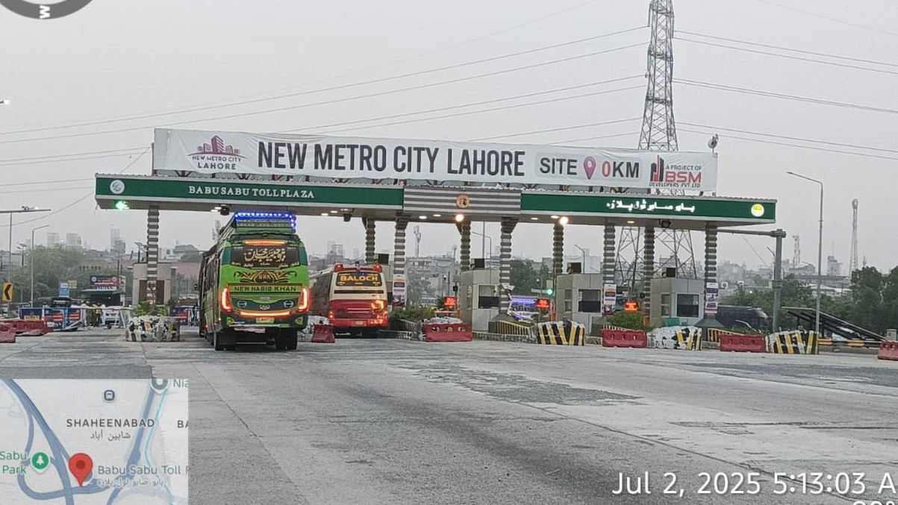
Babu Sabu Toll Plaza
Islamabad To Lahore Both Side Quantity (2)
RATE / MONTHLY
800,000
87 x 8
SIZE
M2 MOTORWAY
Availability : 06-13-2026

Slide 23
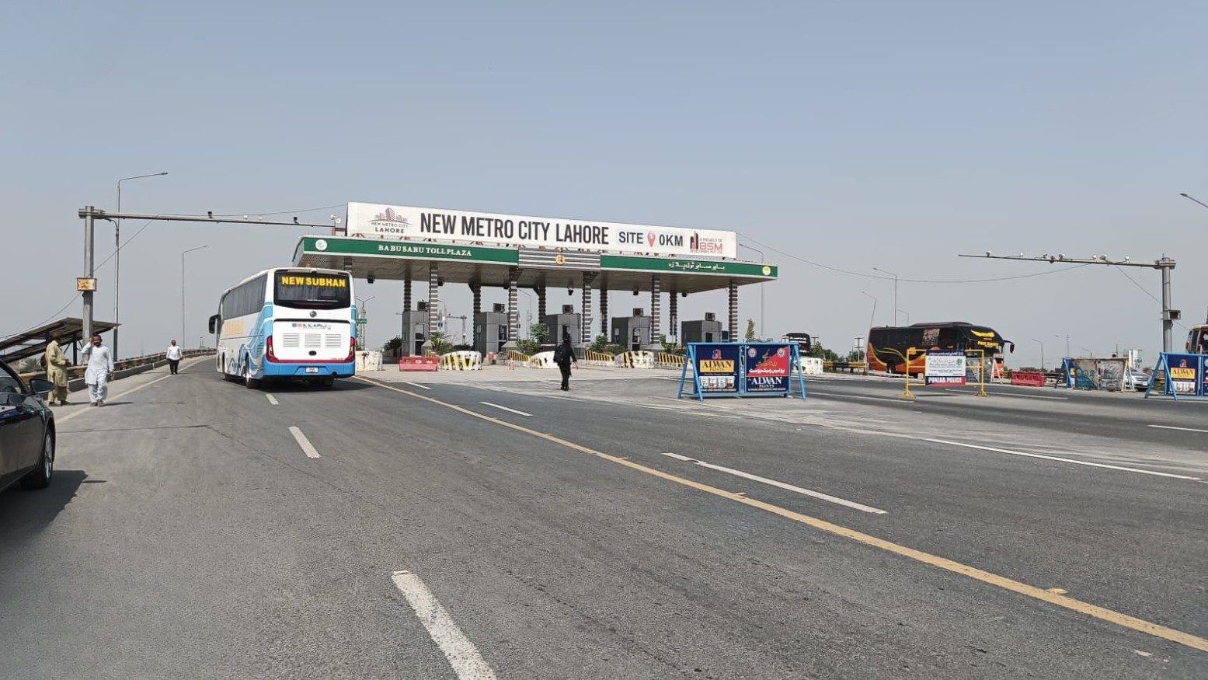
Babu Sabu Toll Plaza Lahore To Islamabad Quantity (1)
RATE / MONTHLY
500,000
60 x 8
SIZE
M2 MOTORWAY
Availability : 06-13-2026

Slide 24
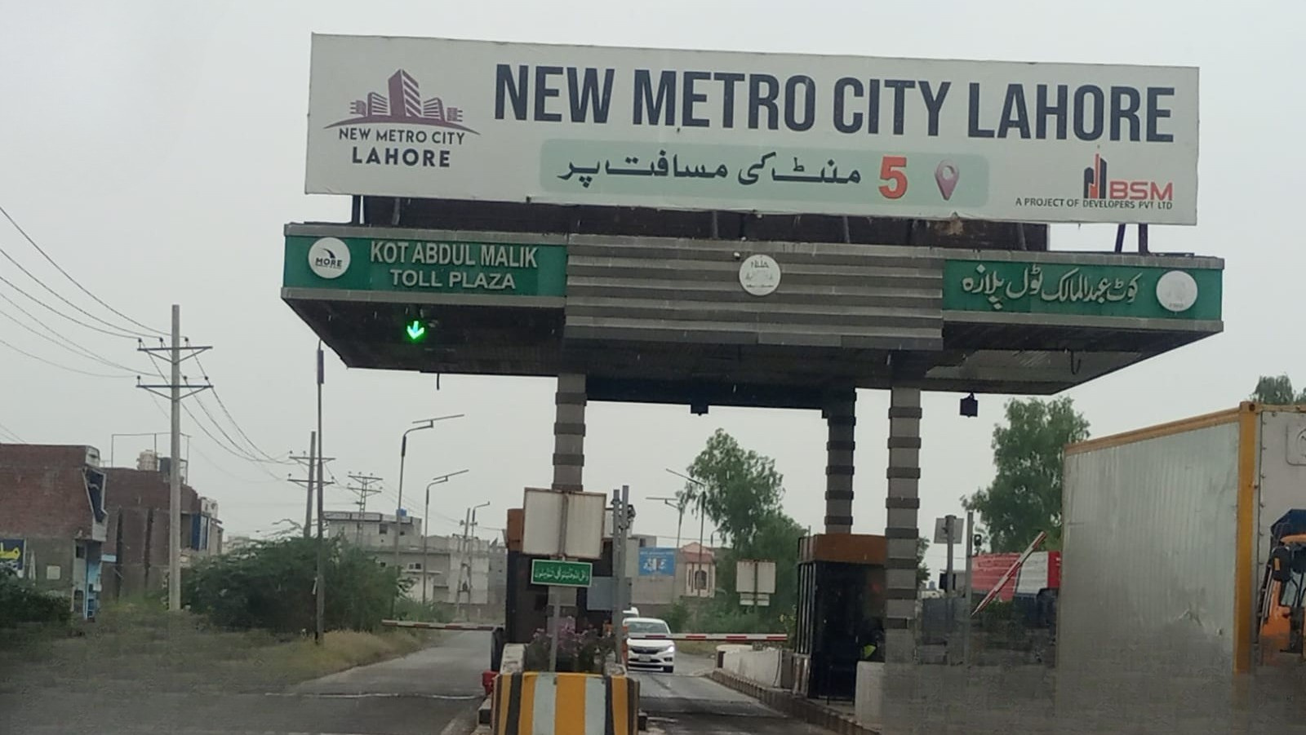
Kot Abdul Malik Interchange Islamabad To Lahore North Quantity (2)
RATE / MONTHLY
400,000
44 x 8
SIZE
M2 MOTORWAY
Availability : 06-13-2026

Slide 25
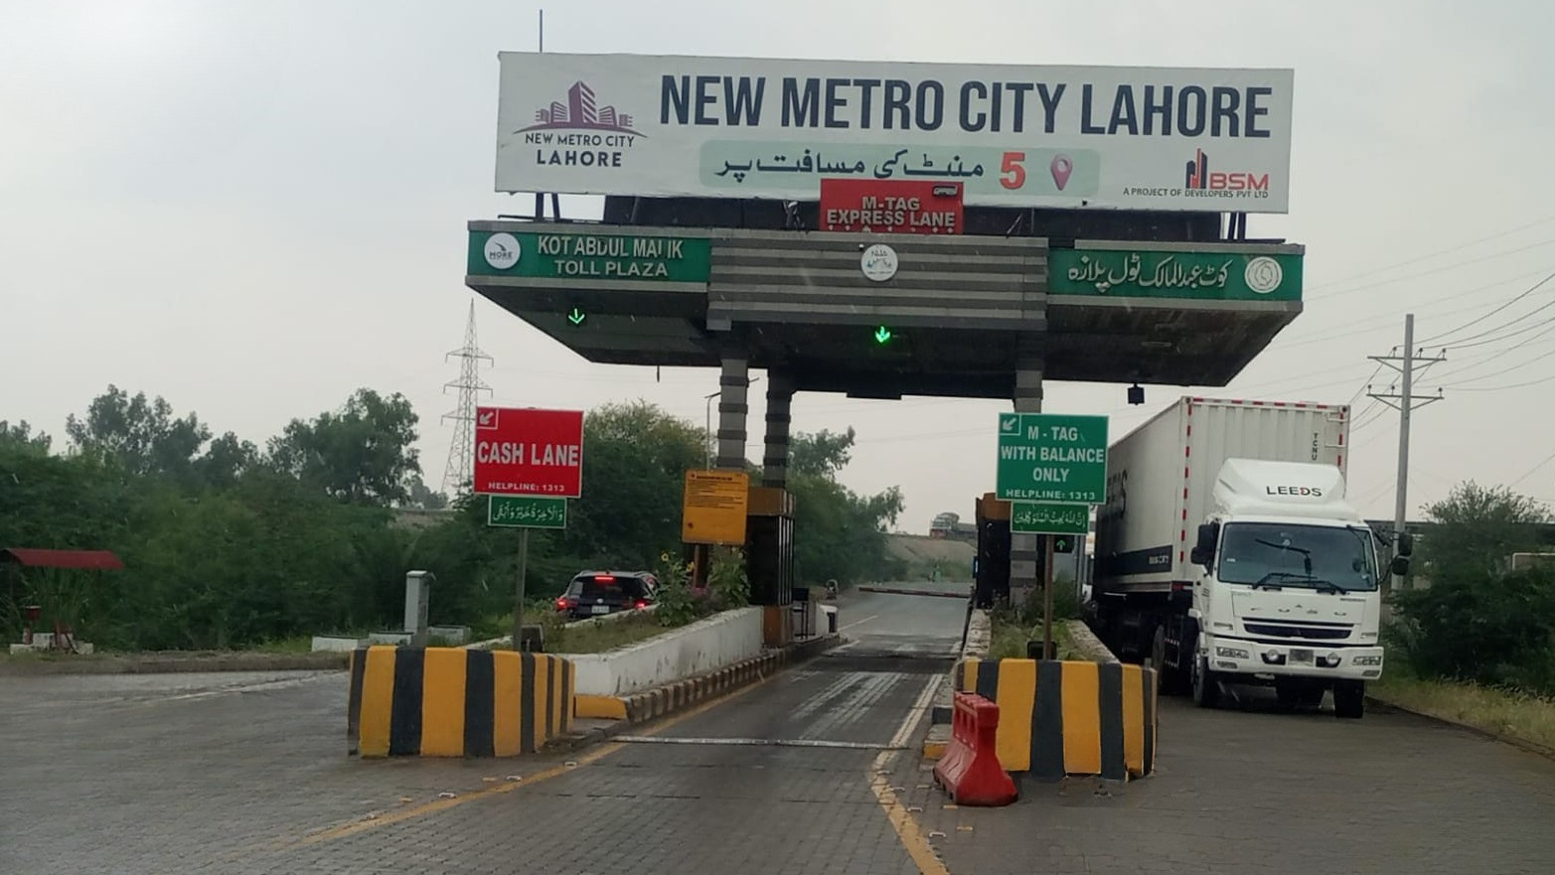
Kot Abdul Malik Interchange Lahore To Islamabad South Quantity (2)
RATE / MONTHLY
400,000
44 x 8
SIZE
M2 MOTORWAY
Availability : 06-13-2026

Slide 26
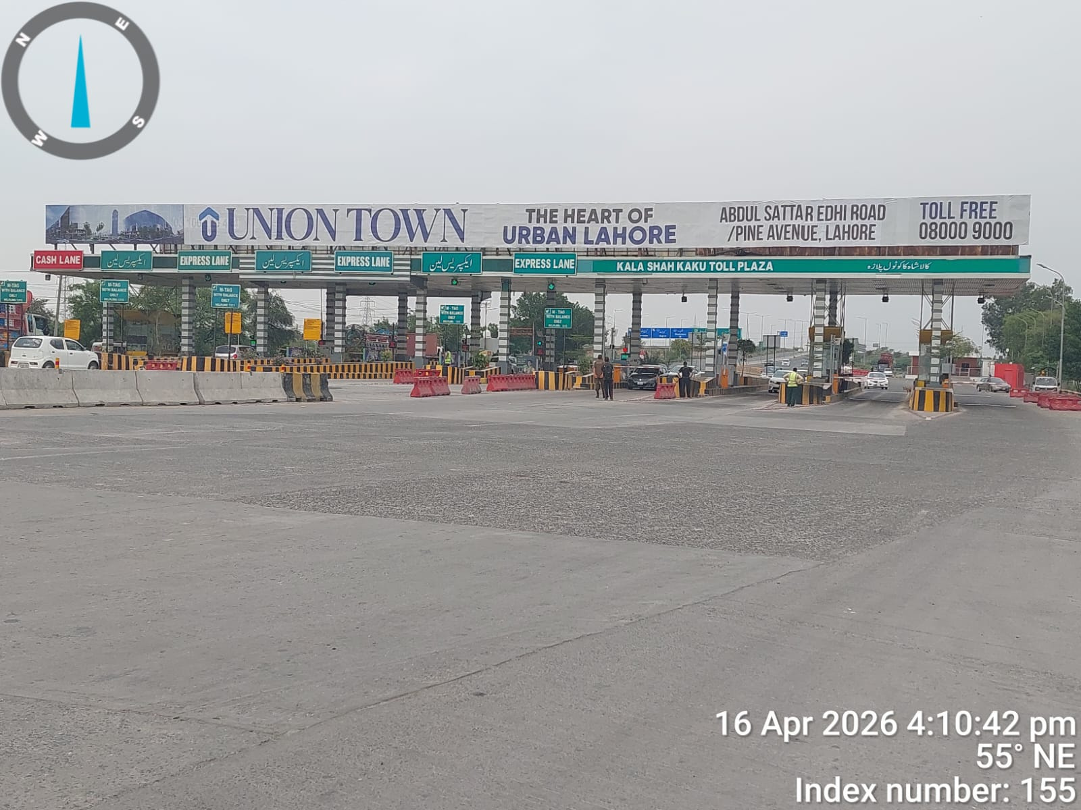
Kala Shah Kaku Toll Plaza
Lahore To Islamabad Both Side Quantity (2)
RATE / MONTHLY
2,500,000
190 x 8
SIZE
M2 MOTORWAY
Availability : 06-13-2026

Slide 27
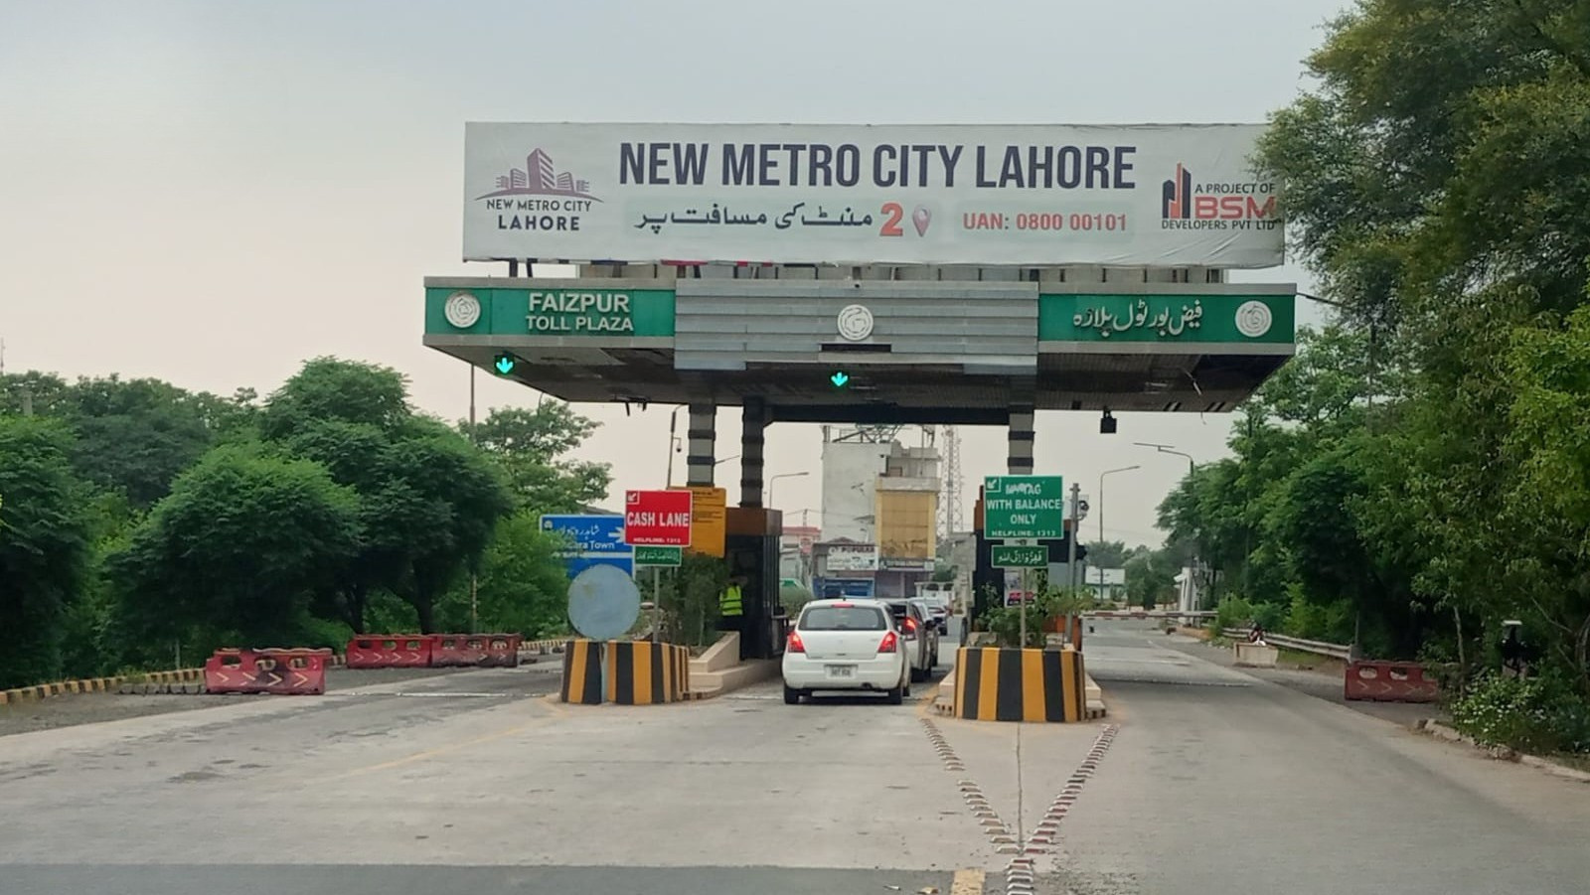
Faiz Pur Interchange
Lahore To Islamabad North Quantity (2)
RATE / MONTHLY
400,000
47 x 8
SIZE
M2 MOTORWAY
Availability : 06-13-2026

Slide 28
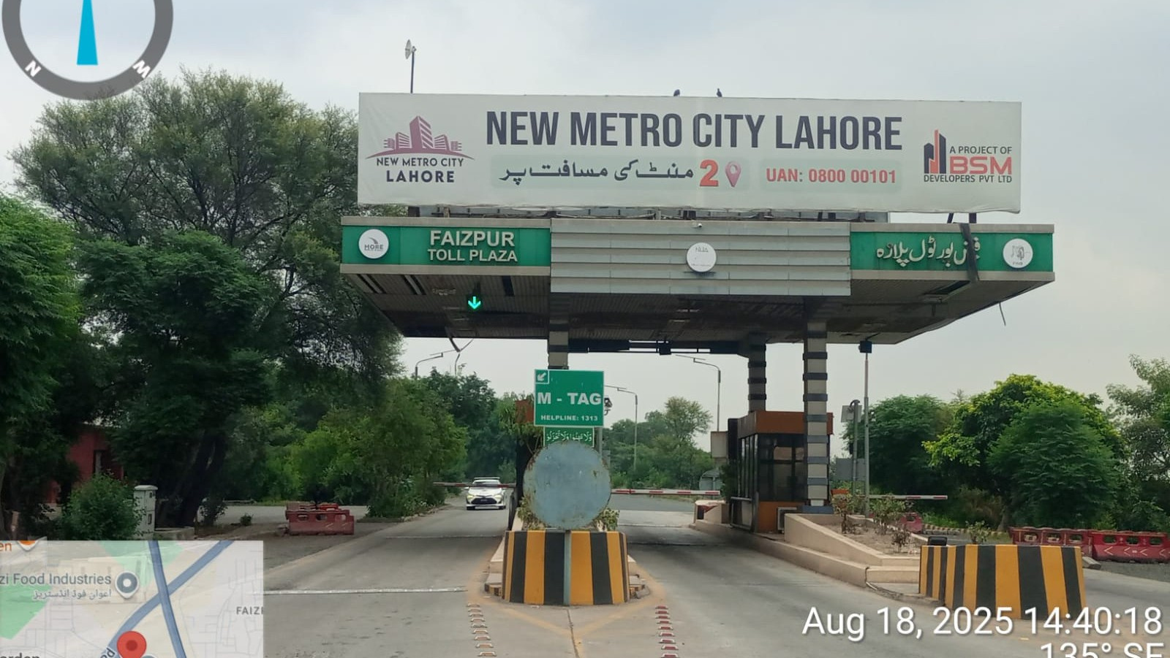
Faiz Pur Interchange
Islamabad To Lahore South Quantity (2)
RATE / MONTHLY
400,000
47 x 8
SIZE
M2 MOTORWAY
Availability : 06-13-2026

Slide 29
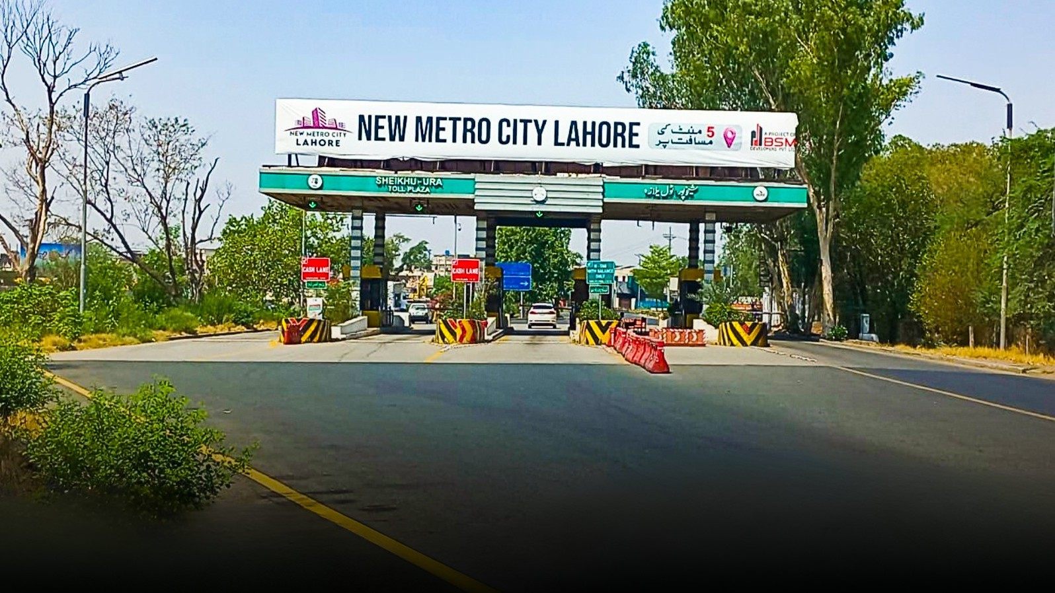
Sheikhu Pura Inter change Lahore To Islamabad North Quantity (2)
RATE / MONTHLY
500,000
77 x 8
SIZE
M2 MOTORWAY
Availability : 06-13-2026

Slide 30
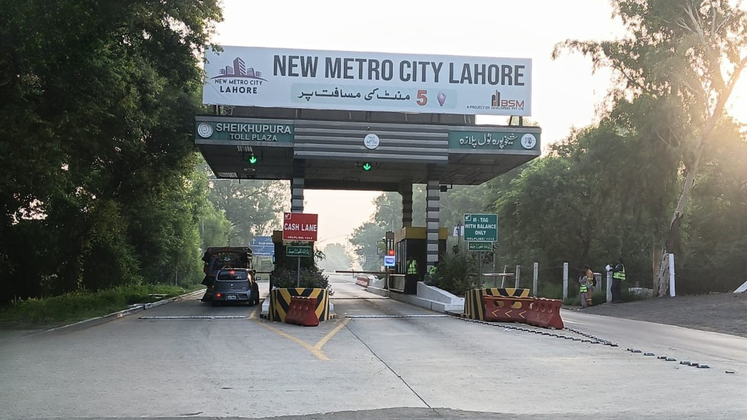
Sheikhu Pura Inter change Islamabad To Lahore South Quantity (2)
RATE / MONTHLY
500,000
44 x 8
SIZE
M2 MOTORWAY
Availability : 06-13-2026

Slide 31
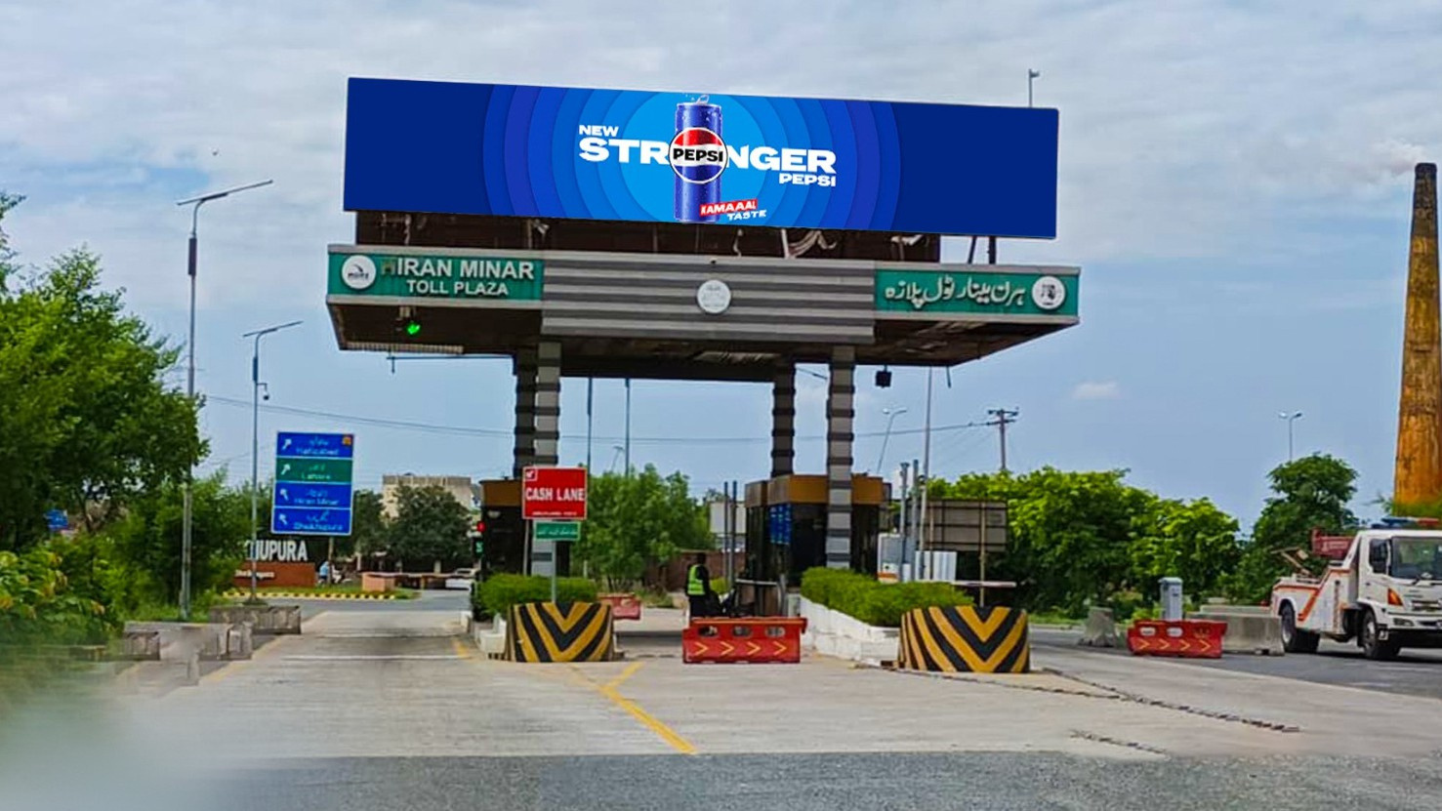
Hiran Minar Toll Plaza North / South Both Side Quantity (4)
RATE / MONTHLY
800,000
45 x 8
SIZE
M2 MOTORWAY
Availability : 06-13-2026

Slide 32
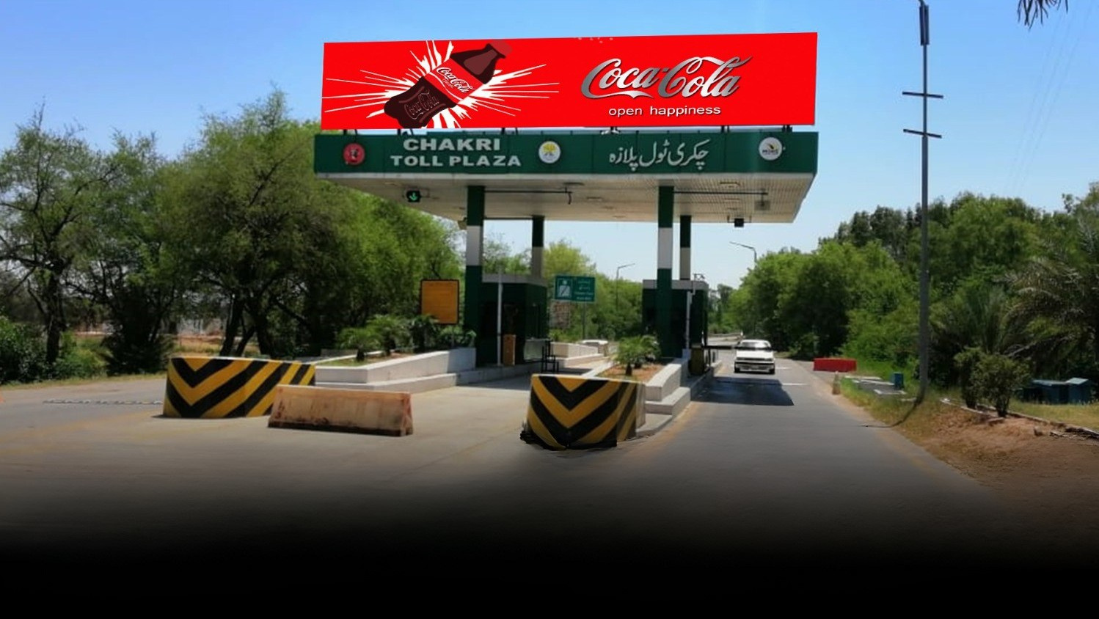
CHAKRI TOLL PLAZA North / South Both Side Quantity (4)
RATE / MONTHLY
800,000
40 x 8
SIZE
M2 MOTORWAY
Availability : 06-13-2026

Slide 33
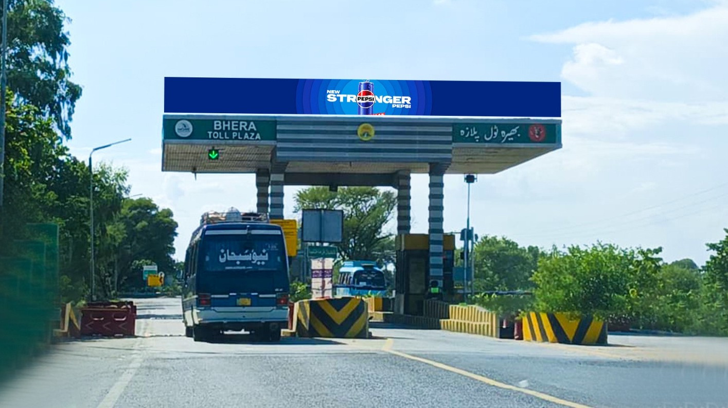
Bhera Toll Plaza
North / South
Both Side Quantity (4)
RATE / MONTHLY
800,000
46 x 8
SIZE
M2 MOTORWAY
Availability : 06-13-2026

Slide 34
Bhera Toll Plaza
North / South
Both Side Quantity (4)
RATE / MONTHLY
800,000
46 x 8
SIZE
M2 MOTORWAY
Availability : 06-13-2026

Slide 35
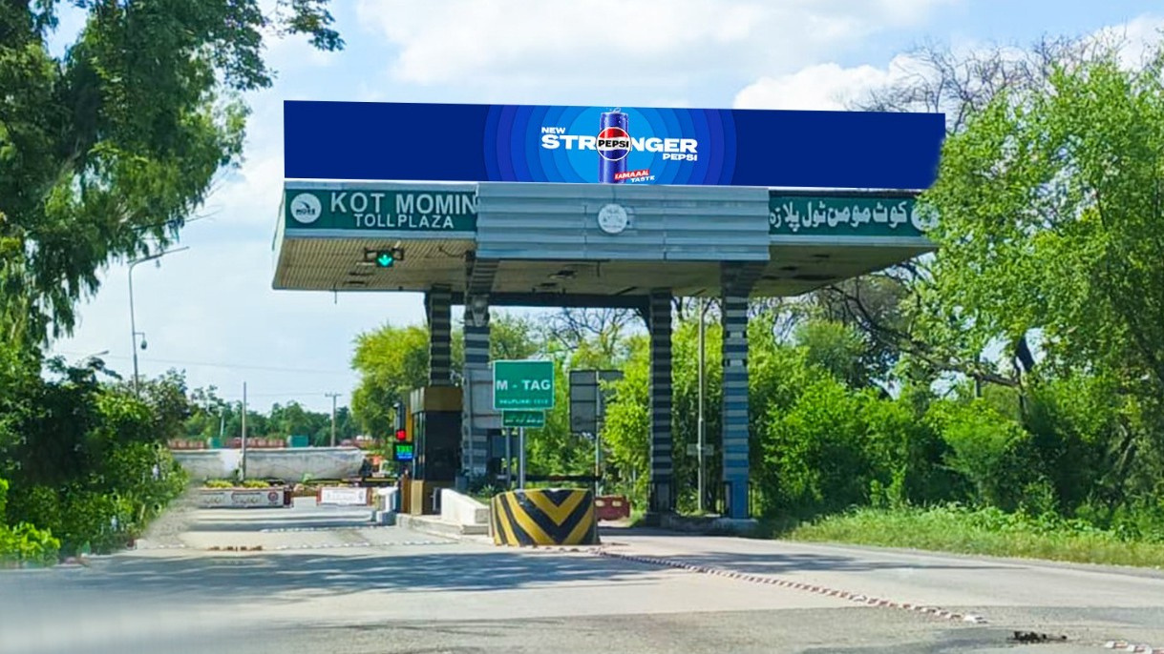
Kot Momin Toll Plaza North / South Both Side Quantity (4)
RATE / MONTHLY
800,000
46 x 8
SIZE
M2 MOTORWAY
Availability : 06-13-2026

Slide 36
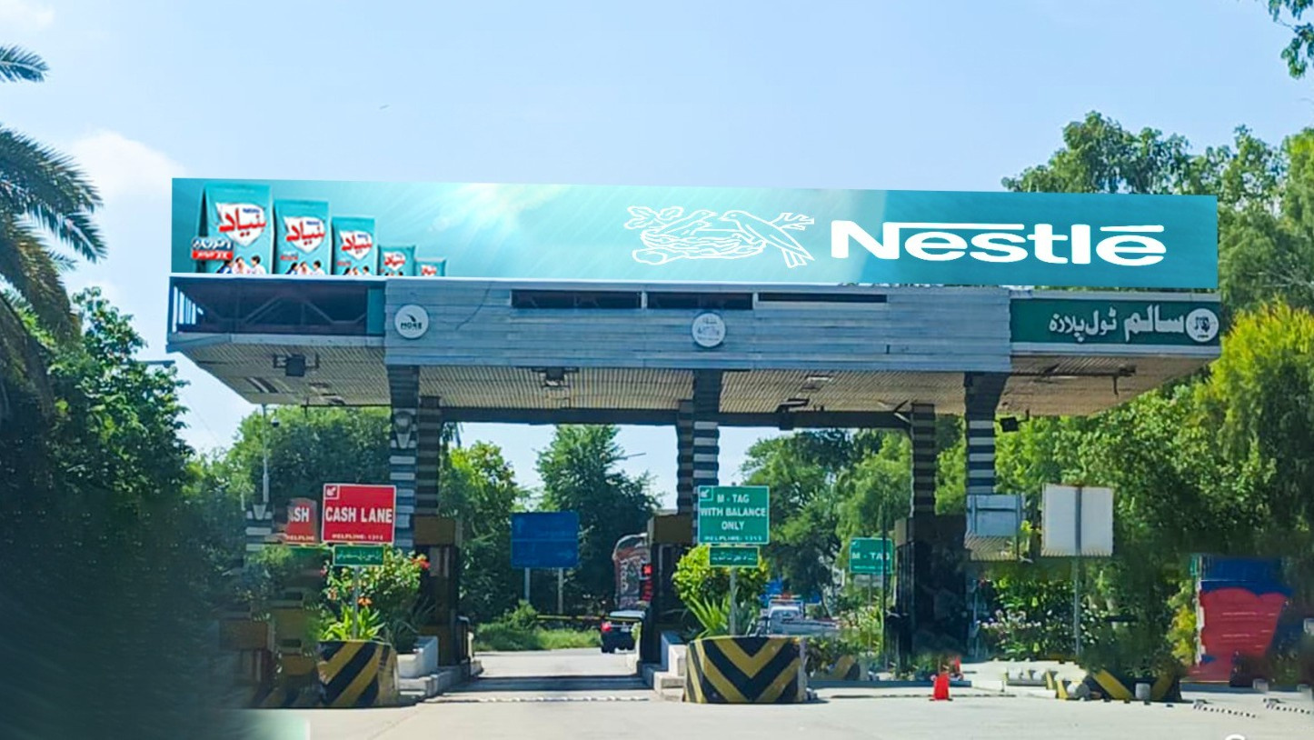
Saalam Toll Plaza
North / South Both Side Quantity (4)
RATE / MONTHLY
800,000
46 x 8
SIZE
M2 MOTORWAY
Availability : 06-13-2026

Slide 37
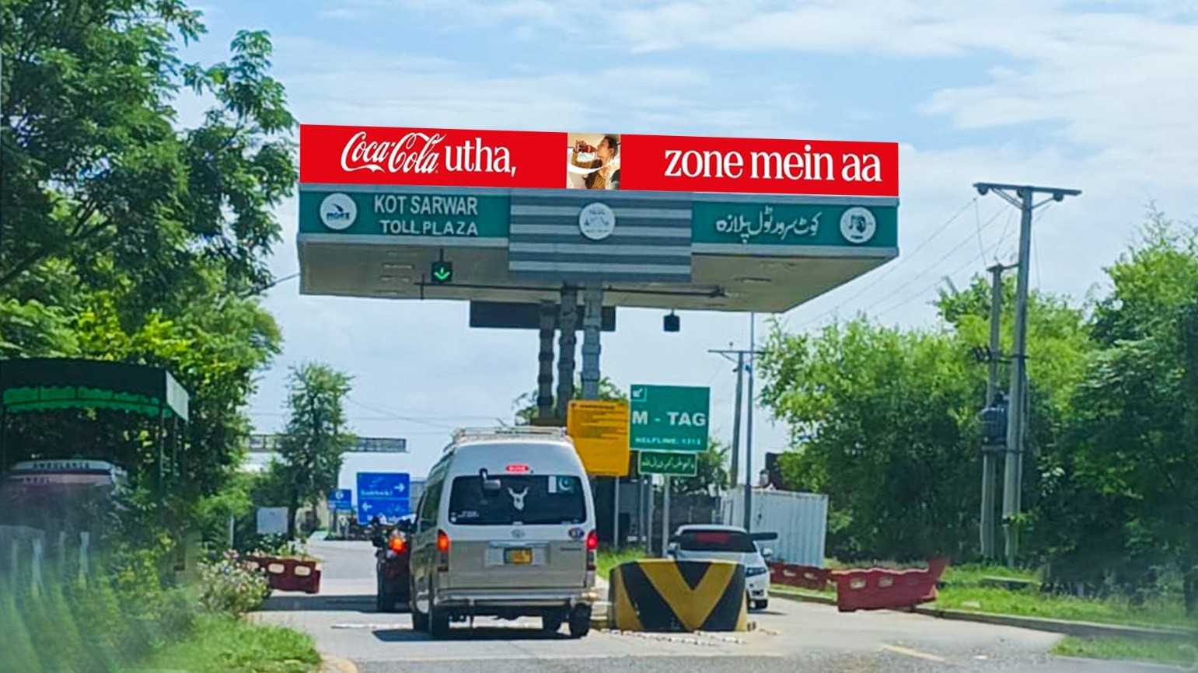
Kot Sarwar Toll Plaza North / South Both Side Quantity (4)
RATE / MONTHLY
800,000
46 x 8
SIZE
M2 MOTORWAY
Availability : 06-13-2026

Slide 38
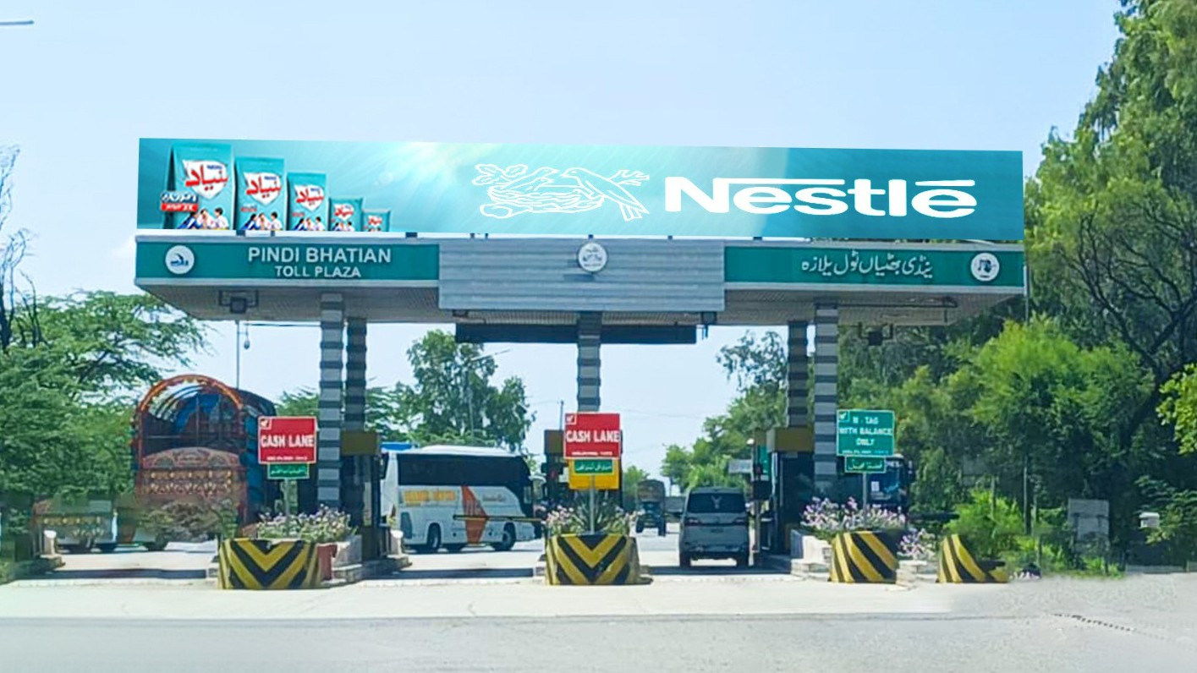
Pindi Bhattian Toll Plaza North / South Both Side Quantity (4)
RATE / MONTHLY
800,000
46 x 8
SIZE
M2 MOTORWAY
Availability : 06-13-2026

Slide 39
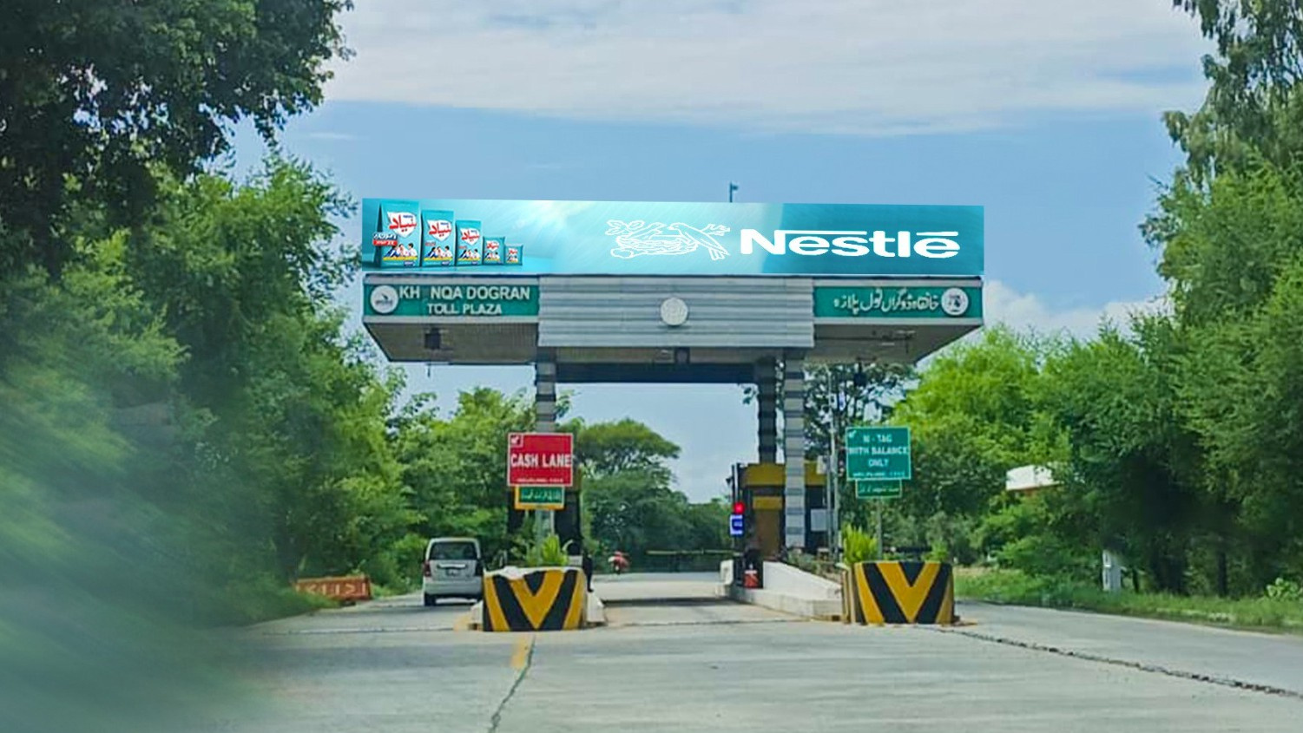
Khanqa Dogran Toll Plaza North / South Both Side Quantity (4)
RATE / MONTHLY
800,000
46 x 8
SIZE
M2 MOTORWAY
Availability : 06-13-2026

Slide 40
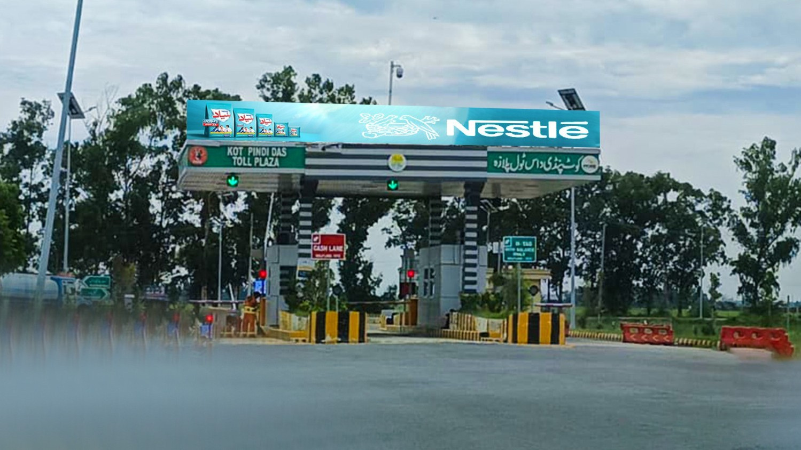
Kot Pindi Das Toll Plaza North / South Both Side Quantity (4)
RATE / MONTHLY
800,000
46 x 8
SIZE
M2 MOTORWAY
Availability : 06-13-2026

Slide 41
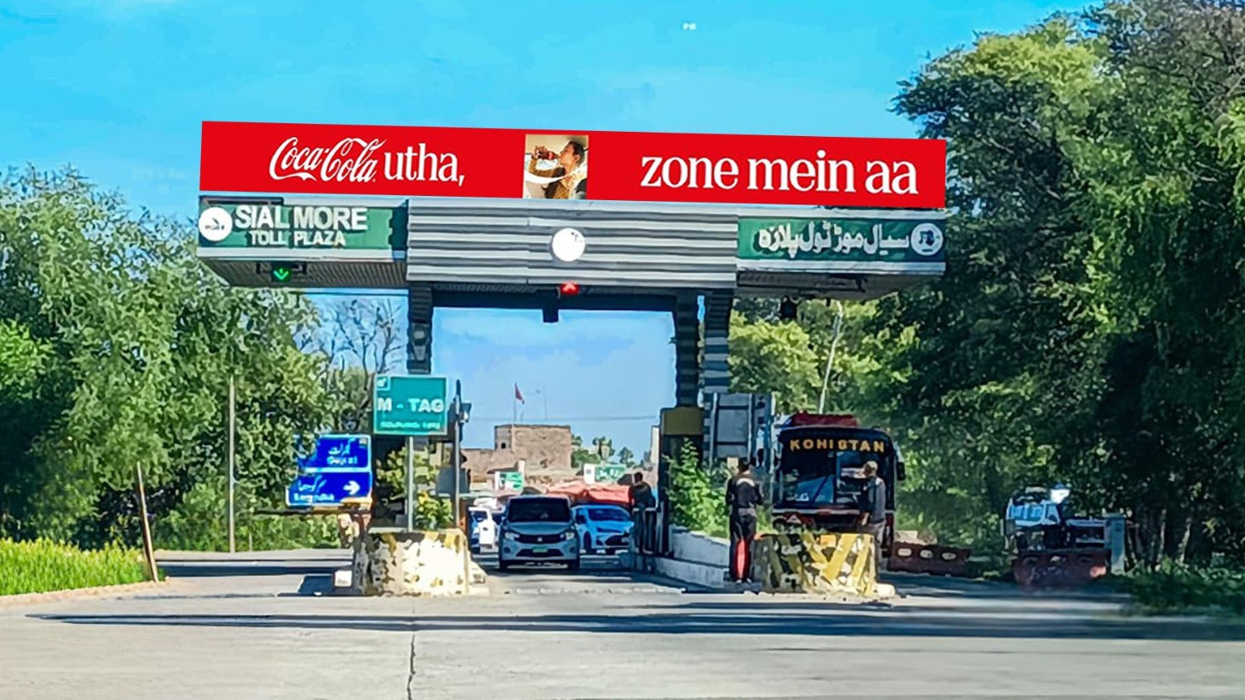
Sial Mor Toll Plaza North / South Both Side Quantity (4)
RATE / MONTHLY
800,000
46 x 8
SIZE
M2 MOTORWAY
Availability : 06-13-2026

Slide 42
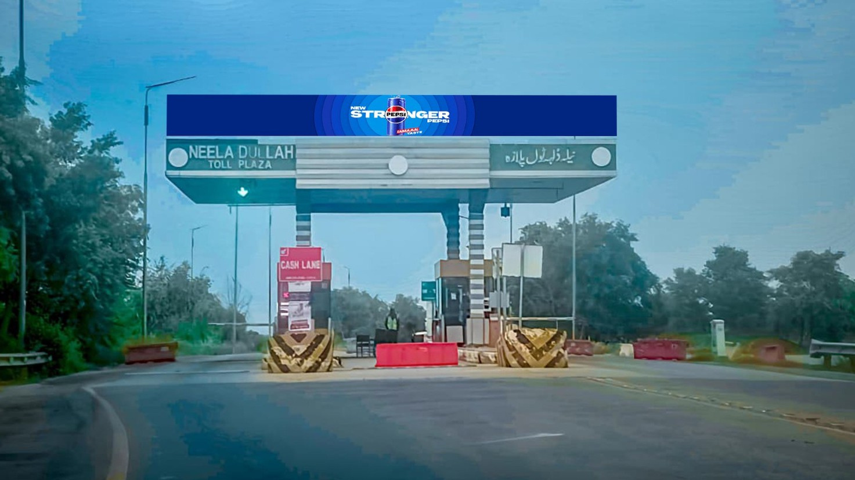
Neela Dullah Toll Plaza North / South Both Side Quantity (4)
RATE / MONTHLY
800,000
46 x 8
SIZE
M2 MOTORWAY
Availability : 06-13-2026

Slide 43
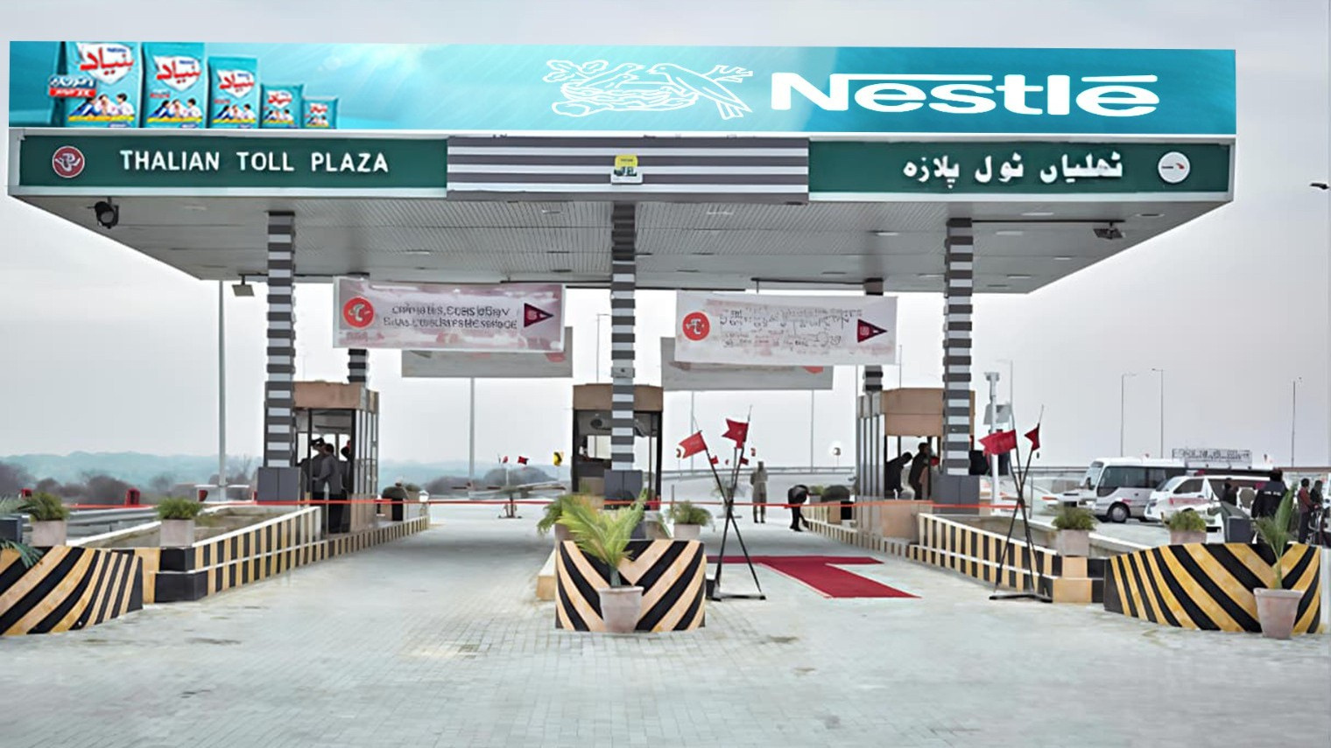
Thalian Toll Plaza
North / South Both Side Quantity (4)
RATE / MONTHLY
800,000
46 x 8
SIZE
M2 MOTORWAY
Availability : 06-13-2026

Slide 44
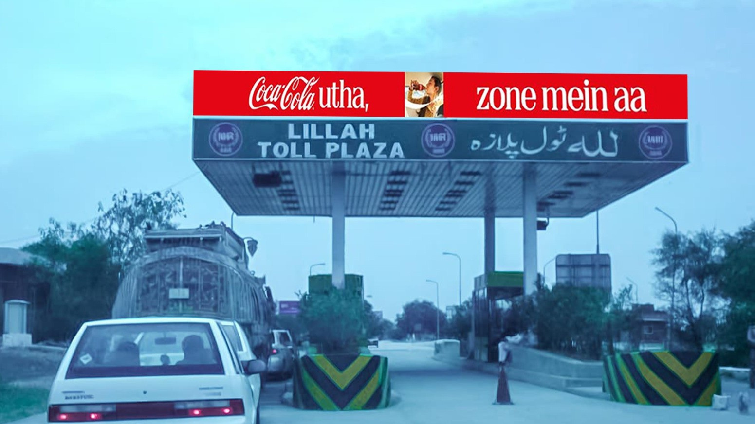
Lillah Toll Plaza
North / South Both Side Quantity (4)
RATE / MONTHLY
800,000
46 x 8
SIZE
M2 MOTORWAY
Availability : 06-13-2026

Slide 45
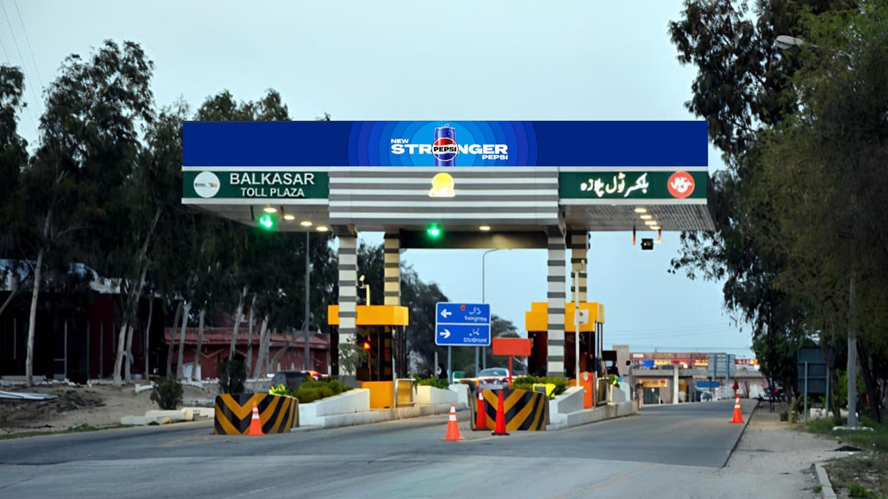
Lillah Toll Plaza
North / South Both Side Quantity (4)
RATE / MONTHLY
800,000
46 x 8
SIZE
M2 MOTORWAY

Slide 46
TCF MEDIA GROUP · DIGITAL NETWORK PORTFOLIO
DHA STREAMERS
— SECTION OVERVIEW
02
Pedestrian
Bridge.
DEFINE THE VIEW
tcfmediagroup.com
Notes:
45

Slide 47
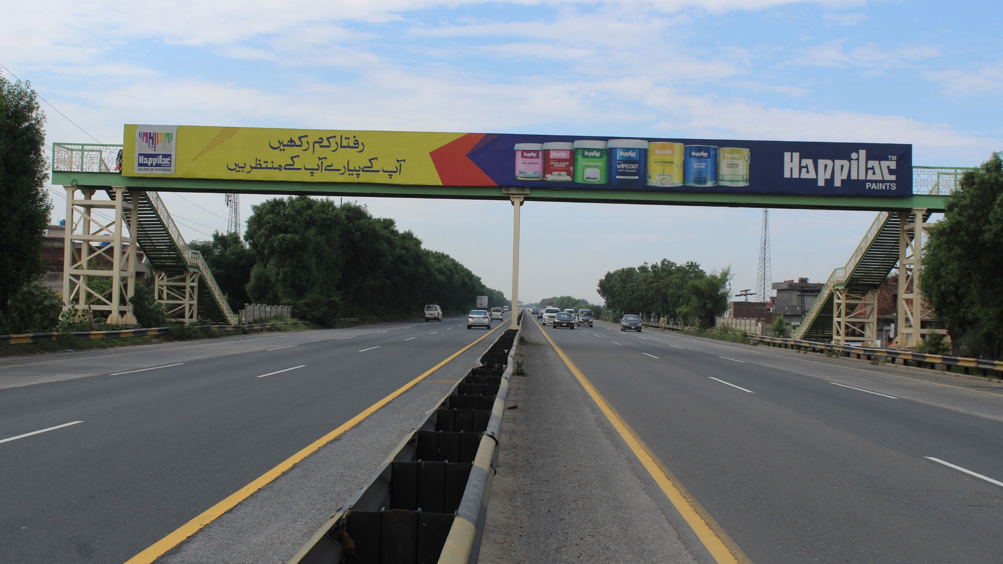
Pedestrian Bridge
Near Thoker Niaz Baig Both Side Quantity (2)
RATE / MONTHLY
800,000
116 x 8
SIZE
M2 MOTORWAY
Availability : 06-13-2026

Slide 48
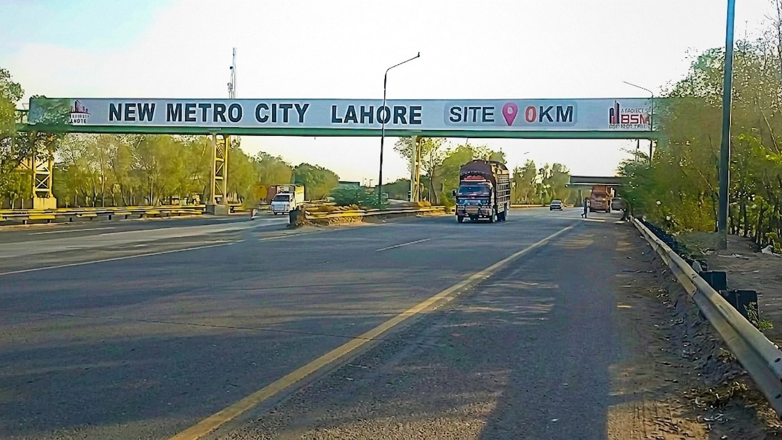
Pedestrian Bridge
Near Babu Sabu
Both Side Quantity (2)
RATE / MONTHLY
800,000
186 x 8
SIZE
M2 MOTORWAY
Availability : 06-13-2026

Slide 49
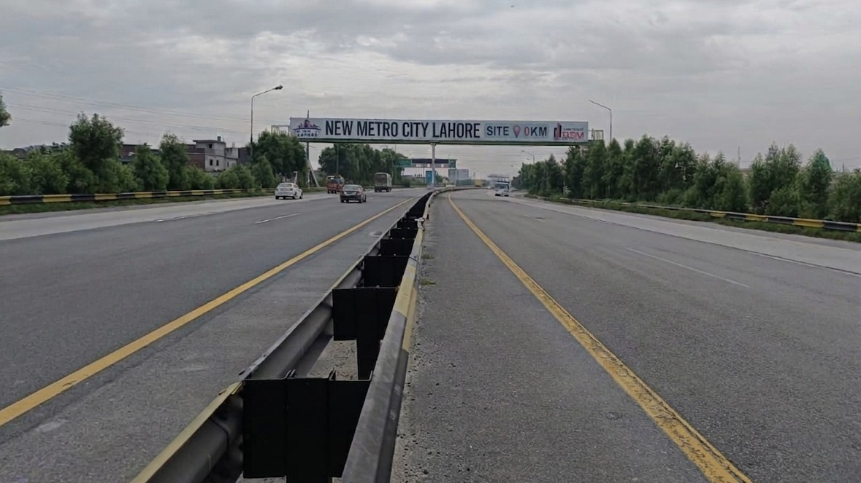
Pedestrian Bridge
After Babu Sabu Quantity (1)
RATE / MONTHLY
500,000
117 x 8
SIZE
M2 MOTORWAY
Availability : 06-13-2026

Slide 50
TCF MEDIA GROUP · DIGITAL NETWORK PORTFOLIO
DHA STREAMERS
— SECTION OVERVIEW
03
Static
Pylons.
DEFINE THE VIEW
tcfmediagroup.com
Notes:
49

Slide 51
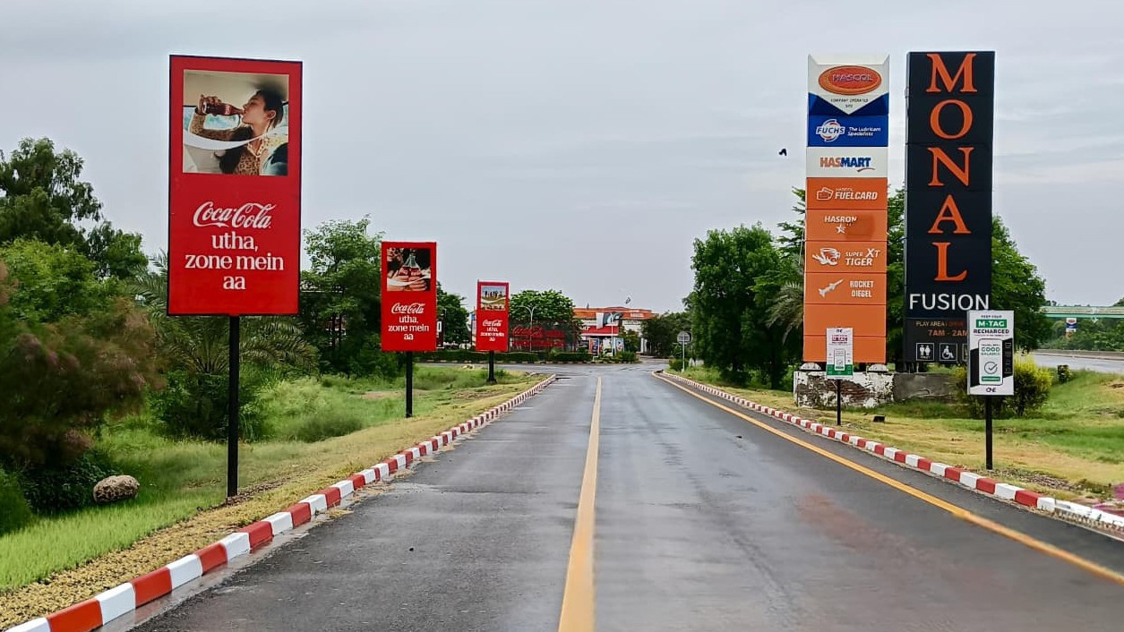
Rest Area (Pylons) Entry Points North / South. Bhera (06), Sukheki (04), Kallar Kahar (02) Sial (02), Chakri (02)
RATE / MONTHLY
60,000 Each
5 x 10
SIZE
M2 MOTORWAY
Availability : 06-13-2026

Slide 52
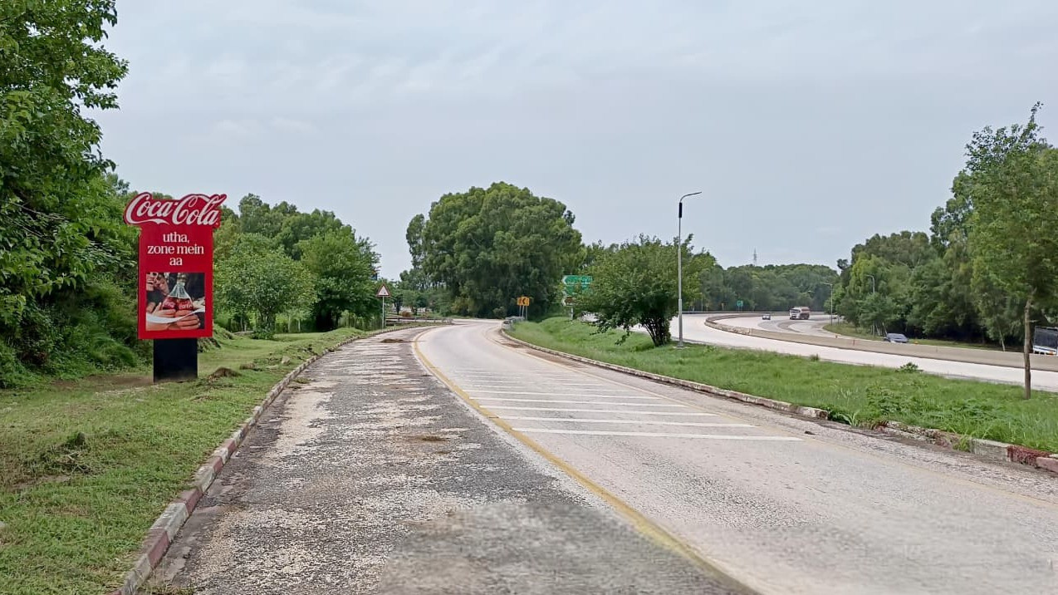
Rest Area (Pylons) Exit Points North / South. Bhera (02), Sukheki (02), Kallar Kahar (02) Sial (02), Chakri (02)
RATE / MONTHLY
60,000 Each
5 x 10
SIZE
M2 MOTORWAY
Availability : 06-13-2026

Slide 53
TCF MEDIA GROUP · DIGITAL NETWORK PORTFOLIO
DHA STREAMERS
— SECTION OVERVIEW
04
C-MART.
DEFINE THE VIEW
tcfmediagroup.com
Notes:
52

Slide 54
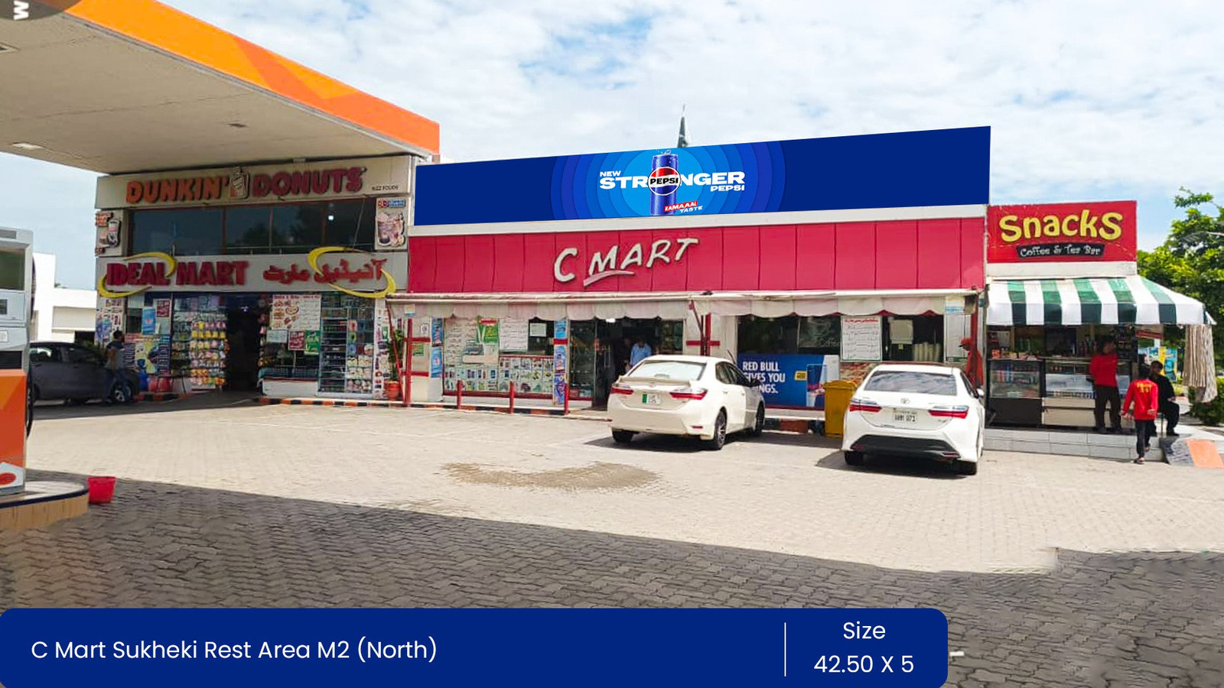
Sukheki Rest Area Lahore To Islamabad North Quantity(1)
RATE / MONTHLY
300,000
42.5 x 5
SIZE
M2 MOTORWAY
Availability : 06-13-2026

Slide 55
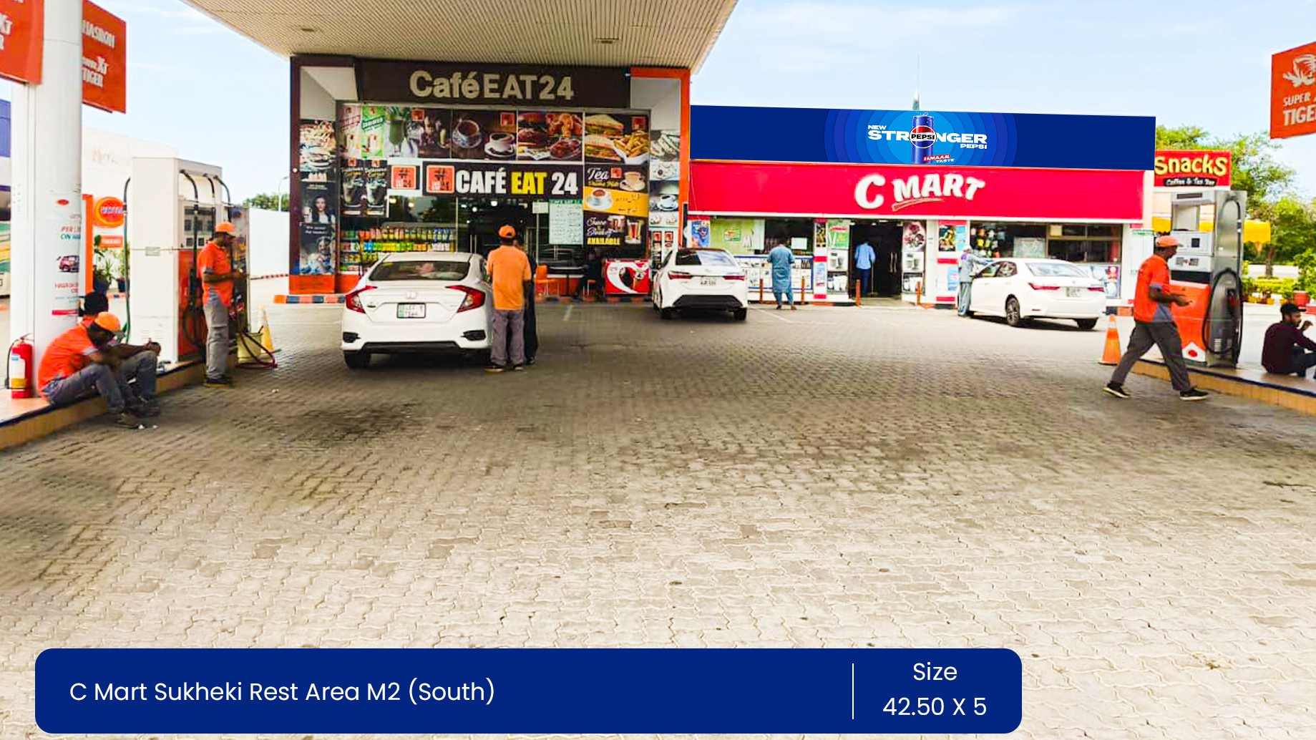
Sukheki Rest Area Islamabad To Lahore South Quantity(1)
RATE / MONTHLY
300,000
42.5 x 5
SIZE
M2 MOTORWAY
Availability : 06-13-2026

Slide 56
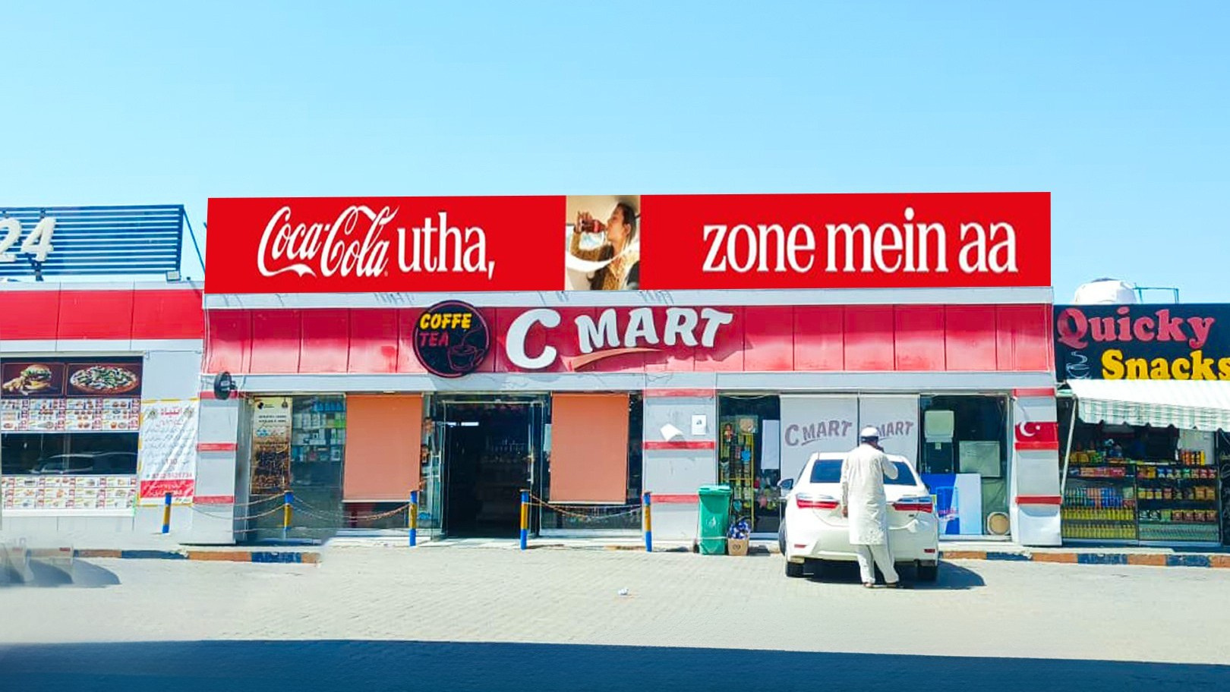
Sial Mor Rest Area Islamabad To Lahore South Quantity(1)
RATE / MONTHLY
300,000
43 x 5
SIZE
M2 MOTORWAY
Availability : 06-13-2026

Slide 57
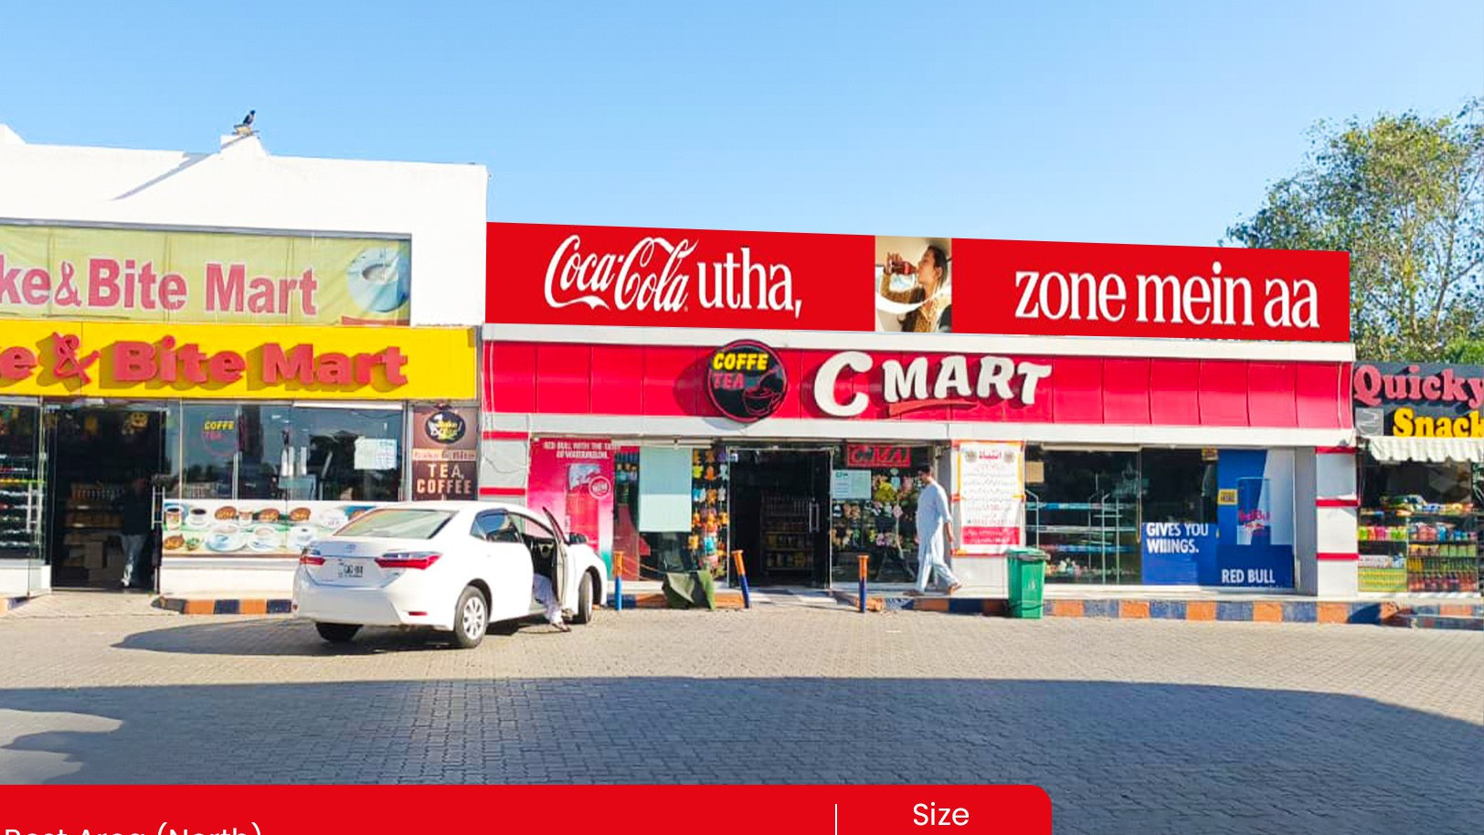
Sial Mor Rest Area Lahore To Islamabad North Quantity(1)
RATE / MONTHLY
300,000
42 x 5
SIZE
M2 MOTORWAY
Availability : 06-13-2026

Slide 58
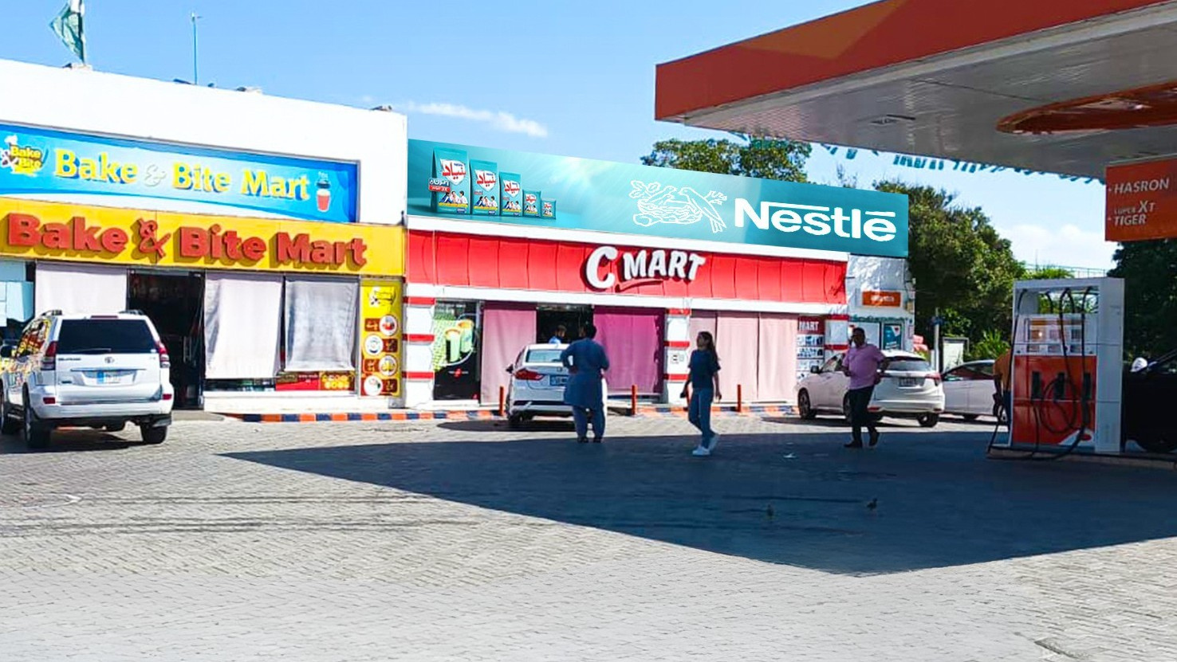
Bhera Rest Area Islamabad To Lahore South Quantity(1)
RATE / MONTHLY
300,000
51 x 5
SIZE
M2 MOTORWAY
Availability : 06-13-2026

Slide 59
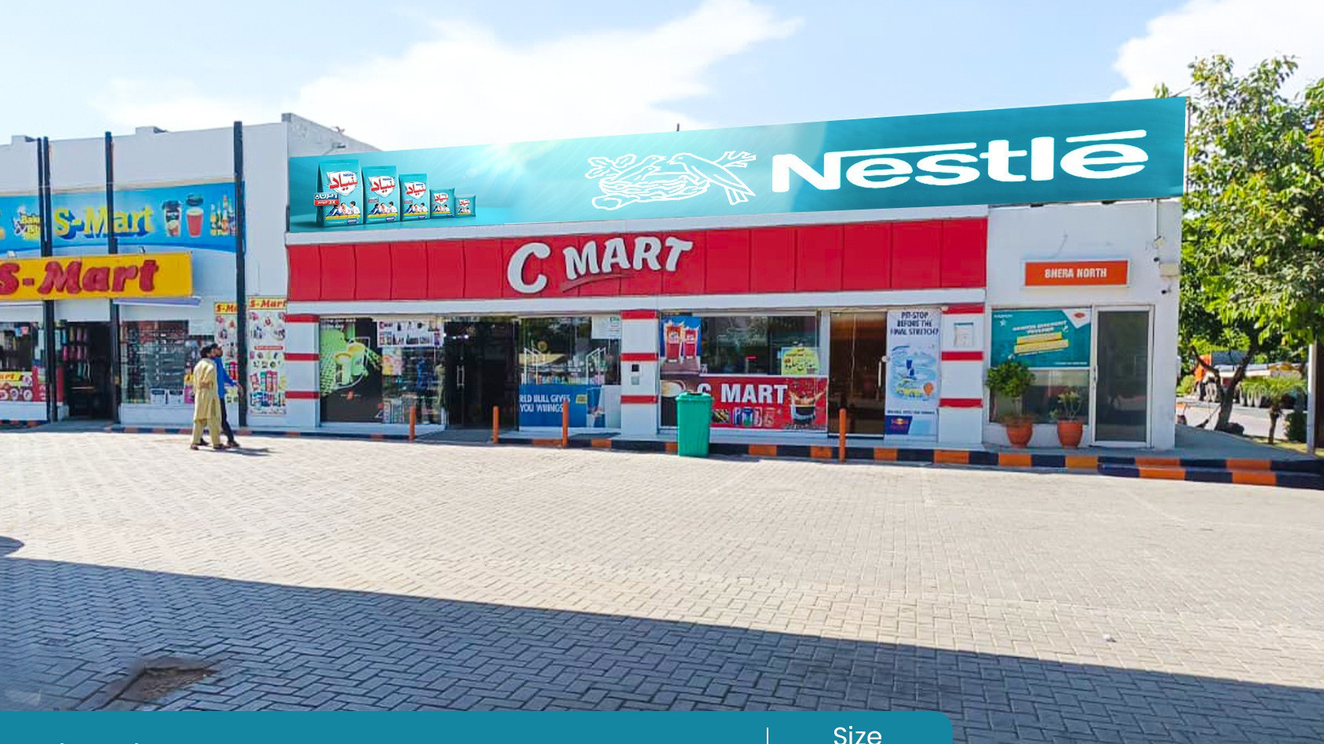
Bhera Rest Area Lahore To Islamabad North Quantity(1)
RATE / MONTHLY
300,000
82 x 5
SIZE
M2 MOTORWAY
Availability : 06-13-2026

Slide 60

Chakri Rest Area Islamabad To Lahore North / South Quantity (2)
RATE / MONTHLY
300,000 Each
43 x 5
SIZE
M2 MOTORWAY
Availability : 06-13-2026

Slide 61

Kallar Kahar Rest Area Islamabad To Lahore North / South Quantity (2)
RATE / MONTHLY
300,000 Each
43 x 5
SIZE
M2 MOTORWAY
Availability : 06-13-2026

Slide 62
TCF MEDIA GROUP · DIGITAL NETWORK PORTFOLIO · 2026
GET IN TOUCH
CONTACT
Let's work
together.
Get in touch.
PHONE
+92 313 455 5444
+92 310 855 5521
WEB
tcfmediagroup.com
OFFICE
Define the View.
46-A XX-Block, Khayaban-e-Iqbal,
DHA Lahore, Pakistan
Pakistan's premium outdoor media network — Billboards, digital streamers,
pylons and motorway billboards. Owned end-to-end.
Notes:
61

