Slide 1
PAKISTAN'S PREMIUM OUTDOOR MEDIA NETWORK
DIGITAL NETWORK PORTFOLIO · 2026
TCF
TAGLINE
Define
the View.
Digital streamers & pylons. Owned end-to-end.
M E D I A G R O U P
TCF MEDIA GROUP
tcfmediagroup.com
MEDIA OWNER · AGENCY · POWERHOUSE
LAHORE · ISLAMABAD · KARACHI
Notes:
1

Slide 2

WHO WE ARE · 01
Media Owner.
Agency.
Powerhouse.
26+
#1
YEARS OF
BILLBOARD
Dominance in OOH
Network in Pakistan
360°
300ft
TCF Media Solutions is Pakistan's only company that combines media ownership with full-service 360° marketing. We own the assets, design the strategy and execute every campaign from idea to impact.
With exclusive rights on M2 Motorway and Pakistan's largest billboard at 300 ft × 30 ft — we don't just advertise. We dominate.
MARKETING
LARGEST
Full-Service Powerhouse
Billboard in Pakistan
TCF MEDIA GROUP
MEDIA OWNER · AGENCY · POWERHOUSE
2 / 28
Notes:
2

Slide 3






WHY TCF WINS · 02
The Unfair Advantages
That Set Us Apart
01
02
03
MEDIA OWNER + AGENCY
EXCLUSIVE RIGHTS
MASSIVE INVENTORY
Unmatched control & agility. No middlemen — we own every asset we advertise on.
M2 Motorway. DHA Lahore and Prime locations — locked.
Pakistan's biggest billboard network including the 300×0 ft largest in the country.
04
05
06
OFFICIAL PARTNER
REAL-TIME EXECUTION
TRUSTED BY GIANTS
Formally partnered with DHA and FWO — Pakistan's most prestigious authorities.
Live campaign monitoring, in-house creative teams, rapid turnaround.
KFC, Coca-Cola, Bahria Town, Gul Ahmed, Shaukat Khanum — and many more.
TCF MEDIA GROUP
THE UNFAIR ADVANTAGES THAT SET US APART
3 / 28
Notes:
3

Slide 4
OUR NETWORK · 03
Pakistan's motorways,
owned end-to-end.
M2
FWO / NHA
FULL M2
AUTHORITY
Lahore → Islamabad
Every Toll Plaza
Contract Partner
Official Rights
TCF Media Group operates Pakistan's most extensive motorway OOH network. Our inventory spans the full Lahore–Islamabad M2 corridor, the LHR–Sialkot M12, and the Swat Motorway into KPK — built in partnership with FWO, the National Highway Authority, and direct rights-holders.
TCF MEDIA GROUP
M2 · M12 · SWAT MOTORWAY
4 / 71
Notes:
4

Slide 5
WHY MOTORWAY · 04
A captive audience,
for four hours straight.
The Lahore–Islamabad M2 is Pakistan's single busiest long-haul corridor. Between 80,000 and 100,000 vehicles travel it every day — and each passenger spends roughly four uninterrupted hours on the road. For a brand, that's the kind of dwell time no urban billboard, radio spot, or streaming ad can match.
80K–100K
~4 HRS
2.4M+
VEHICLES DAILY
EXPOSURE PER TRIP
MONTHLY IMPRESSIONS
on the M2 corridor alone
uninterrupted, captive audience
per premium placement
TCF MEDIA GROUP
WHY MOTORWAY ADVERTISING WINS
5 / 71
Notes:
5

Slide 6
TCF MEDIA GROUP · DIGITAL NETWORK PORTFOLIO
DHA STREAMERS
— SECTION OVERVIEW
01
Lahore
Billboards.
Digital LED streamers running across DHA Lahore's Phase 6 and Phase 8 corridors — premium roadside placements with continuous brand exposure.
DEFINE THE VIEW
tcfmediagroup.com
Notes:
4

Slide 7
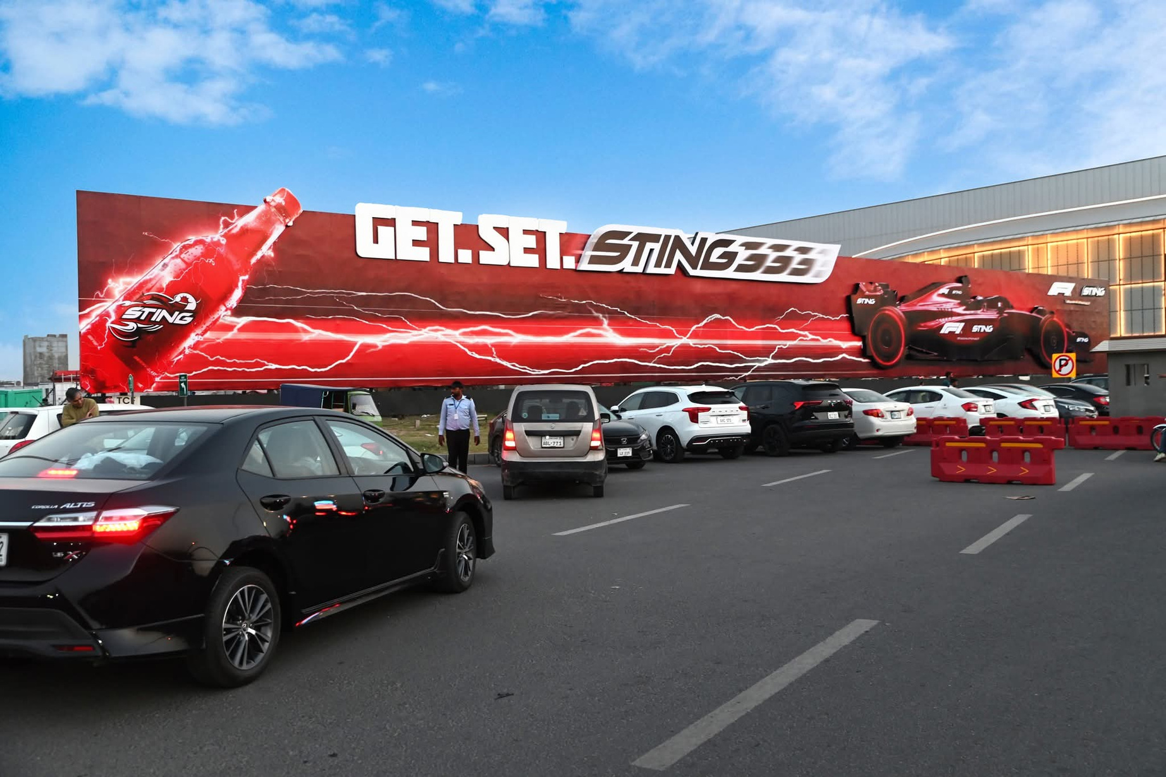

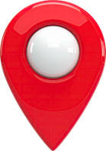
Dolmen Mall Panel DHA Phase 6 Lahore
RATE / MONTHLY
11,000,000
300*30
SIZE
MOV
IDX 801908
Impressions
1,186,129
BILLBOARDS
Availability : 06-13-2026

Slide 8
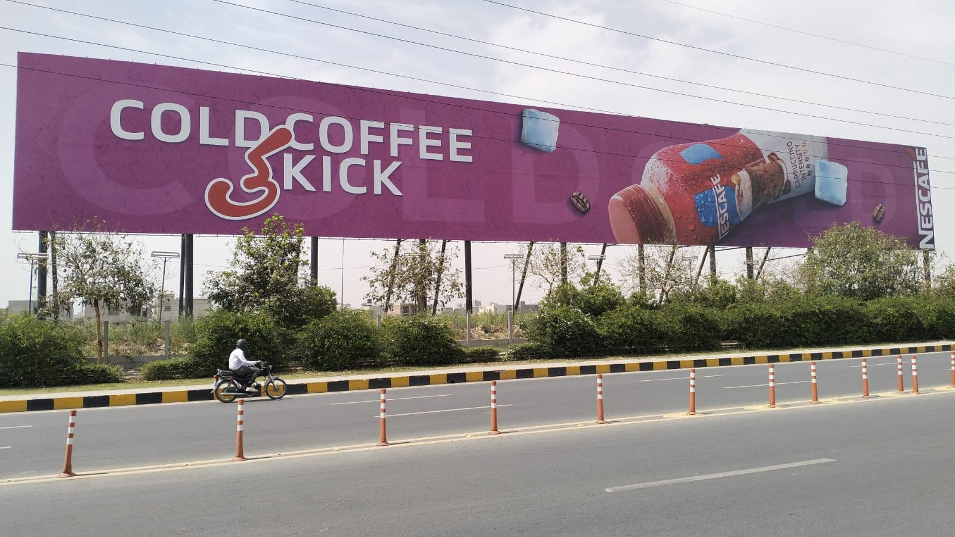
Infront of Spice bazaar DHA Phase 6
RATE / MONTHLY
9,000,000
300*40
SIZE
MOV
IDX 802717
Impressions
1,803,737
BILLBOARDS
Availability : 06-13-2026

Slide 9
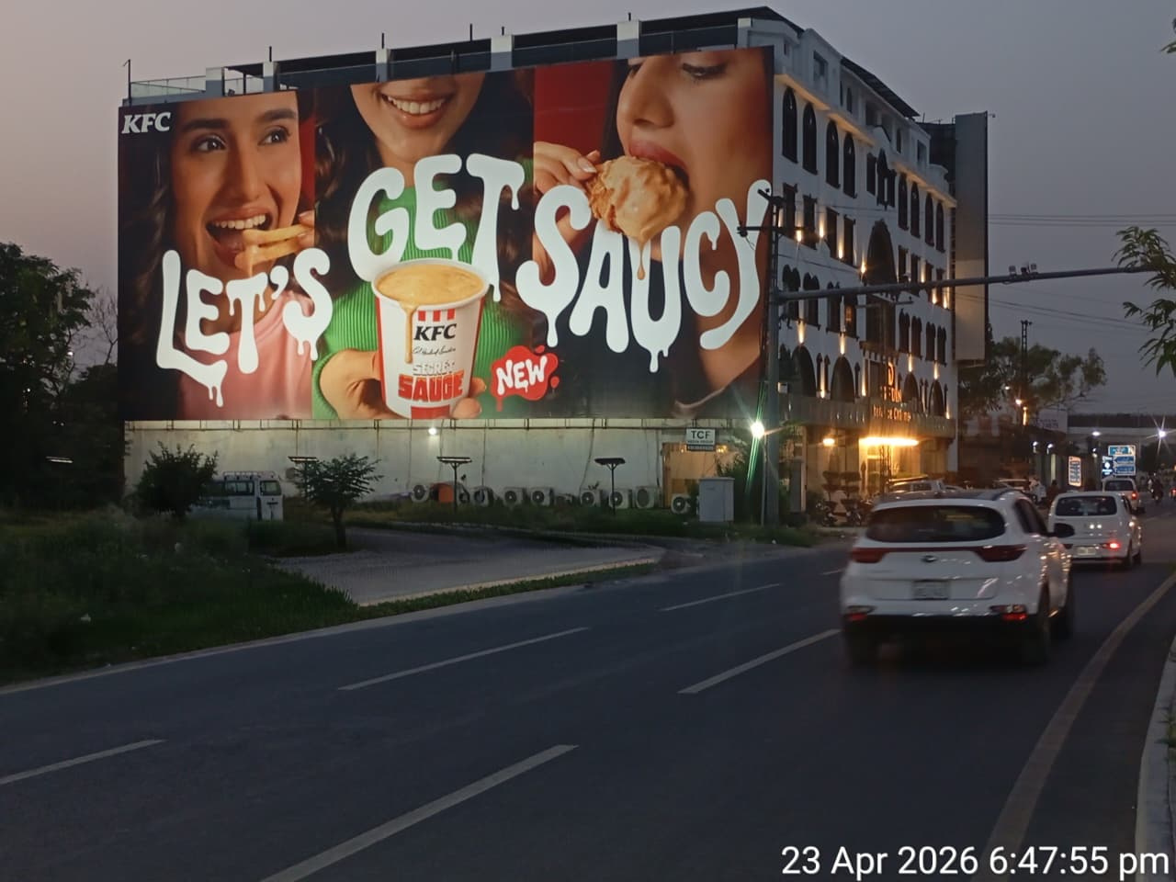
Magnum In Hotel Wall Panel DHA Khayaban-e-Iqbal (TGT Packages Mall)
RATE / MONTHLY
7,500,000
108*50
SIZE
MOV
IDX 800126
Impressions
1,784,909
BILLBOARDS
Availability : 06-13-2026

Slide 10
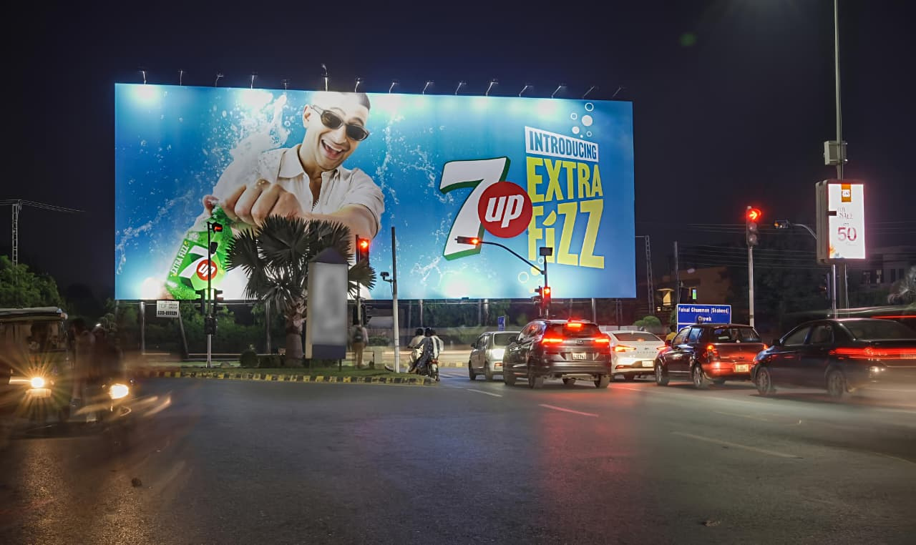
Faisal Ghumman Chowk DHA Khayaban-E-Iqbal Phase 3
RATE / MONTHLY
9,000,000
100*40
SIZE
MOV
IDX 792093
Impressions
1,784,909
BILLBOARDS
Availability : 06-13-2026

Slide 11
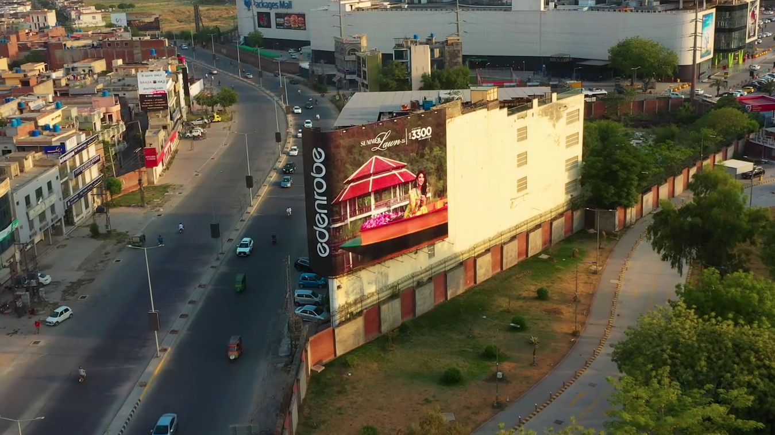
Magnum In Hotel Wall Panel DHA Khayaban-e-Iqbal Entrance
RATE / MONTHLY
2,500,000
100*40
SIZE
MOV
IDX 802104
Impressions
1,803,737
BILLBOARDS
Availability : 06-13-2026

Slide 12
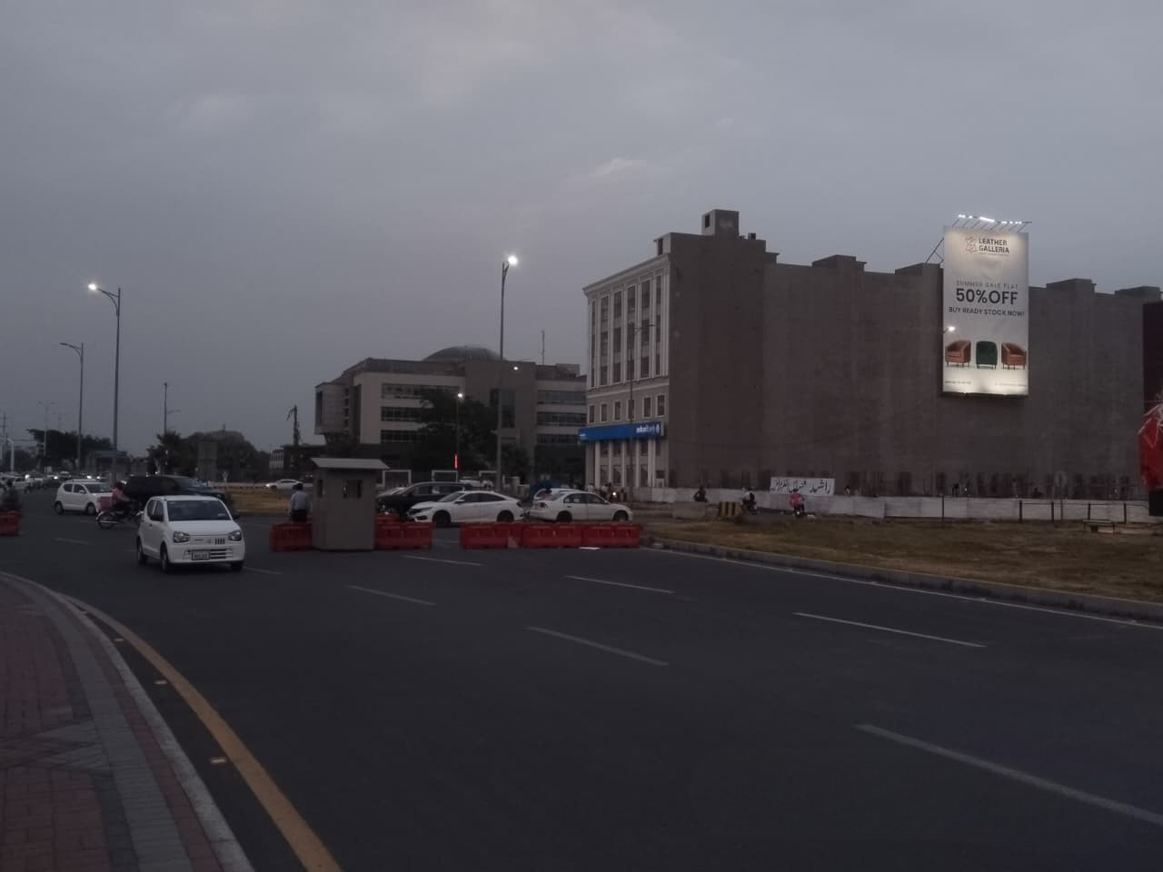
Opposite
Dolmen Mall phase 6 LAHORE
RATE / MONTHLY
2,000,000
30*50
SIZE
MOV
IDX 802716
Impressions
941,046
BILLBOARDS
Availability : 06-13-2026

Slide 13
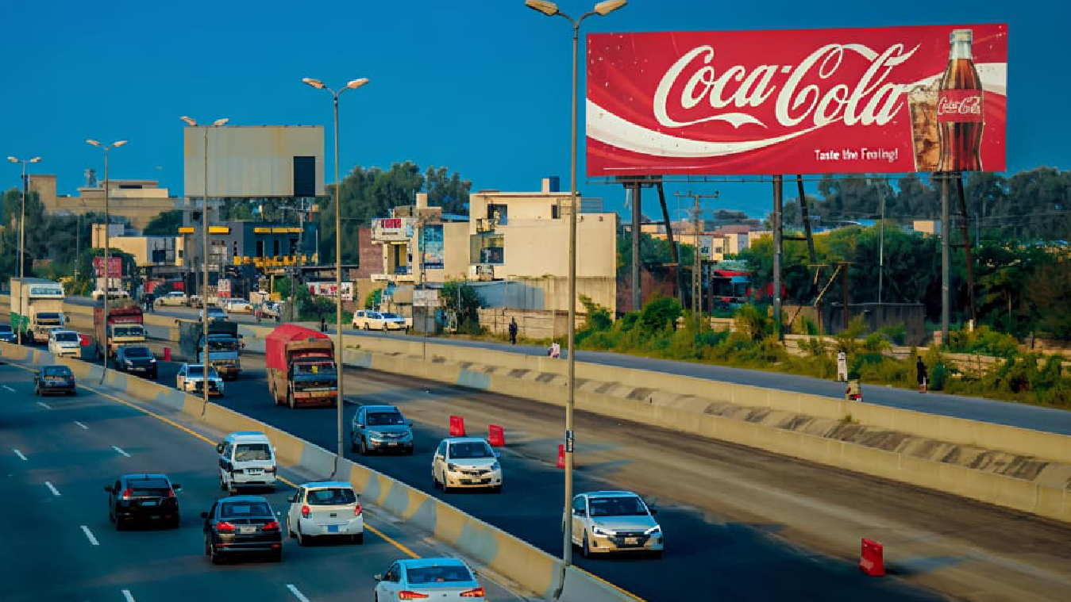
DHA M Block Phase 5 Ring Road TGT DHA Phase 6 / AirPort
RATE / MONTHLY
1,200,000
90x30
SIZE
MOV
IDX 801806
Impressions
1,109,871
BILLBOARDS
Availability : 06-13-2026

Slide 14
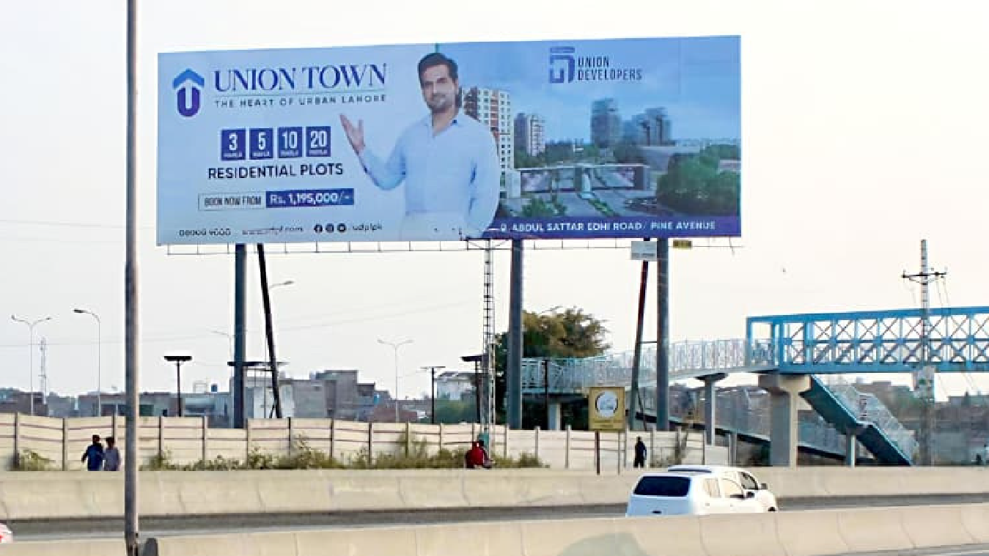
DHA M Block Phase 5 Ring Road TGT Lake City
/ Sui Gas Society
RATE / MONTHLY
1,200,000
90x30
SIZE
MOV
IDX 801807
Impressions
987,495
BILLBOARDS
Availability : 06-13-2026

Slide 15
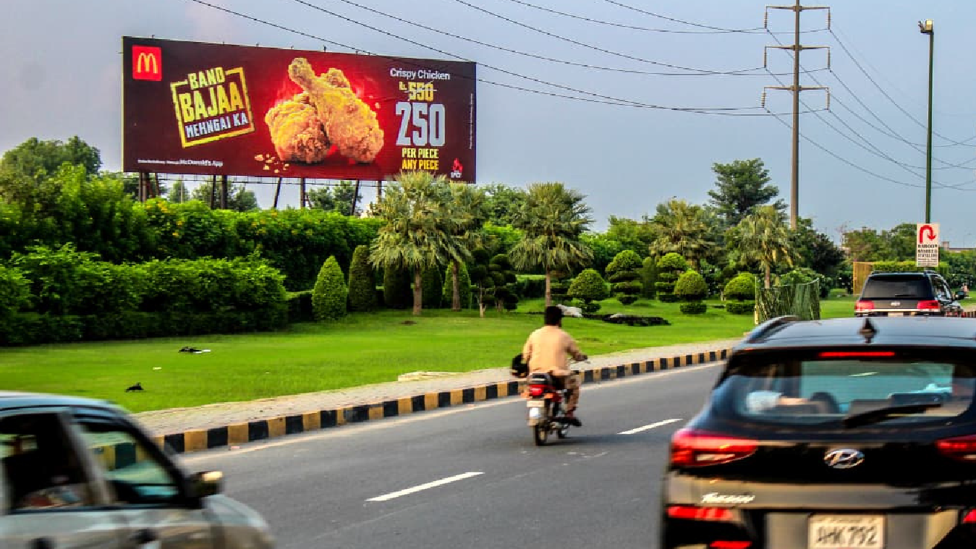
DHA Main Boulevard Phase 6 (Opp.
Commercial Area)
RATE / MONTHLY
2,500,000
100x30
SIZE
MOV
IDX 801944
Impressions
1,109,871
BILLBOARDS
Availability : 06-13-2026

Slide 16
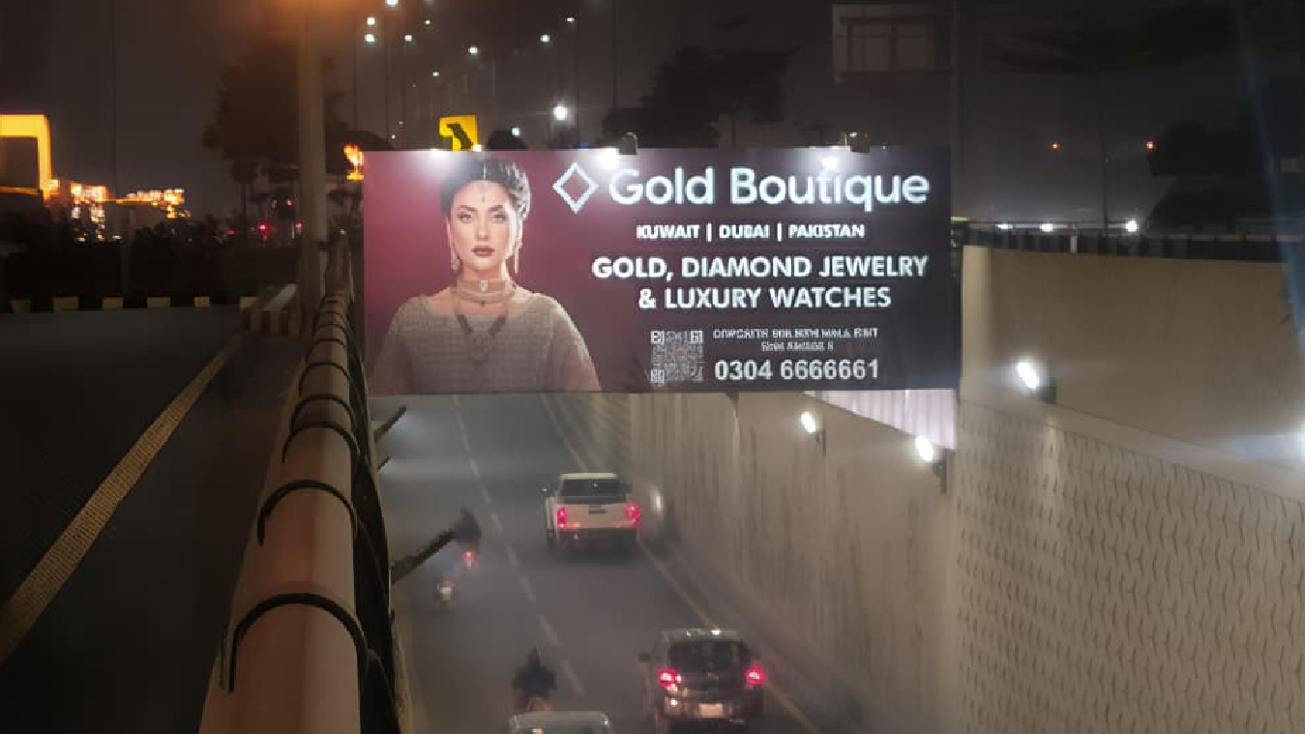
DHA Phase 6 Underpass Traffic Coming from Broadway Chowk
RATE / MONTHLY
1,000,000
24x9.50
SIZE
MOV
IDX 801715
Impressions
1,012,015
BILLBOARDS
Availability : 06-13-2026

Slide 17
TCF MEDIA GROUP · DIGITAL NETWORK PORTFOLIO
DHA STREAMERS
— SECTION OVERVIEW
02
Backlit
Billboards.
DEFINE THE VIEW
tcfmediagroup.com
Notes:
15

Slide 18
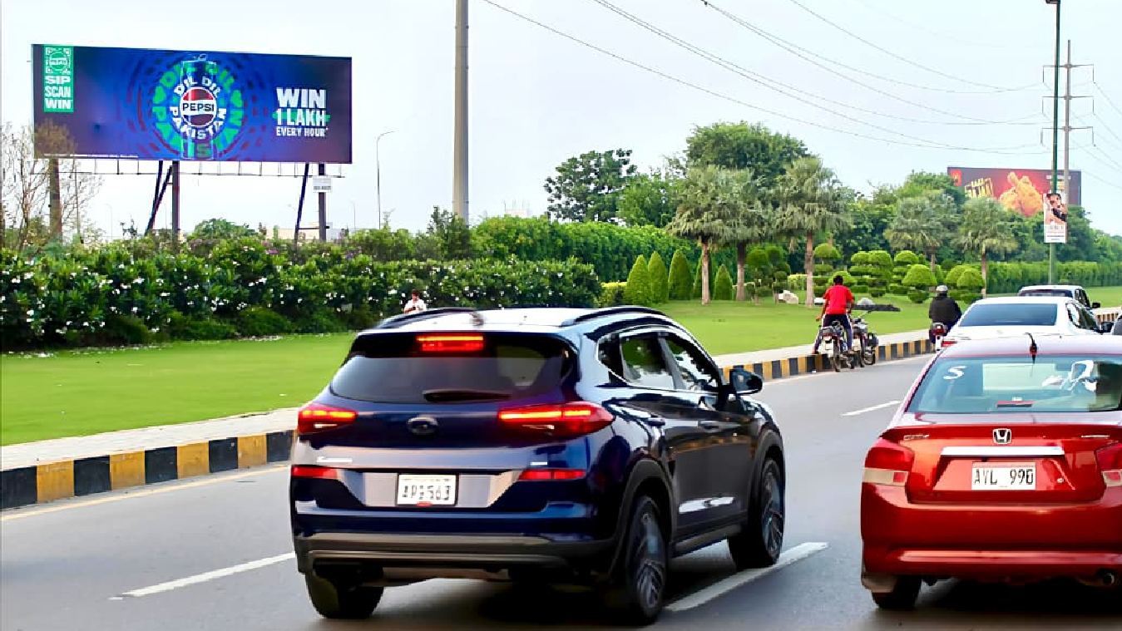
DHA Main Boulevard Phase 6
(Opp. Commercial Area)
RATE / MONTHLY
4,000,000
60x20 Backlit
SIZE
MOV
IDX 802077
Impressions
937,685
BILLBOARDS
Availability : 06-13-2026

Slide 19
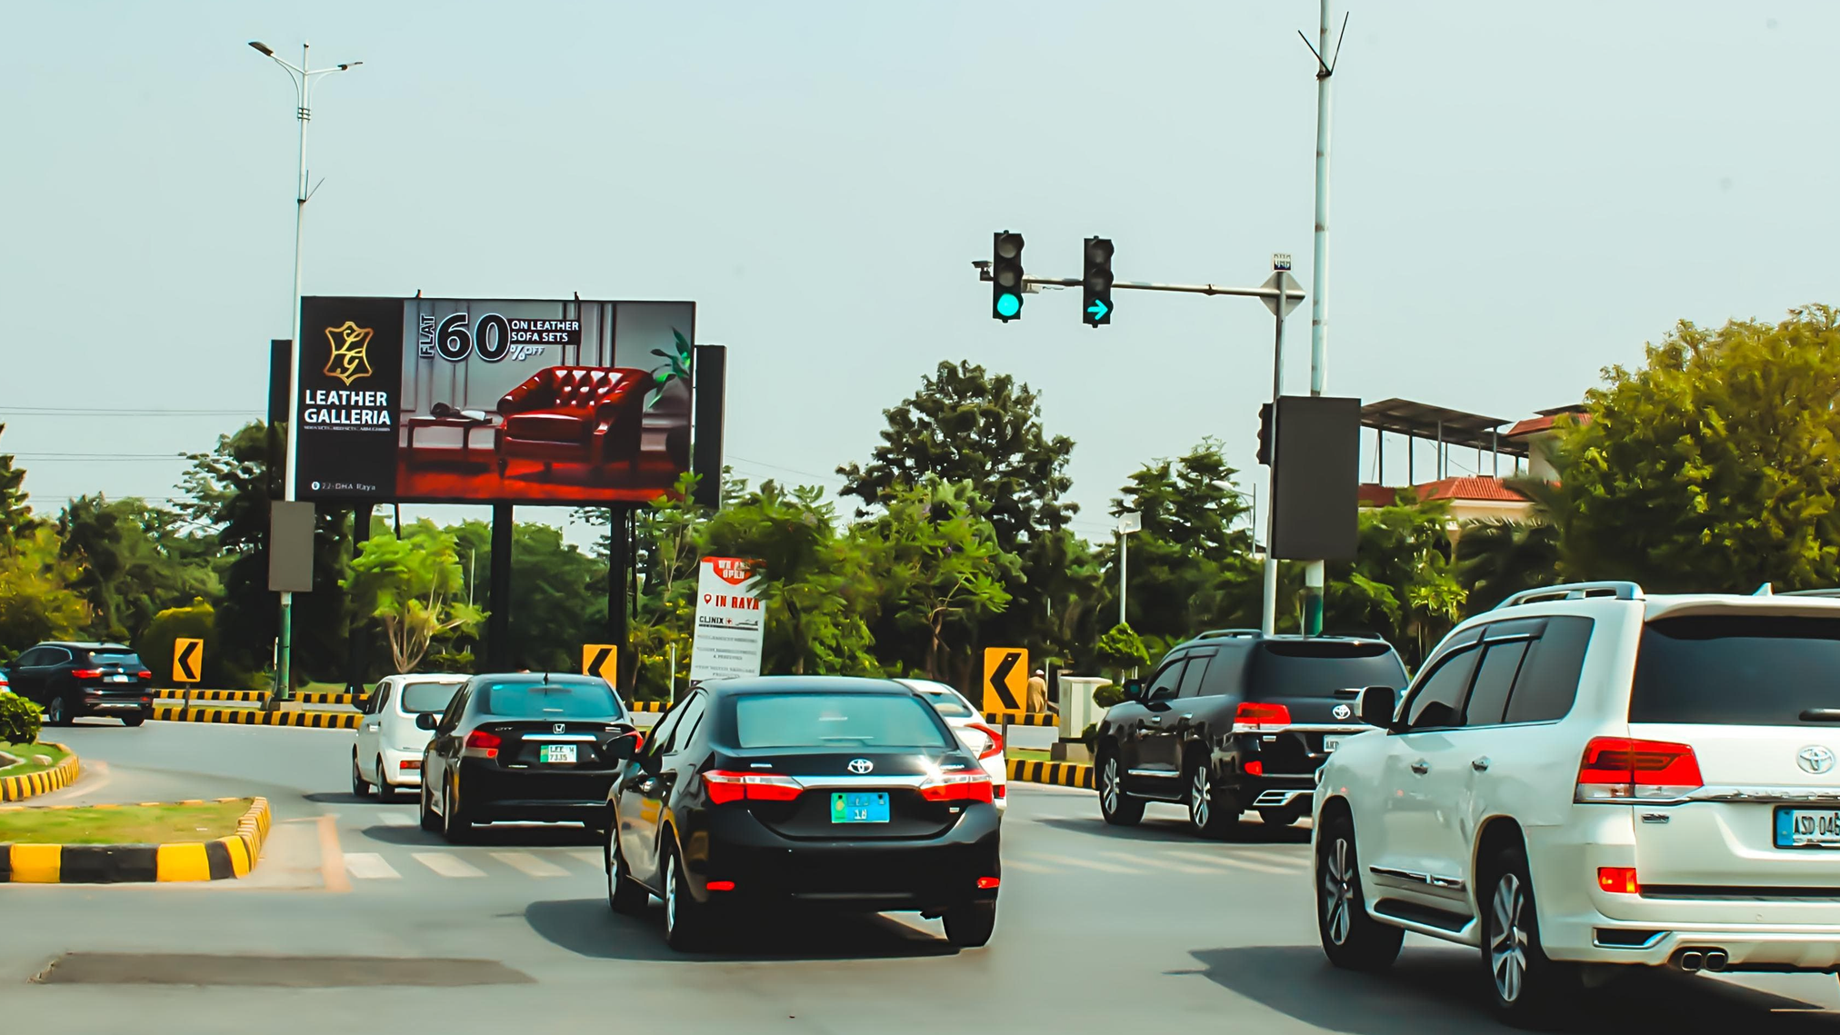
DHA Phase 6 Broadway Chowk Towards
DHA Raya 1st Signal
RATE / MONTHLY
3,000,000
20x40 Backlit
SIZE
MOV
IDX 801651
Impressions
892,119
BILLBOARDS
Availability : 06-13-2026

Slide 20
TCF MEDIA GROUP · DIGITAL NETWORK PORTFOLIO
DHA STREAMERS
— SECTION OVERVIEW
02
Backlit
Pylons.
DEFINE THE VIEW
tcfmediagroup.com
Notes:
18

Slide 21
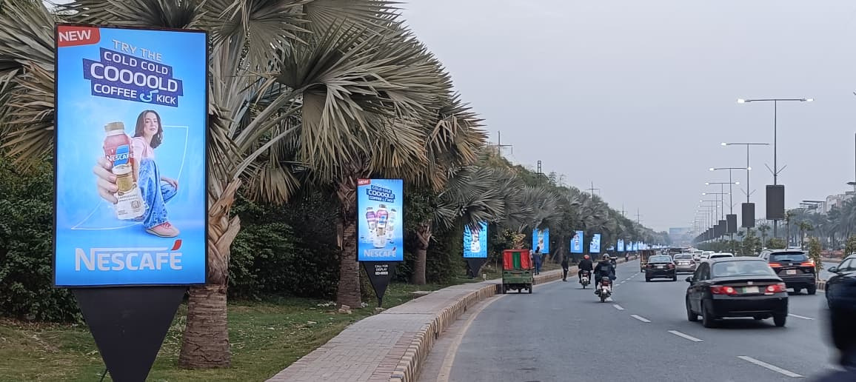
DHA Khyban e Iqbal Road Phase 3 XX
RATE / MONTHLY
RS 40,000/- Each
7x4 Backlit
SIZE
Quantity 30
Impressions
1,531,765
BILLBOARDS
Availability : 06-13-2026

Slide 22
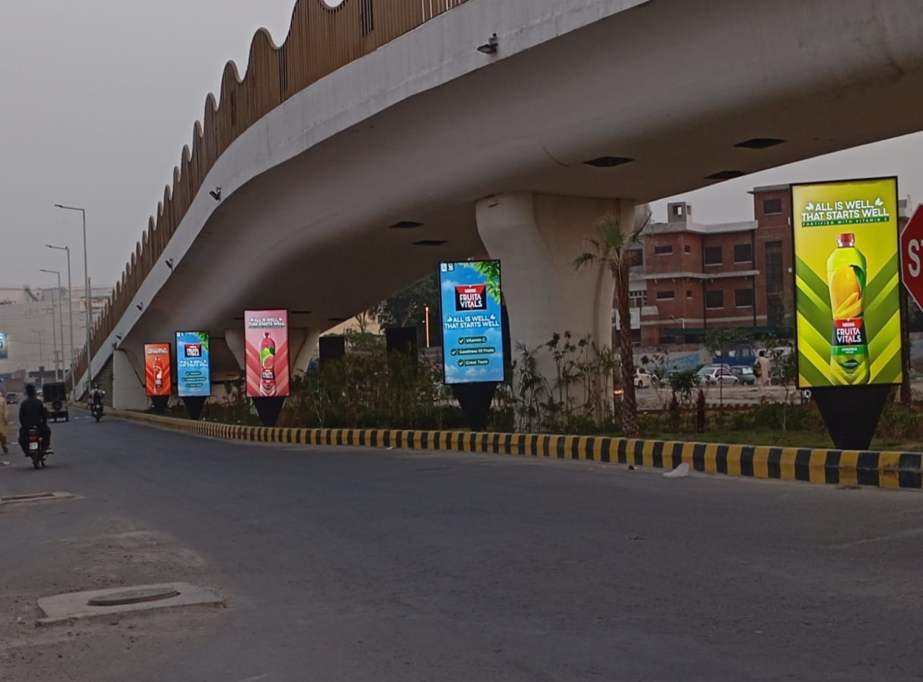
DHA Khyban e Iqbal Road Phase 3 XX
RATE / MONTHLY
RS 40,000/- Each
7x4 Backlit
SIZE
Quantity 10
Impressions
1,512,796
BILLBOARDS
Availability : 06-13-2026

Slide 23
TCF MEDIA GROUP · DIGITAL NETWORK PORTFOLIO · 2026
GET IN TOUCH
CONTACT
Let's work
together.
Get in touch.
PHONE
+92 313 455 5444
+92 310 855 5521
WEB
tcfmediagroup.com
OFFICE
Define the View.
46-A XX-Block, Khayaban-e-Iqbal,
DHA Lahore, Pakistan
Pakistan's premium outdoor media network —Billboards, digital streamers,
pylons and motorway billboards. Owned end-to-end.
Notes:
21

